Slide 1
As research and education becomes more interdisciplinary, how should resources be organised and allocated?
Professor Paul Wellings
Vice-Chancellor, Lancaster University
HEPI : Research Excellence: competition or collaboration in today’s globalised HE sector?
Thursday 2 December 2010

Slide 2
INTERDISCIPLINARY RESEARCH
An old idea rediscovered
Use of methods from many traditional disciplines
Often an attempt to address an important
thematic problem

Slide 3
THE AGE OF MASS INNOVATION
“. . . . . Innovators are those people who know 99% that everybody knows and therefore we are able to create the 1% that nobody knows. If you don’t know the 99%, or cannot get access to it, you will not have the foundation to create the new 1% . . . . .”
Thomas Friedman (2008)
Hot, Flat and Crowded

Slide 4
WHAT IS NEEDED?
Pooling and Connectivity
Rapid Access to Information
External Advice
Greater Programme Level Autonomy
Accessible Funding Streams

Slide 5
NATIONAL RESEARCH PATTERNS
United Kingdom
Japan
(based on data from Elsevier)

Slide 6
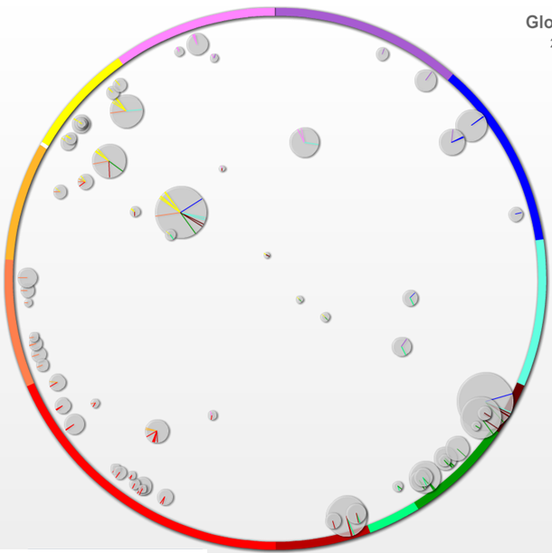
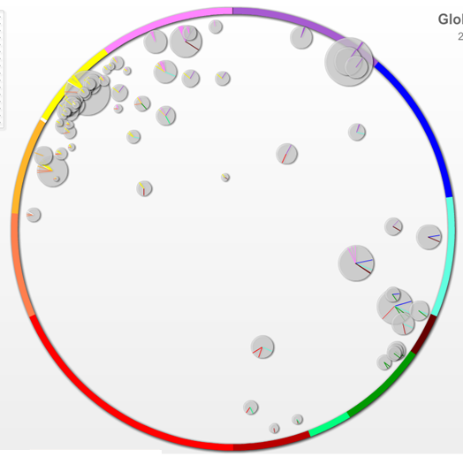
UNIVERSITY RESEARCH PATTERNS
Global 2007
Global 2007
UNIVERSITY A
UNIVERSITY B
(based on data from Elsevier)

Slide 7
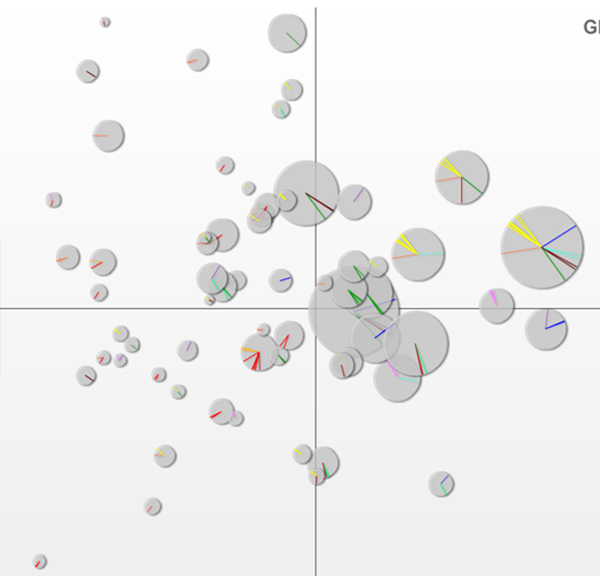
University A’s Research Portfolio : Comparing Growth and Market Share
Competencies to potentially investigate further
Relatively high growth
Lower relative market share

Slide 8
RUSSELL GROUP & 1994 GROUP
COMPETENCIES – Evidence for negative allometry

Slide 9
IMPLICATIONS FROM INSTITUTIONAL
DATA AND SCALING DATA
The national picture is the sum of a variable
landscape of institutional contributions
Within institutions, priorities appear to be aligned
with global positions
Between institutions, bigger doesn’t generate
proportionately more competencies
Connectivity important
Lots of evidence for inter-institutional collaboration

Slide 10
WHAT TO DO – NATIONAL LEVEL
HEFCE Research Funding should continue to target
excellence wherever it is found
DTCs should be encouraged to allocate a
proportion of studentships to interdisciplinary work
Research Councils should monitor emergent
interdisciplinary research streams and invest in some
areas
Thematic research investments should reward
inter-institutional collaboration and engagement
with end users
Programme autonomy and governance should
reflect the complexity of interdisciplinary research

Slide 11
WHAT TO DO – UNIVERSITY LEVEL
Time of ideas to grow to maturity
Openness in debate and criticism
Hospitality towards novelty
Respect for specialist expertise
Flexibility toward interdisciplinary opportunities

Slide 12
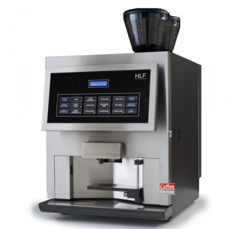
WHEN ALL ELSE FAILS :
Ration the number of locations offering really good coffee in order to increase connectivity and the sharing of ideas.
Thank You

