Slide 1

Enhancing Value Task Force
Getting the Most out of UK Research
Professor Shirley Pearce
5th December, 2012

Slide 2
Task Force Executive Group
Steering Group Co-chairs:
Mr David Eyton, Head of Technology, BP
Professor Shirley Pearce, Former Vice-Chancellor, Loughborough University
Working Group Co-chairs:
Professor Michael Caine, Associate Dean (Enterprise), Loughborough University
Dr Robert Sorrell, VP Public Partnerships, BP
Strategic Partners:
Dr David Docherty, Chief Executive, CIHE
Professor Alan Hughes, Director, CBR and UK~IRC
Assisted By:
Sally Devine, Task Force Coordinator, CIHE
Christopher Ganje, Policy Advisor, BP
www.cihe.co.uk/enhancingvalue

Slide 3



The Task
The group set out to:
Place UK public and private sector research in an EU and global context.
Explore the similarities and synergies between public and private sector research.
Isolate the characteristics of different sectors and explore appropriate sectoral systems of innovation.
Identify and prioritise a small set of key actions for change that will enhance the value of publicly-funded research and collaboration with business.

Slide 4
How does UK Compare…?
£26.4bn invested in UK R&D in 2009……
Has that changed over time and what are other countries doing?
Where does it come from?

Slide 5
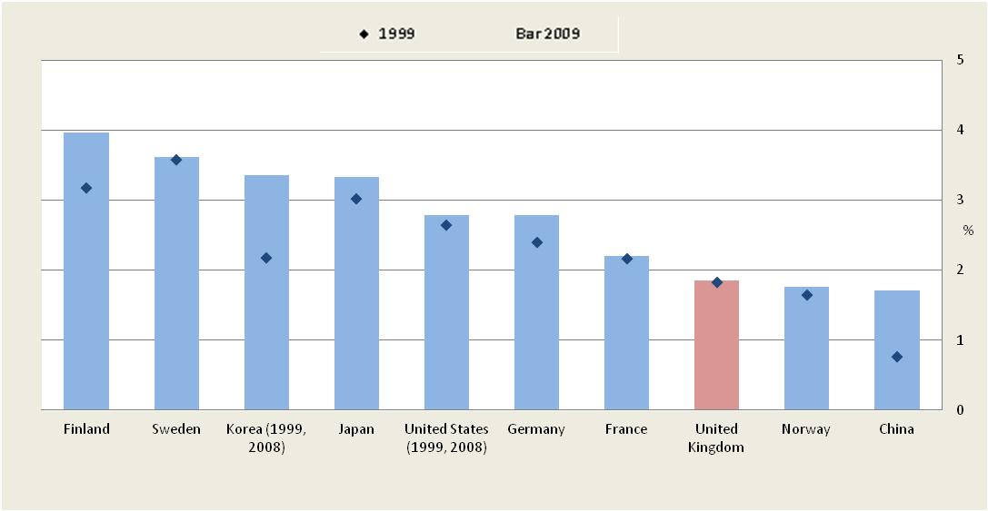
GERD: gross domestic expenditure on R&D, 1999 and 2009 (as % of GDP)
Taken from Task Force Report: The UK R&D Landscape, by Alan Hughes and Andrea Mina
Source: OECD
Notes:
Rest of the world increasing
Show some highlights

Slide 6
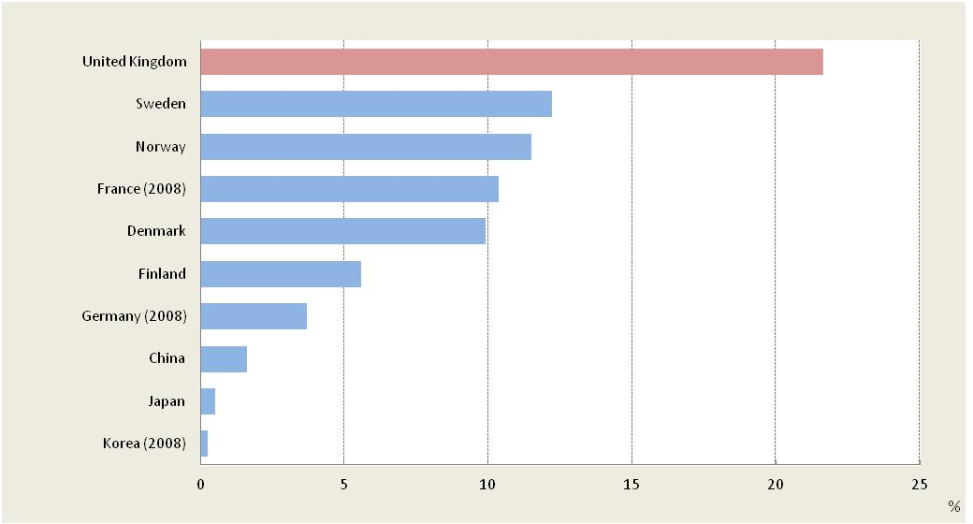
R&D funds from abroad, 2009 (as a % of business enterprise R&D)
Taken from Task Force Report: The UK R&D Landscape, by Alan Hughes and Andrea Mina
Source: OECD
Notes:
How get benefit to uk of this investment …not loose it to overseas countries that are parent country

Slide 7
Size of firms matters…
34% of R&D (BERD) contributed by the 10 largest firms
Only 3.5% contributed by independent small and medium sized firms (not subsidiaries)
So, major corporations and their supply chains are important parts of the innovation system

Slide 8
Large multinationals matter to us…
How do we keep them here?
How do we compare with other countries in terms of government incentives and should we do more?

Slide 9
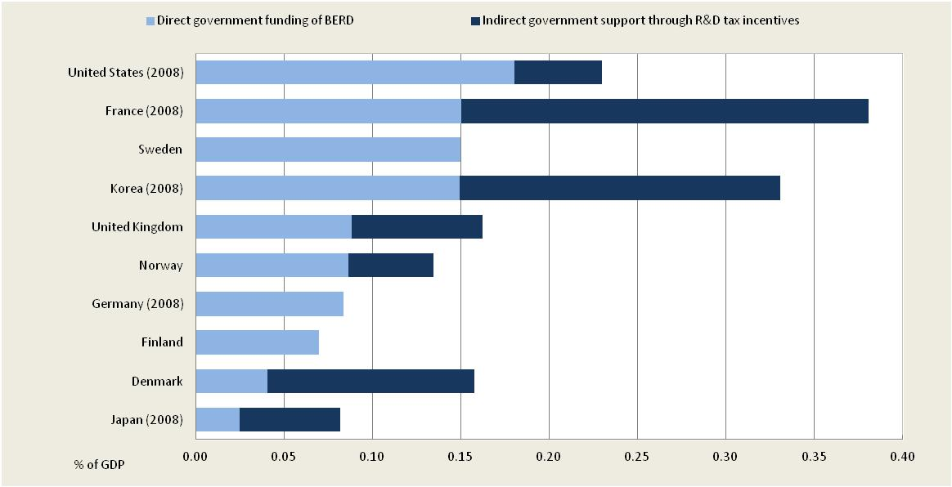
Direct government funding of business R&D and tax incentives for R&D, 2009 (as a % of GDP)
Taken from Task Force Report: The UK R&D Landscape, by Alan Hughes and Andrea Mina
Source: OECD

Slide 10
First report, landscape summary:
There is a ‘funding gap’ compared to international competitors
R&D is concentrated in the large firms and their supply chains and subsidiaries
UK innovation system is ‘open’ and vulnerable.

Slide 11
What is the impact of this expenditure?
Not a simple question
Rate of Return/Return on investment ROI ok for some eg pharma (10-25% over 10-25yrs) but too simple generally…..heroic!
Exploitation of research dependent on businesses having absorptive capacity and investment
Classic systems problem
How do we measure ‘pathways to impact’ and what parts can we influence most?

Slide 12
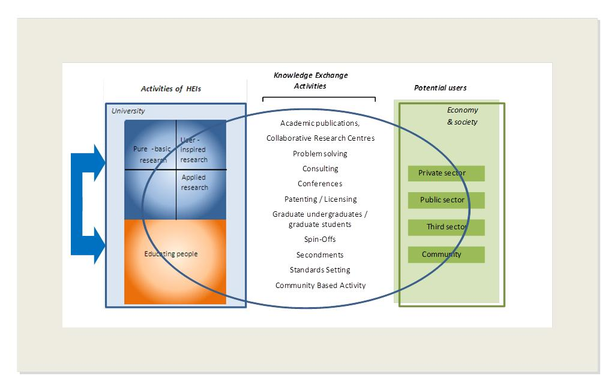
Pathways to impact
Taken from Task Force Report: Enhancing Impact, The Value of Public Sector R&D, by Alan Hughes and Ben Martin
Source: Adapted from Hughes, A., Ulrichsen, T., and Moore, B. (2010) ‘Synergies and Trade Offs between Research, Teaching and Knowledge Exchange’, A Report to HEFCE by PACEC and Centre for Business Research, University of Cambridge, http://www.cbr.cam.ac.uk/pdf/SynergiesFullReport.pdf

Slide 13
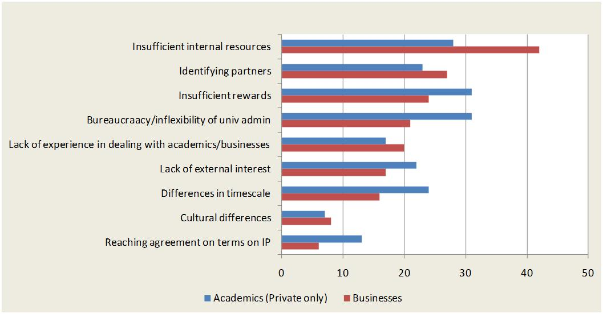
Constraints on Interactions: Businesses and Academics engaged with private sector only (% of respondents)
Taken from Task Force Report: Enhancing Impact, The Value of Public Sector R&D, by Alan Hughes and Ben Martin
Source: Hughes and Kitson (2012)

Slide 14
Universities are doing more
Income from industry growing
KTP scheme successful
Partnerships growing
Spin outs growing…….(basic research)
Relationships matter
But industry does experience frustration with HE…
And vice versa?

Slide 15
Industry comments….
University rules and regulations e.g. confidentiality
IP……
Technology Transfer Office rules
Promotion criteria
Industry is source of ideas not just university
But businesses need to change too…
Investment in interaction with universities
Management of the relationship

Slide 16
Sector variations?
Do different industry sectors have different needs and are the innovation pathways in different?
Understand the heterogeneity…….

Slide 17
Users of Universities as a Source of Knowledge rating them as highly important by industrial sector
Taken from Task Force Report: Enhancing Impact, The Value of Public Sector R&D, by Alan Hughes and Ben Martin
Source: Cosh and Hughes (2010)

Slide 18
Can we improve our understanding of differences between sectors?
CDIT
Construction
Energy
Pharmaceuticals and Biotech
The research team carried out 71 interviews with top-level sources from both large and small firms, universities, government/regulators and charities.

Slide 19
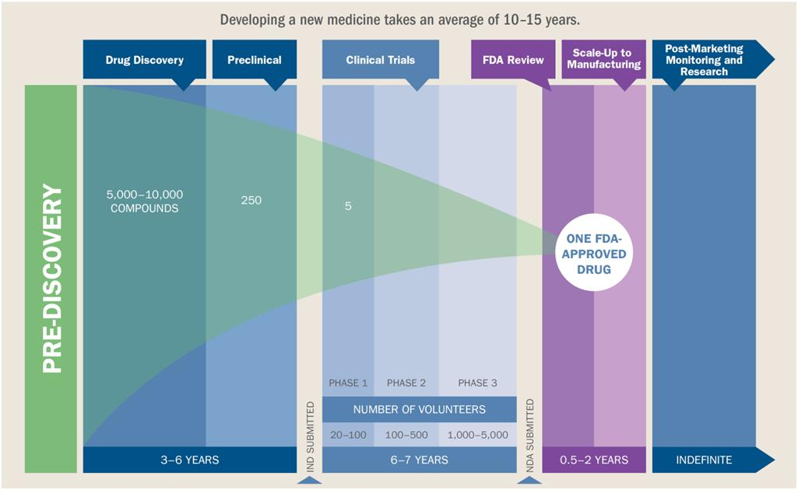
The Research and Development Process: Pharma
Taken from Task Force report: Enhancing Collaboration, Creating Value, By Andrea Mina and Jocelyn Probert.
Source: PhRMA (2011)

Slide 20
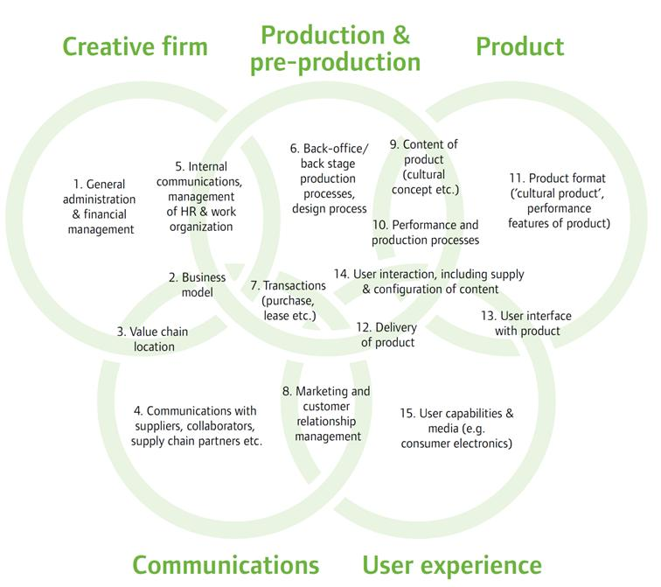
Sites of Innovation in the Creative Industries
Taken from Task Force report: Enhancing Collaboration, Creating Value, By Andrea Mina and Jocelyn Probert.
Source: Miles & Green (2008)

Slide 21
Recommendations:
Final report out 10th December
Small number of recommendations focusing on:
Maintaining quality of research base
Keeping large multinationals here in UK for R&D
Understanding sector differences
Strengthening university business interactions

Slide 22


Supported by

Slide 23
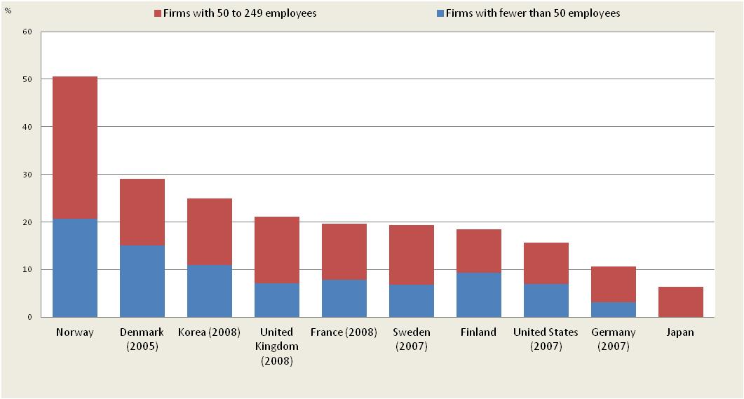
Business R&D by size class of firms, 2009 (as a % of total BERD)
Taken from Task Force Report: The UK R&D Landscape, by Alan Hughes and Andrea Mina
Data source: OECD

Slide 24
How do we compare with USA
Cosh and Hughes 2010 survey 3,500 UK and USA businesses in 2004/5
What sources of knowledge do you use for innovation?
How do you value universities as sources of knowledge?

Slide 25
Frequency of Use by Sources of Knowledge UK and US
A slide each please of exhibit 12 and 13 from second report
Taken from Task Force Report: Enhancing Impact, The Value of Public Sector R&D, by Alan Hughes and Ben Martin
Source: Cosh and Hughes (2010)

Slide 26
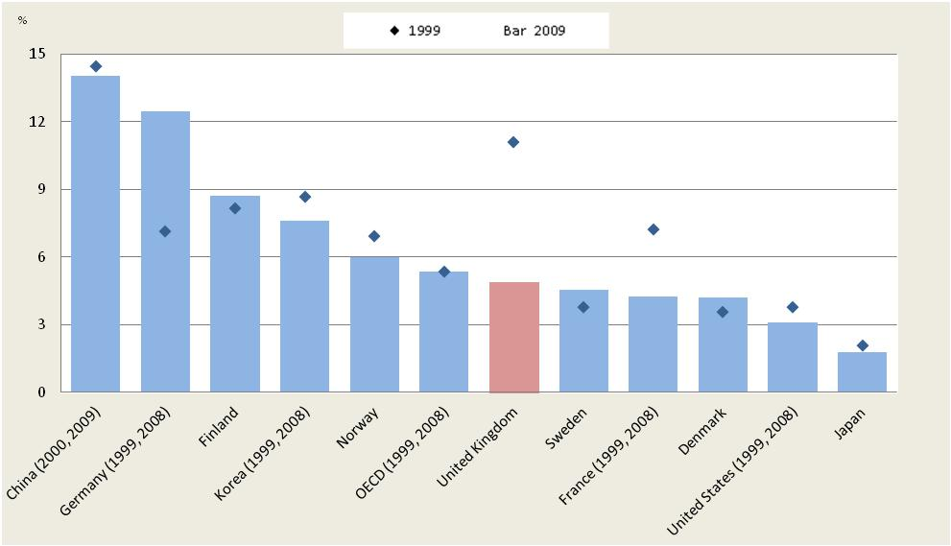
Business-funded R&D in the higher education and government sectors, 1999 and 2009 (as a % of R&D performed in these sectors (combined))
Taken from Task Force Report: The UK R&D Landscape, by Alan Hughes and Andrea Mina
Source: OECD

Slide 27
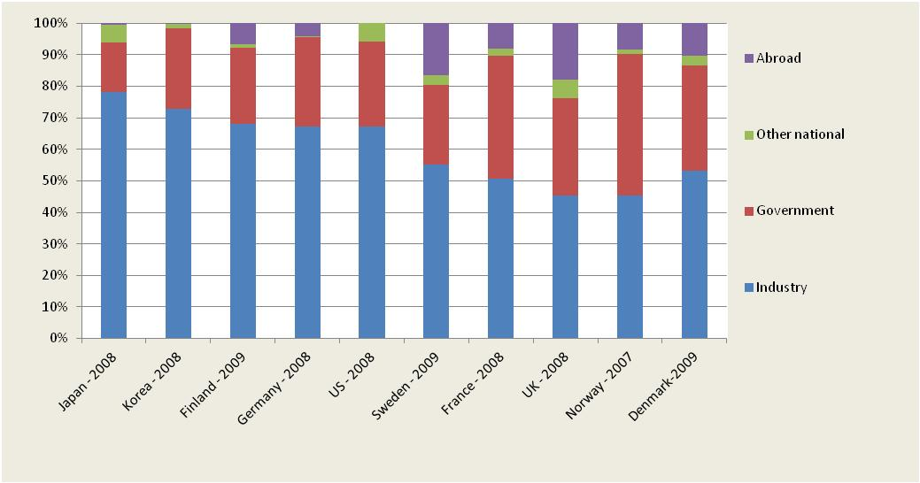
Funding of GERD (latest available year)
Taken from Task Force Report: The UK R&D Landscape, by Alan Hughes and Andrea Mina
Source: OECD

