Slide 1
Creating Collaborative Advantage
Effective university and industry partnerships
Brian Fender
Institute of Knowledge Transfer
December 5th 2012

Slide 2
Key words
Innovation
Knowledge Transfer
Autonomy
Strategy
Facilitation
Individuals
Communication

Slide 3
Innovation
Knowledge
+
SKILL
+
+
CREATIVITY
Outcome
Problem
The innovation environment

Slide 4
Outcomes Benefit
The territory of knowledge transfer
Outcomes
Development; Use in a new field; Feed entrepreneurs
Benefit (Impact)
Economic or social

Slide 5
Innovation and Improvement
Outcome
+
SKILL
+
+
CREATIVITY
Benefit
Problem
The innovation environment

Slide 6
How Industry meets Universities (1)
    Research Teaching/Training/Service
    Economy ← Knowledge Transfer → Society
    Markets, Industry Public Funding
Strategy
Facilitators

Slide 7
Elements of a strong KT strategy for Universities and Research Institutes
Alignment with mission and vision and widely communicated
Strong engagement of the senior management team
Interaction with the University Council or Governing Body
The relation of KT to research and teaching or service activities
Inclusion of KT in the budgetary planning process
A portfolio of policies which refer to:
  faculty / staff engagement in consultancy and start-up companies.
  rewards and incentives to participate in KT including reference to promotion criteria.
  start-up companies, investment and exit strategies.
  ethical matters relating to engagement with outside bodies.
The role of entrepreneurship education and the support of entrepreneurs
The structure and organisation of the knowledge transfer office(s)
The relationship between a central KT office and individual faculties/divisions
Monitoring of performance indicators
Targets for future performance

Slide 8
How Industry meets Universities (2)
    Teaching/Training/Service Knowledge Transfer →
    Research
    Markets, Industry Public Funding
Strategy
Facilitators

Slide 9

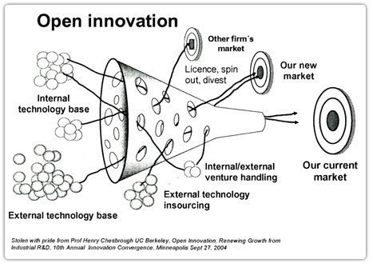
Conceptualising Innovation

Slide 10
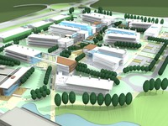
Triple Helix interactions requires facilitators and agencies
Applied research Institutes
  Fraunhofer-Gesellschaft (Germany); NTO (Netherlands); A*(Singapore);
  AIRTO (UK)
Thematic Clusters
  Silicon valley
  Science Parks
    Stevenage –GSK et al; European Marine Institute
  Tech City
Government induced collaborations
  KTPs; Catapults, Catalyst programmes
Intermediate companies
  Biotechnology companies; university KT companies; spin-outs
Patent Offices
  IP law firms

Slide 11
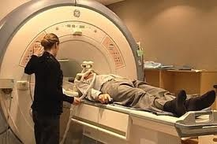
BTG Story
Formed in 1981 as British Technology Group from an early life as the National Research Development Corporation with a role of commercialising publicly funded R&D.
Successes Cephalosporin, MRI, and pyrethrins.
Privatised in 1992; floated on stock market
1995
Facilitated collaboration between universities and industry through development and licensing of IPR
Inadequate business model migrated from general commercialisation of IPR→ biotechnology → specialised pharmaceutical company. Cap £1.1b

Slide 12
Interacting Players
Independent -
Increasingly
Interacting
Chesbrough
‘Open Innovation’
Etzkowitz
‘Triple Helix’
Social and Economic Markets
Government
Policy & Funding
Universities
Research Institutes
Hospitals
Intermediates &
Facilitators

Slide 13
Drivers for Innovation &
Knowledge Transfer
Global challenges
Global competition; job creation
Knowledge creators desire to be useful
Open Innovation
Explosion in digital Information and communication
Vibrant innovation environment
Knowledge Transfer/Exchange processes
  IPR based
  People based
    research collaboration and contracts; consultancy,; tailored CPD; Knowledge Transfer Partnerships
Strategic Partnerships

Slide 14
Framework Funding Billion Euros
1984-8 to 2006-13

Slide 15
Universities World Ranking a UK strength
Top 30 universities THE Shanghai Jiao Tong
US 20 (1) 22(1)
UK 4 (2) 4 (5)
Canada 2 (21) 1 (26)
Switzerland 1 (12) 1 (23)
Japan 1 (27) 2 (21)
Australia 1 (28) -
Singapore 1 (29) -
100 Europe 33(UK 11) 33 (10)

Slide 16
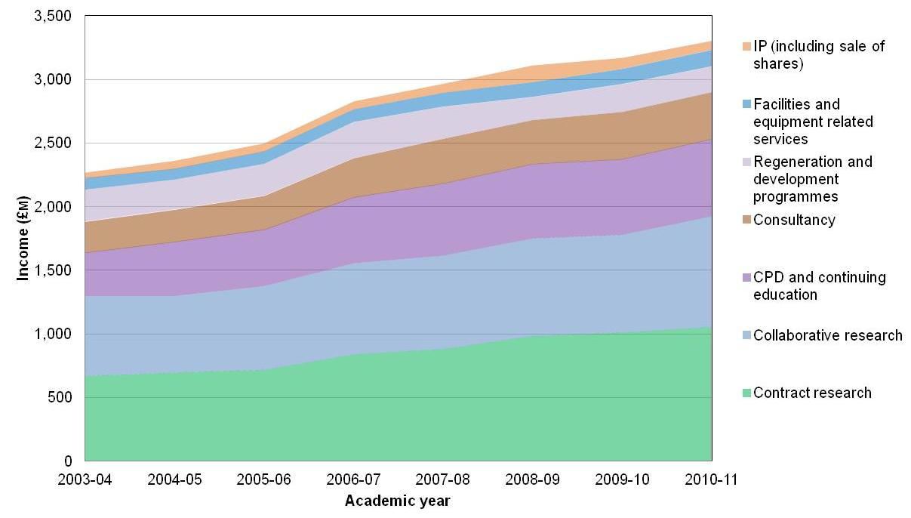
Knowledge Transfer/Exchange Income

Slide 17
R&D as percentage of GDP; no. researchers pm
2012 World Bank statistics
Country % Trend Researchers Trend
Israel 4.27 down na na
Finland 3.84 level 7647 level
Sweden 3.62 level 5018 level
Japan 3.45 level 5189 down
Korea Rep. 3.36 up 4947 up
Germany 2.82 up 3780 up
US 2.79 up 4673 -
France 2.23 up 3690 up
Canada 1.95 up 4335 -
UK 1.82 level 3794 down
Netherlands 1.80 level 2818 down
China 1.47 up 1199 up

Slide 18
UK R&D Strengths and Weaknesses
European Context (millions euros); Top 1000 companies
Sector Total Euro R&D UK R&D %
Oil and gas 2529 1355 53.6
Food Processing 2097 1021 48.6
Pharmaceuticals 20966 8060 38.4
Support Services 983 350 35.6
Banks 5486 1843 33.6
Media 1847 528 28.6
Fixed&Mob comms 4569 1308 28.6
Biotechnology 1496 387 25.9
Software 4441 1035 23.3
Aerospace & defence 8295 1154 18.6

Slide 19
UK R&D Strengths and Weaknesses
European Context (millions euros); Top 1000 companies
Sector Total Euro R&D UK R&D %
Household goods 1377 212 15.4
General Industries 1756 252 14.4
Computer Services 1066 148 13.9
Health Care & Equip. 2157 123 5.7
Electricity 1728 82 4.7
Industrial Machinery 4345 197 4.5
Leisure Goods 1966 62 3.1
Chemicals 7607 202 2.7
Construction & Materials 1405 33 2.3
Commercial Vehicles 2708 41 1.5
Automobiles & P 30197 162 0.5

Slide 20
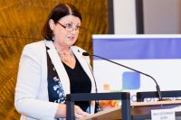
Country Participation in Framework programmes 2007-11(March)
Country Euros b Euros per head
Germany 3.205 39.4
UK 2.897 45.9
France 2.373 36.2
Italy 1.616 26.4
Spain 1.279 27.1
Maire Geoghegan-Quin Netherlands 1.331 79.5
EU Commissioner Sweden 0.797 87.5
for Innovation & Greece 0.496 46.0 Research Finland 0.451 85.7
Ireland 0.264 56.0
Latvia 0.015 6.8

Slide 21
Consequences of FP7 2012 for
European economy and employment
A. Fougeyrollas, P. Le Mouel and P Zagame
Impacts from a one-off shock induced by the FP7 call
EU investment in research and innovation (€ billions) 7
Total public and private investment in research and
innovation (€ billions)
12.18
Jobs creation – short term 174000
Cumulative Job creations after 15 years 449000
Cumulative GDP growth (€ billions) after 15 years 79.4
Multiplier effect of 2012 investment in research 6.5

Slide 22
UK Government Initiatives
UK Research and Investment Partnerships
  £300m with 2x co-funding
    Enhance research facilities of HEIs; encourage strategic partnerships between HEIs and others; stimulate additional investment In HE research; strengthen the contribution of the research base to economic growth
Catapult scheme
  £200m centres of excellence to ‘bridge the gap between business academia, research and government’
    High value manufacturing; cell therapy; off-shore renewable energy; satellite applications; connected digital economy; future cities and transport systems.
University Challenge Seed Fund
Knowledge Transfer Partnerships 1975→regularly reviewed

Slide 23

Challenges to Management
‘Modern Management has reached the limits of improvement‘ -Hamel
…..Ensure that the work of management serves a higher purpose
Reduce fear and increase trust
De-structure and disaggregate the organisation
Reinvent strategy making as an emergent democratic process
Create internal markets for ideas, talent and resources
Expand and exploit diversity
Develop holistic performance measures
Stay very close to customers and stakeholders….

Slide 24






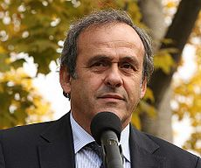
Think Diversity; Think Footballers

Slide 25
People for University – Industry Collaboration
Core competencies
Good communication and interpersonal skills
Management skills
Commercial awareness
  New business development skills
  Negotiating skills
  Understanding of IP and licensing
  Discipline/industry specific knowledge
  Understanding business (and innovative) model options
Personal CPD plan
Personal Networking - use of social network skills
Creation of Networks to build collaboration
Includes Key elements of Education programme for Certified Trans- national TT professionals EC report August 2007
Notes:
25

Slide 26
University – Industry Collaboration
Communication Essentials
Databases of research and CPD activity
Easily navigated web site – backed by social media
Single contact point for new callers
Opportunities for face to face as well as e communication
Stories

