Slide 1

University Research and the Economy
Alan Langlands
HEPI conference
5 December 2012

Slide 2
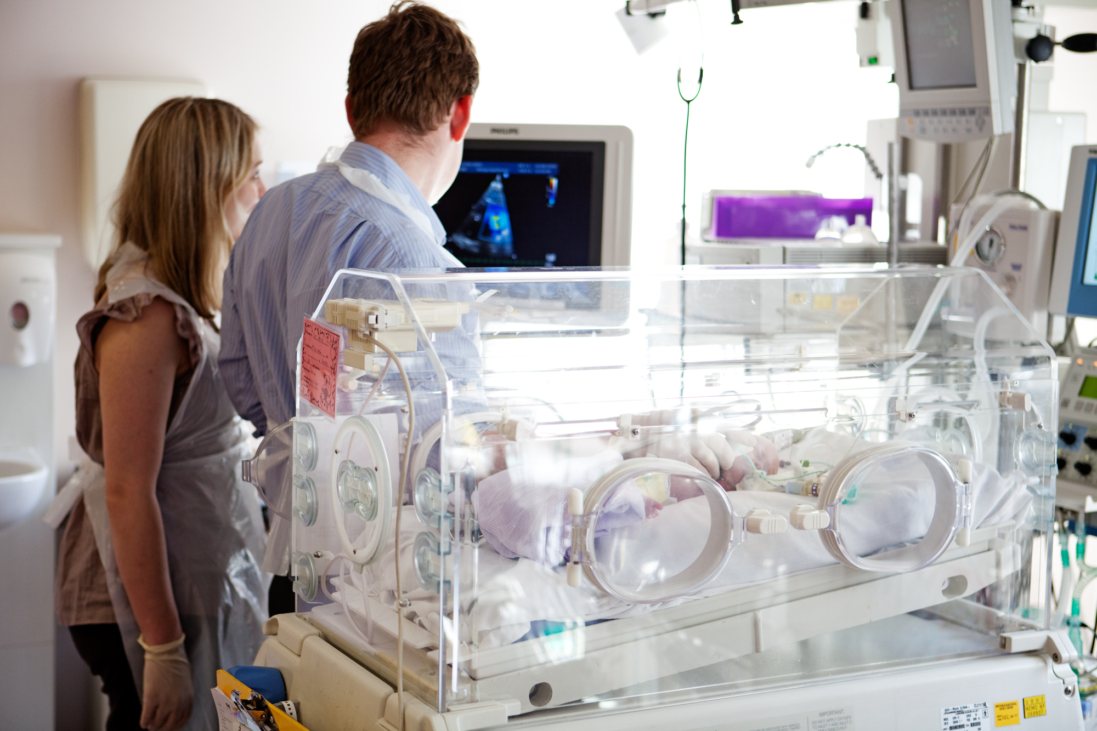
St Michael's Hospital NICU, Bristol (Cots for Tots Appeal )

Slide 3

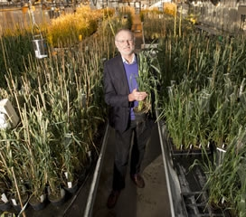



Slide 4

How HEFCE supports economic growth

Slide 5
  Highest public interest priorities:
  Selective, performance based funding:
STEM
Specialist institutions
Study time abroad
Postgraduate education
QR
Capital funding
HEIF

Slide 6

Strong foundations
  2nd in the World for research excellence and the most efficient in the G8
  2nd for university - business collaboration and 3rd for the quality of scientific research institutions
  HE – UK’s 7th biggest export industry
  Ring-fenced funding (£4.6bn) and around 15% European research funding

Slide 7

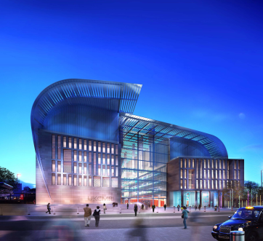

Slide 8
HEI sources of income
(2008-9 to 2014-15)

Slide 9
CONTEXT
The Growth imperative
  ‘to achieve strong, sustainable and balanced growth’
The Plan for Growth
HMT 2011
  ‘a competitive business sector needs excellent universities to produce the graduates, postgraduates, research and innovation… required to drive economic prosperity’
Stronger Together
CBI 2009

Slide 10
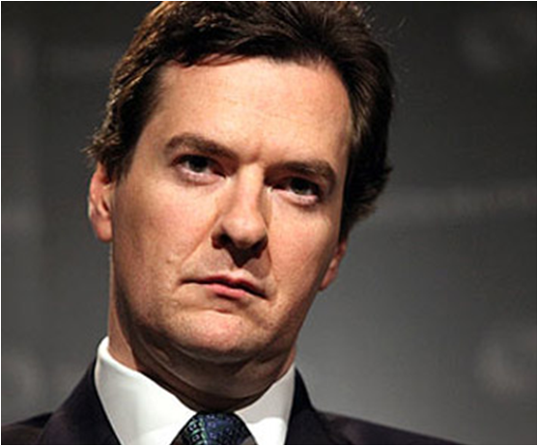

Elevator pitch

Slide 11

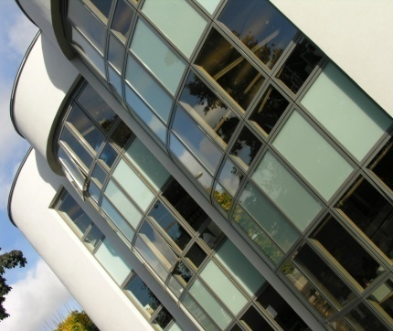
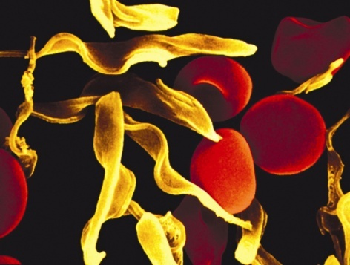
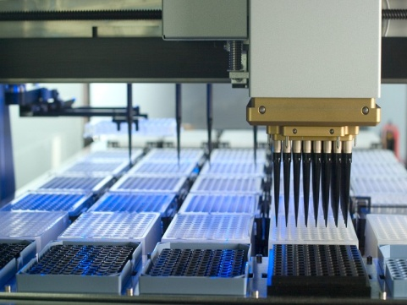
RESEARCH
Pre-requisites for success
Sustaining the balance between curiosity driven research and national priorities
A long-term commitment of funding: dual support / QR
Investing in infrastructure and human capital
Vibrant postgraduate and postdoctoral communities
A research assessment process that stimulates excellence and commands confidence: [REF]

Slide 12
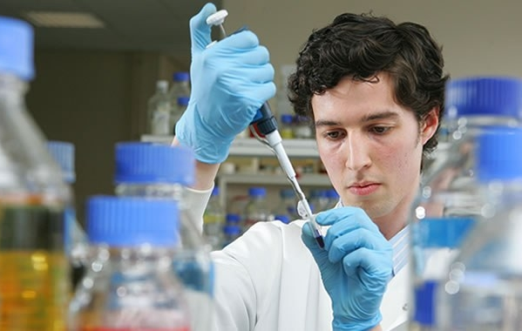

UK Research Partnership Investment Fund

Slide 13
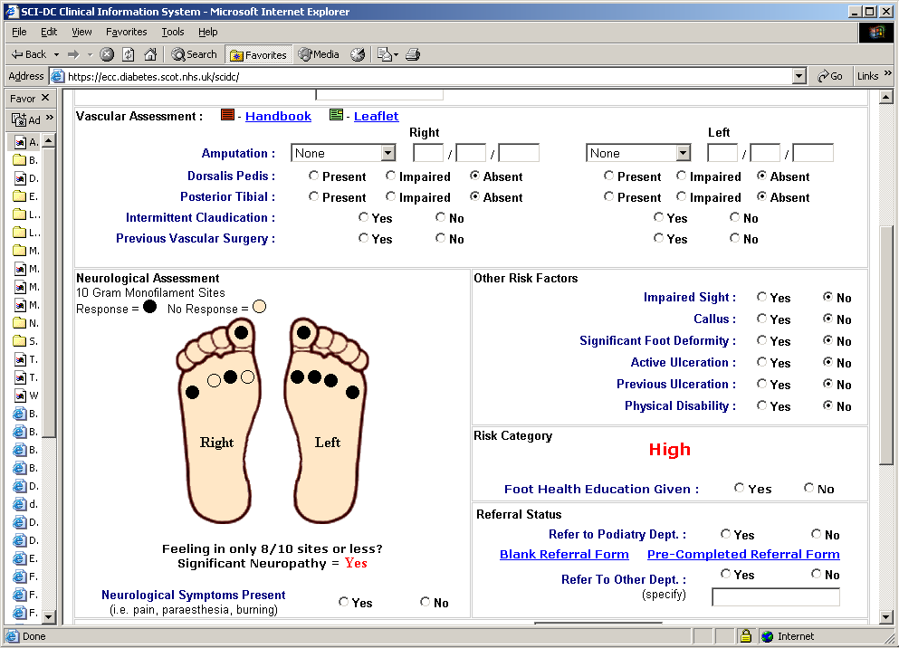

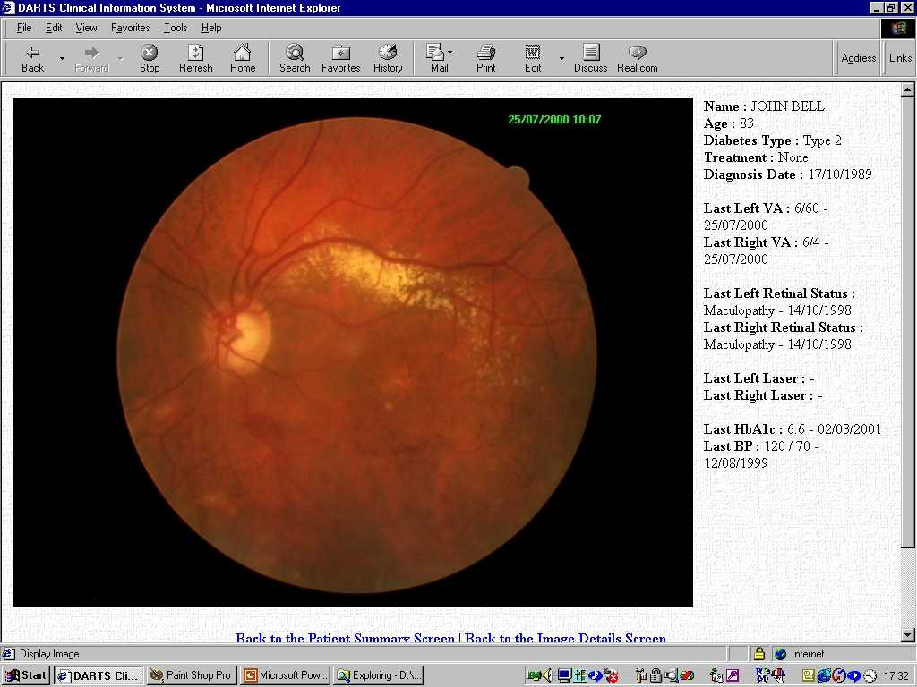
Date Research (1)
  Identifying more effective treatments, improving drug safety, studying disease and improving health.
  Clinical Practice Research Data link: MHRA/NIHR
  4 e-health research centres of excellence: MRC consortium
  UK Biobank: WT, MRC, UK health departments

Slide 14

Date Research (2)
  Improving access to, a linkage between, datasets to tackle some of the major issues facing society and the economy in new and innovative ways.
  Researching casual pathways over the life course – linking data on education, health, employment, income and wealth
  Informing policies on poverty, social mobility and childcare
  The UK Administrative Data Research Network

Slide 15
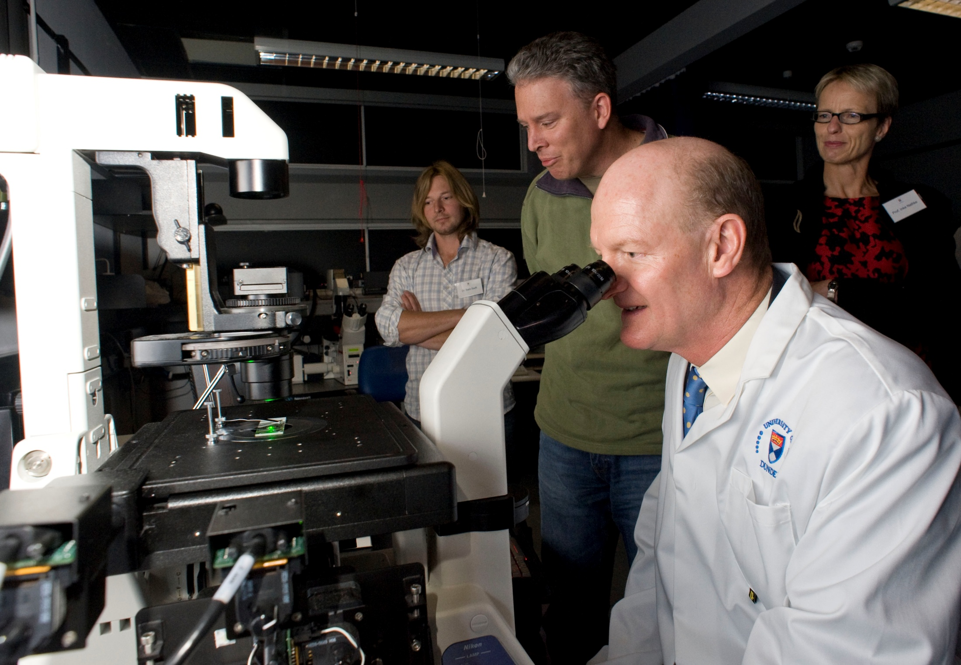
Open access (1)
  Removing paywalls that surround taxpayer funded research will have real economic and social benefits… it will herald a new era of academic discovery… and keep the UK at the forefront of global research.

Slide 16
Open access (2)
  HEFCE’s view:
  Outputs from publicity funded research should be widely and freely disseminated
  The long run aim is wide availability of publicly funded research: the transition needs to be carefully managed
  The transition will mean additional costs – these are small relative to total research budgets – no plans to change funding allocations
  There will be no effect on REF 2014 – we will consult on the principles, polices and practical issues that affect REF 2020

Slide 18

Thank you for listening
a.langlands@hefce.ac.uk

