Slide 1
The student learning experience
2013 Survey
Bahram Bekhradnia
Director, HEPI
10 May 2013

Slide 2
Scheduled hours of teaching by subject (2006, 2007, 2012 & 2013)

Slide 3
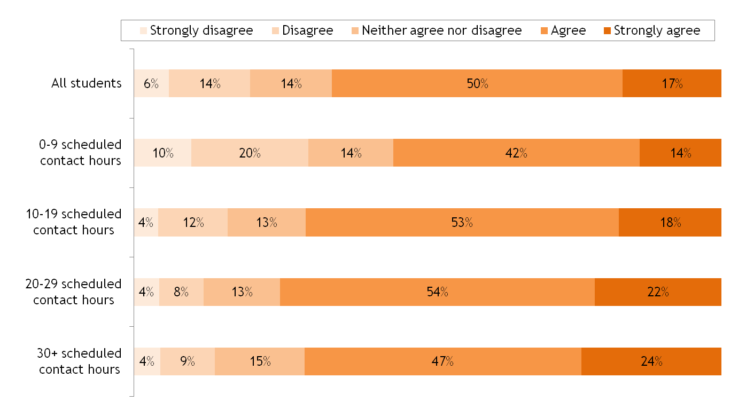
Students do mind – a bit

Slide 4
Proportion of hours of teaching by group sizes and number of contact hours

Slide 5
Total study by subject (private study + attended hours)

Slide 6
Student workload by subject – highest and lowest institutional mean hours per week
 | Lowest institutional mean | Highest institutional mean | Median institutional mean value
Medicine and dentistry | 32.7 | 49.8 | 36.3
Subjects allied to medicine | 25.3 | 44.2 | 34.0
Biological sciences | 20.2 | 46.3 | 28.2
Veterinary sciences, agriculture & related subjects | 34.7 | 45.5 | 39.2
Physical sciences | 22.8 | 47.0 | 31.0
Mathematical & Computer Sciences | 23.1 | 44.0 | 30.7
Engineering and technology | 20.6 | 47.2 | 34.5
Social studies | 20.0 | 43.0 | 25.3
Law | 21.5 | 47.2 | 29.5
Business and administrative studies | 15.9 | 39.2 | 24.8
Languages | 22.9 | 42.1 | 28.1
Historical and philosophical studies | 19.3 | 44.6 | 27.1
Creative arts and design | 22.9 | 43.0 | 31.2
Education | 21.1 | 36.6 | 26.8
All subjects | 15.9 | 49.8 | 29.6

Slide 7
Mean scheduled hours by mean private hours for subject areas within institutions

Slide 8
Students – in universities of all kinds – are very satisfied with the quality of their courses

Slide 9
Value for Money is rather different (but not unexpected)

