Slide 1
University Admissions – the changing landscape and the future
HEPI Conference – 15 May 2013
Mary Curnock Cook
Chief Executive

Slide 2
Demand Factors
(Effect of fees)
Participation rate increases barely cover population decline
c.9,000 fewer 18 year olds each year
Rises in participation in 90s and 2000s feeding through to mature demand

Slide 3
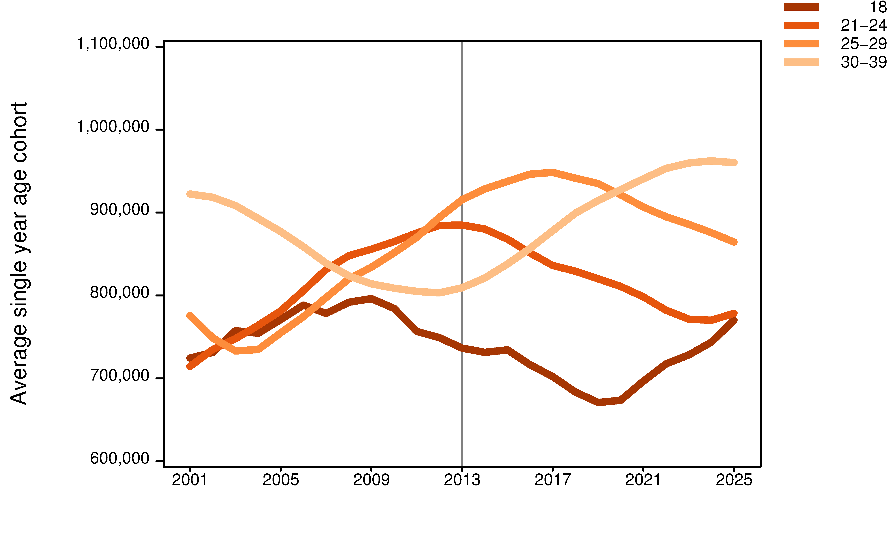
Population changes – age groups

Slide 4
Demand Factors
Effect of fees
Participation rate increases barely cover population decline
c.15,000 fewer 18 year olds each year
Rises in participation in 90s and 2000s feeding through to mature demand
Apprenticeships growing
21,000 Advanced Apprentice achievements under 19
63,000 at 19+ (growing 45%)
Qualifications and qualifications reform

Slide 5
Percentage of English 19 year olds holding Level 3
DfE data 2004 – 2012

Slide 6
Percentage of English 19 year olds holding Level 3
DfE data 2004 – 2012, extrapolated to 2017

Slide 7
19 year olds holding Level 3
DfE data 2008 – 2012, extrapolated to 2017 shown as proportion of 2012 value

Slide 8
Percentage of English 19 year olds holding Level 3
DfE data 2004 – 2012
Uncapped
recruitment
Capped
recruitment

Slide 9
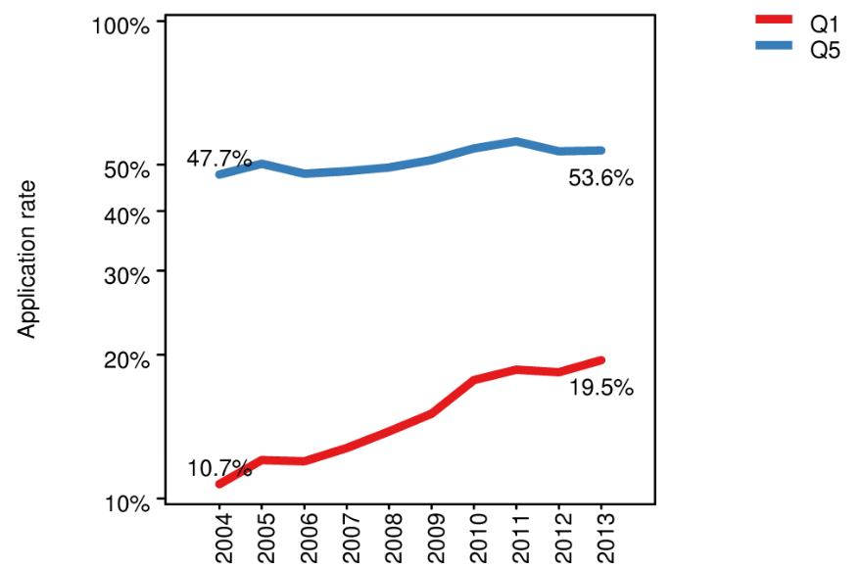
English 18 year olds: Application rates for POLAR2 Q1 and Q5
Uncapped
recruitment
Capped
recruitment

Slide 10
Market Impact
Intense competition for limited number of ‘exempt’ students
High Grade BTECs accounted for 25% of AAB+ in 2012
Weak Demand + Strong Supply
= Falling ‘price’
Price = Tariff

Slide 11
Admissions dynamic
2011: Applicants chasing places
2012: Places chasing applicants

Slide 12
Market Strategies?
Offer making
Conversion of offers

Slide 13
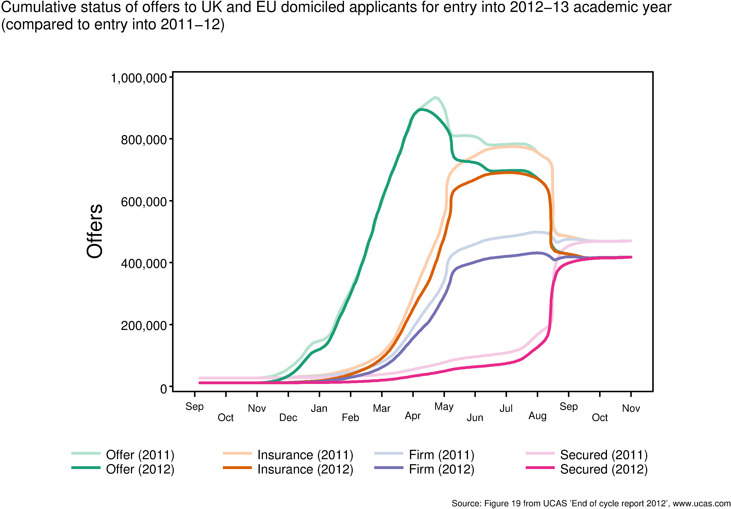
Cumulative offers to UK & EU applicants for 12-13 & 11-12 academic years

Slide 14
A successful offer-making pattern....

Slide 15
A less successful offer-making pattern...

Slide 16
Percentage of offers made chosen as firm Overall average, competitor average & XX HEI

Slide 17
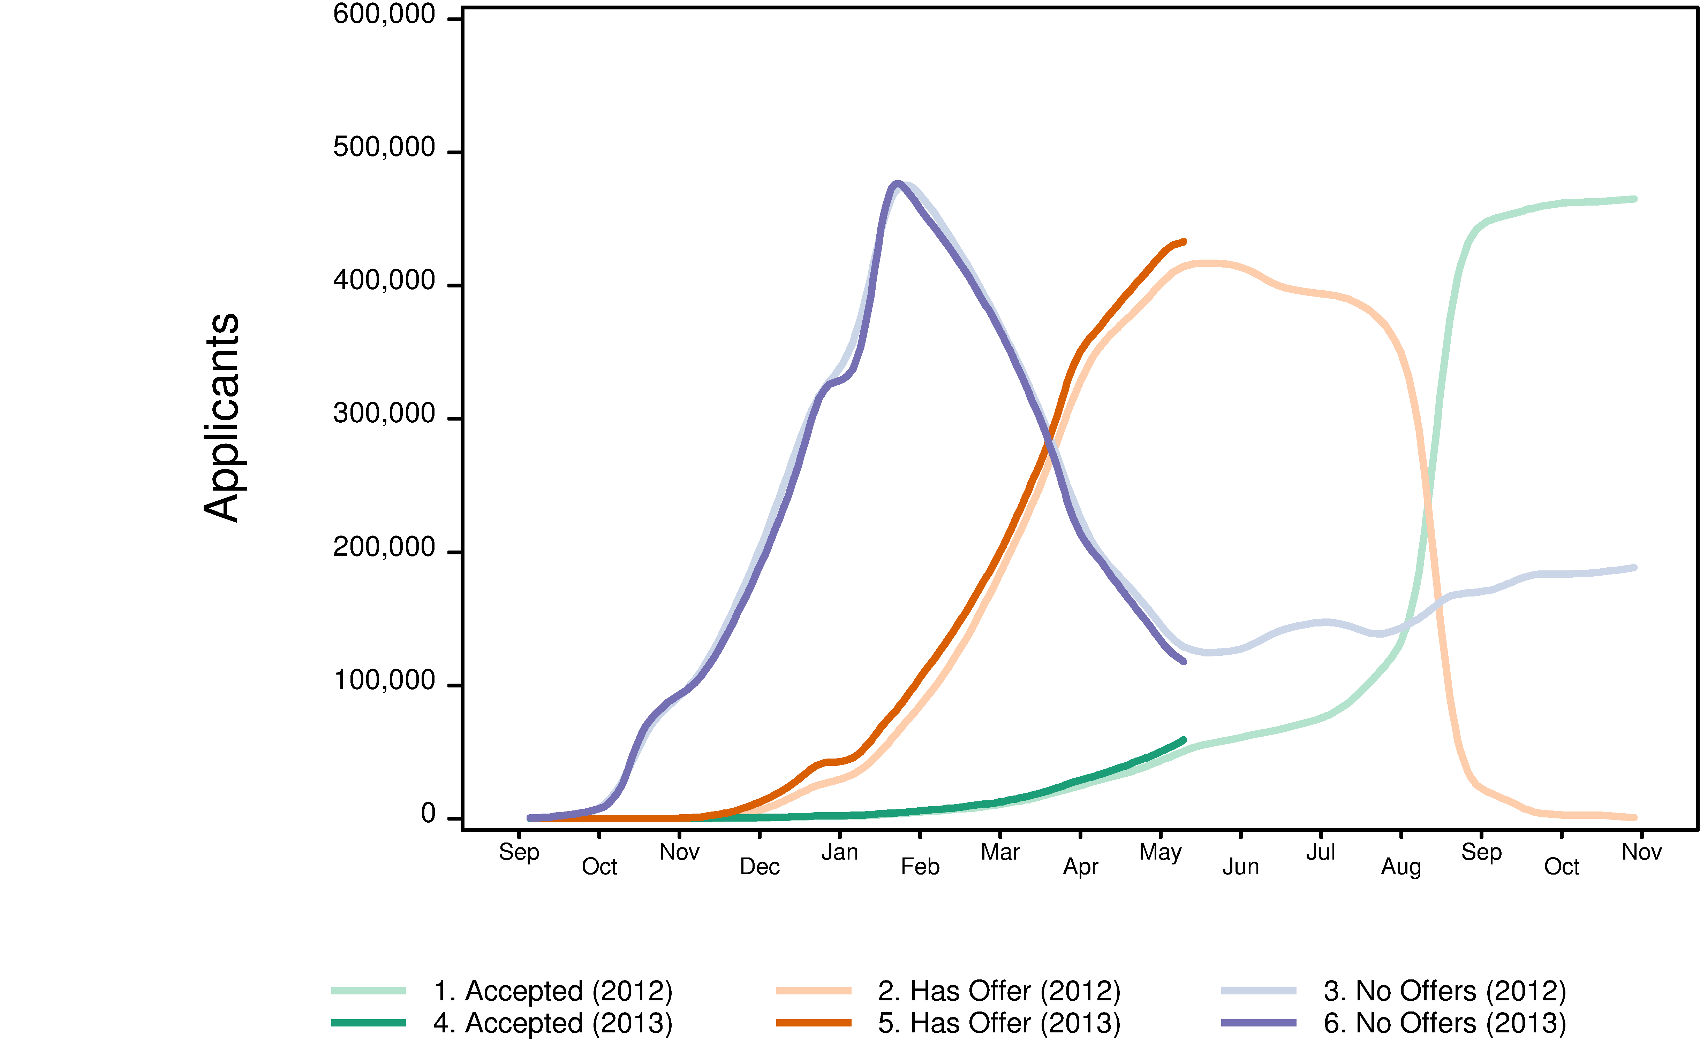
Update on 2013 Cycle

Slide 18
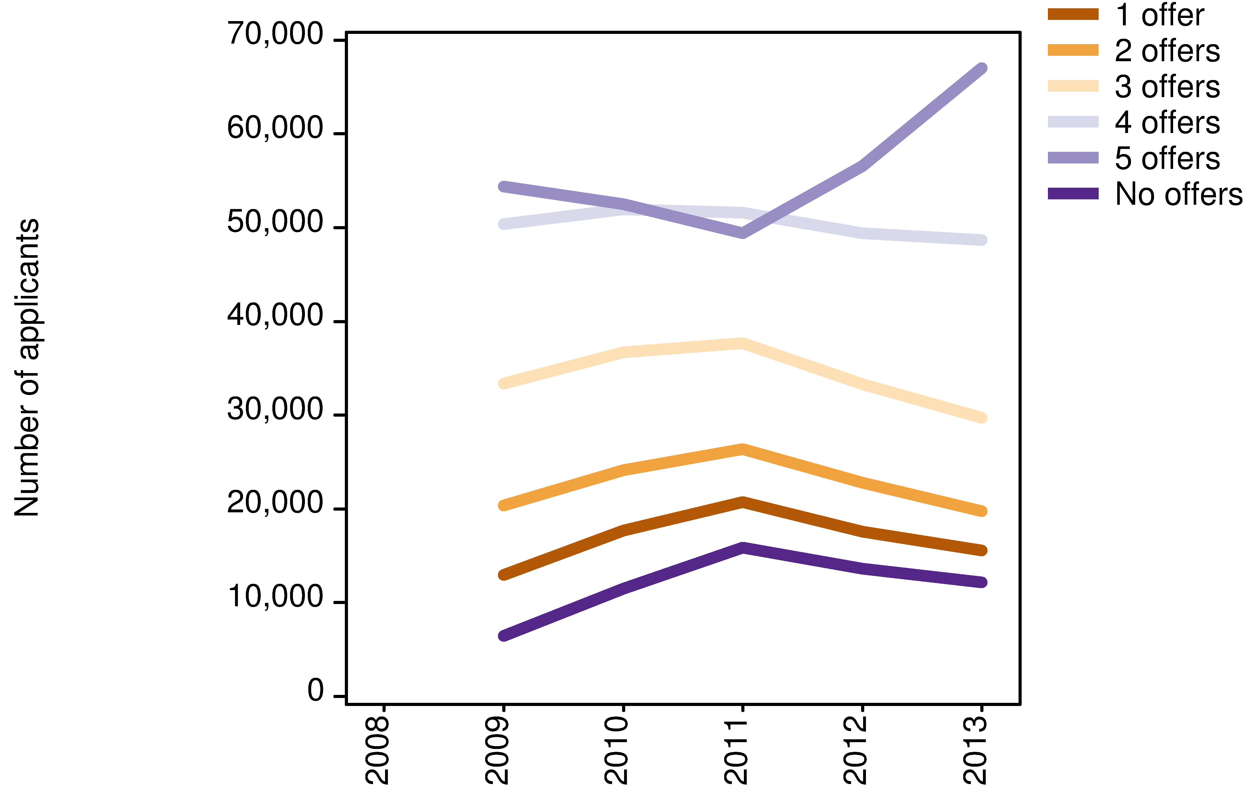
UK 18 year olds by number of offers received in mid March: 2009- 2013

Slide 19
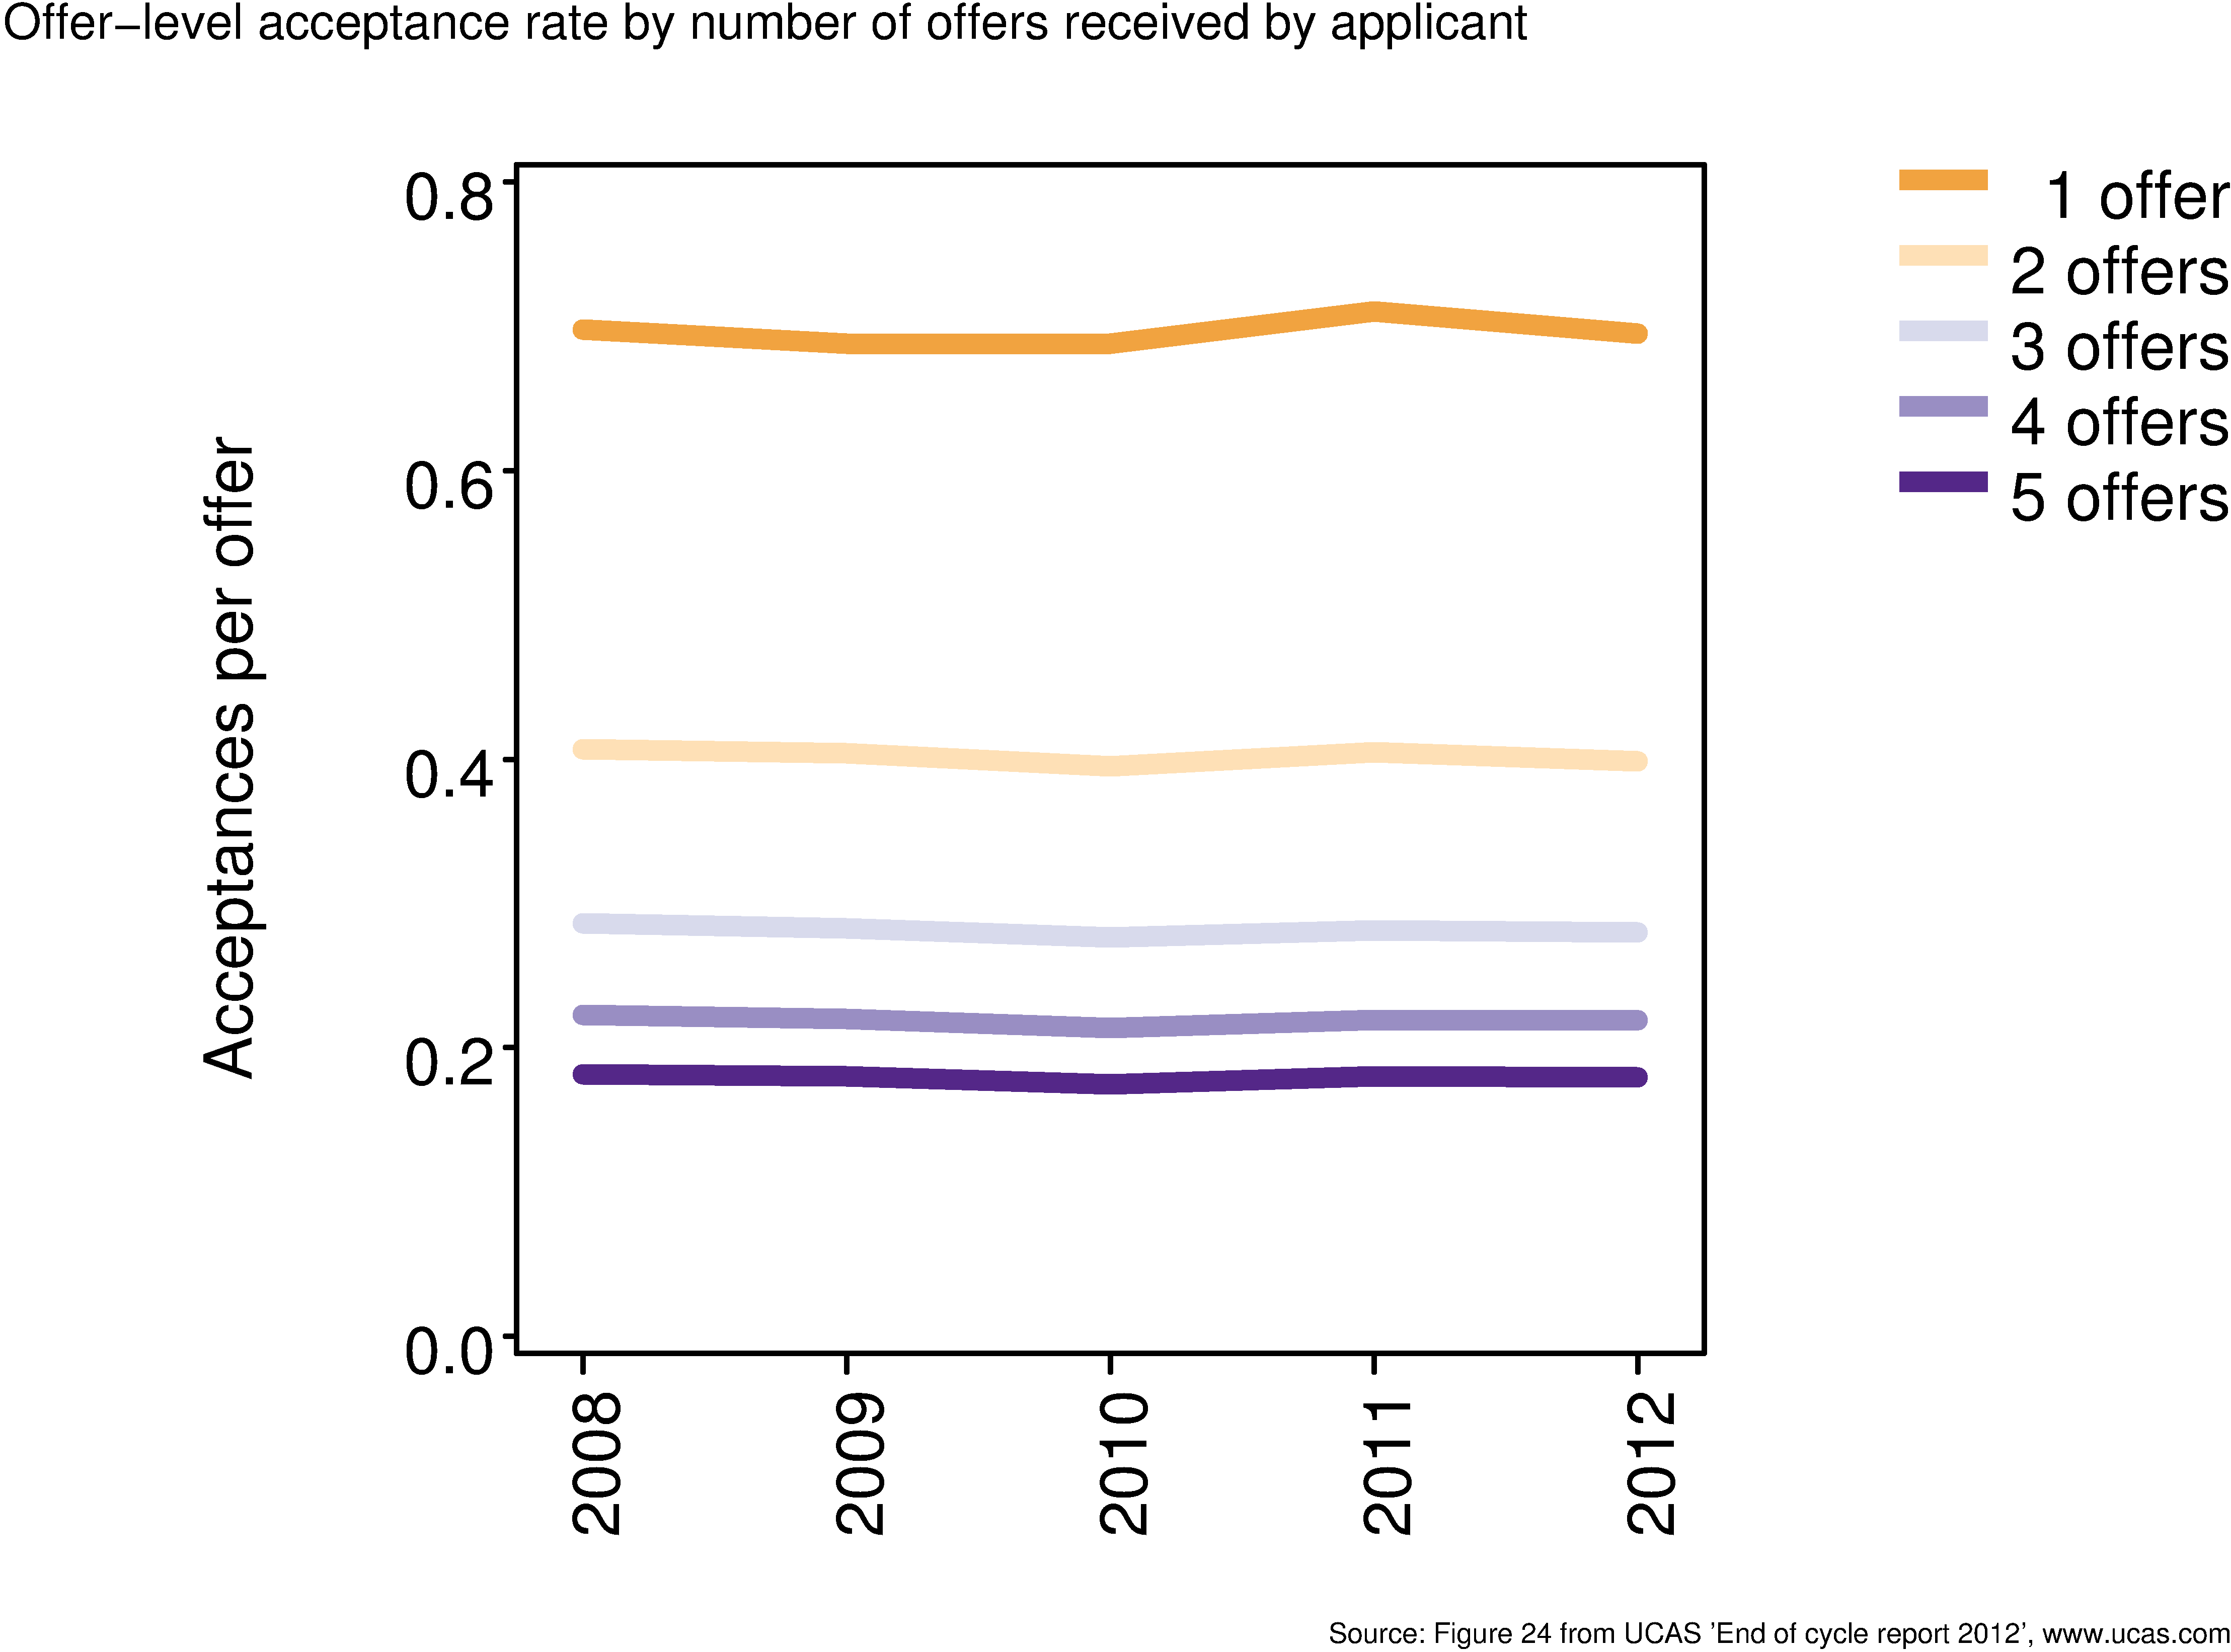
Offer-level acceptance rate by number of offers received by applicant

Slide 20
Future
Weak demand indicators
Strategic collaboration in sector
Forensic approach to marketing and recruitment
Earlier relationships with potential students
Qualifications reform critical
Focus on alternative progression routes
Market-matched programmes
Part-time, flexible, Honours + Masters, etc

Slide 21
Questions?
Mary Curnock Cook
Chief Executive
 01242 544 996
 m.curnockcook@ucas.ac.uk

