Slide 1

Professor Les Ebdon CBE
Director of Fair Access to Higher Education

Slide 2
The new landscape
2006 changes did not deter people from going to university; will this be true for 2012 onwards?
Multiple factors affect choice of whether/where to go to university
– not all under universities’ control
Considerable diversity in fee levels and financial support

Slide 3
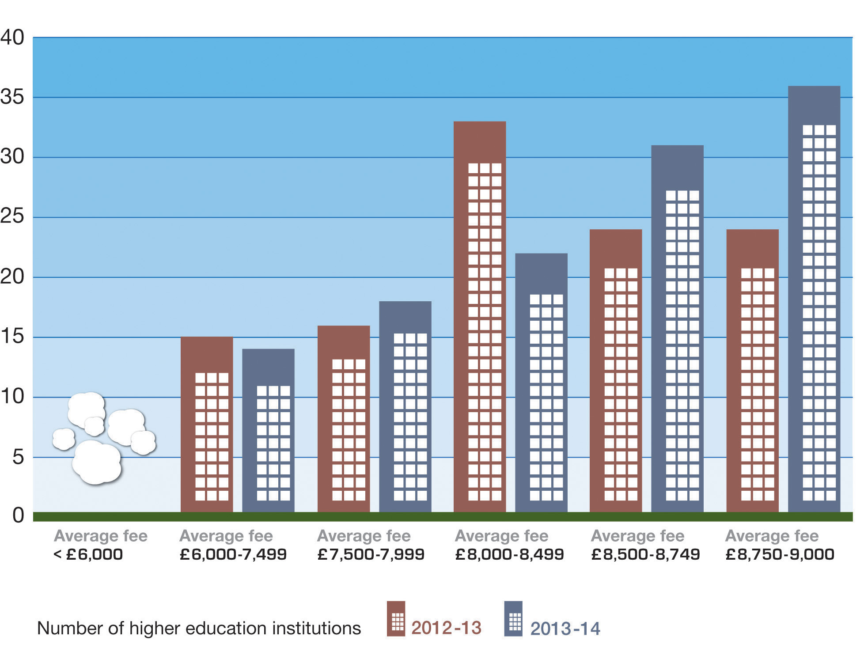
Changes in average fee, 2012-13 and 2013-14
Source: OFFA publication 2012/07, 2013-14 access agreements: institutional expenditure and fee levels, and OFFA publication 2012/06, Access agreements 2012-13: final data including initial teacher training

Slide 4
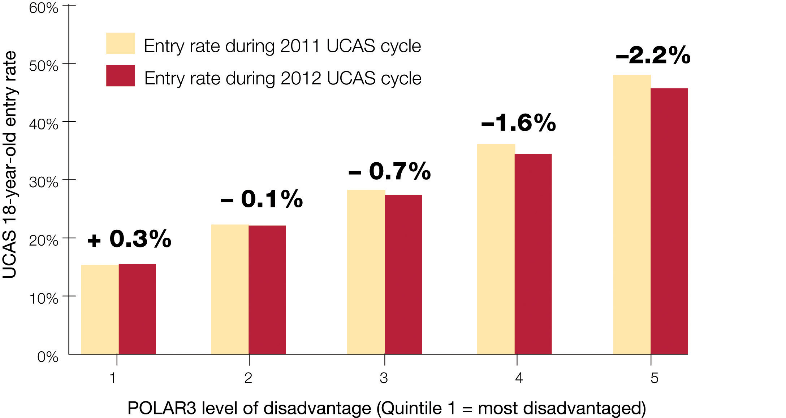
Entry rates of English 18-year-olds
(Source: HEFCE publication 2013/03, Higher education in England: Impact of the 2012 reforms)

Slide 5
Acceptances by age 2011-12 to 2012-13
Age | Academic year of entry |  |  | Change
 | 2010-11 | 2011-12 | 2012-13
20 and older | 153,261 | 147,671 | 137,815 | -10.1%
18 and younger | 233,868 | 239,281 | 234,678 | -0.3%
Source: UCAS 2012 end of cycle report

Slide 6
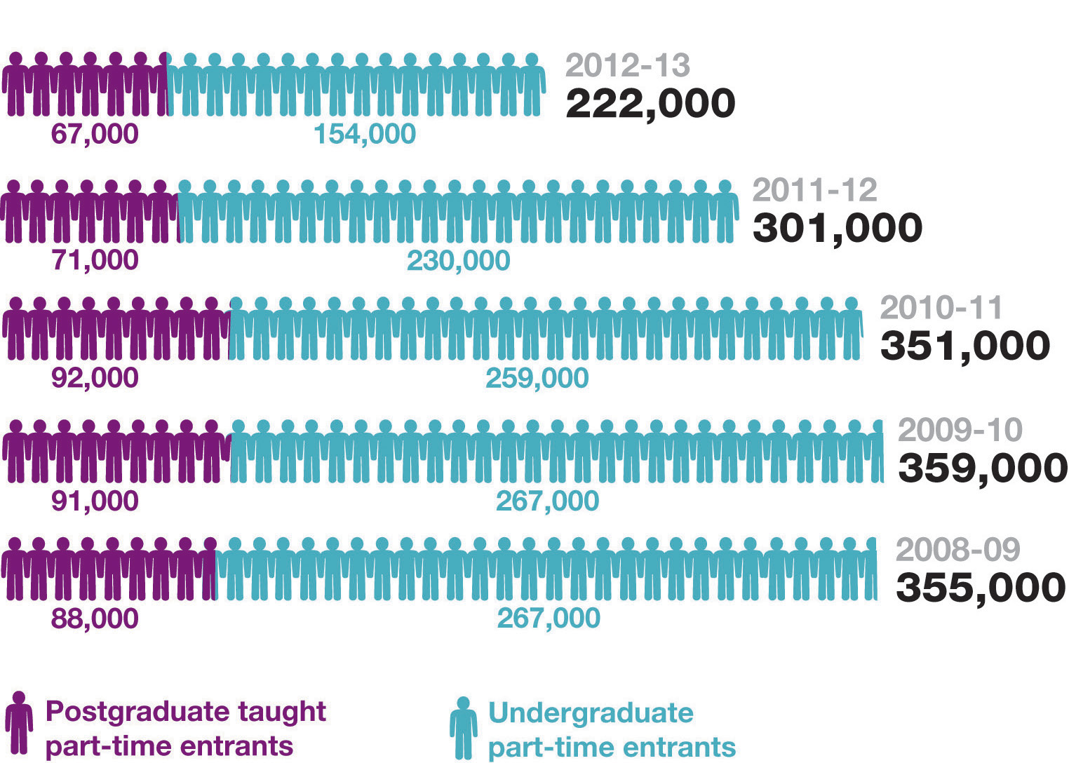
Entry to part-time higher education courses (England)
(Source: HEFCE publication 2013/03, Higher education in England: Impact of the 2012 reforms)

Slide 7
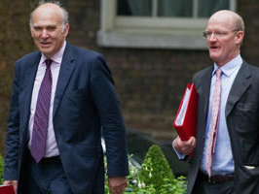
“The government also wants to support those wishing to study part-time in higher education, and mature students. We would like institutions to consider such students within their overall approach to access, and would like [OFFA] to take account of their efforts in considering their access agreements.”
BIS guidance to OFFA, February 2011
Part-time and mature students

Slide 8
Financial concerns for mature students
69 per cent worry about financing their higher education study
63 per cent suffer financial hardship
27 per cent apply for discretionary funding
26 per cent have commercial debts
49 per cent receive institutional financial support e.g. bursaries.
Source: Never Too Late To Learn: Mature Students in Higher Education (Million+/NUS, 2012)

Slide 9
Estimated access agreement expenditure (including Government NSP allocation) by 2016-17: by type of spend, HEIs and FECs
Total: £809.5 million

Slide 10

Financial support 2013-14 ̶ key figures
Total sector-wide investment £529.8 million.
This comprises:
£167.3 million on fee waivers
£320.1 million on bursaries and scholarships
£42.4 million on ‘student choice’ support.

Slide 11
2013-14 access agreements: mature
65 higher education institutions have target(s) in their access agreements relating to mature students
Almost half of these 65 also have target(s) around increasing participation of mature students who haven’t previously participated in HE
39 have target(s) relating to mature non-continuation
4 per cent of all access agreements include bursaries specifically targeted at mature learners - but overall impact of bursaries much higher

Slide 12
2013-14 access agreements: part-time
Total spend on access measures for part-time students in 2013-14 = over £13.4 million
One in five access agreements has target(s) specifically relating to part-time students
Five have target(s) on non-continuation of part-time
17 have target(s) around increasing part-time participation
Four target financial support specifically to part-time students (plus many more income-based awards that apply to part-time too)

Slide 13
OFFA guidance 2014-15: mature/part-time
Consider different types of courses/flexible provision
Take a broad view of outreach to include potential mature learners as well as work with schools
Focus on part-time student retention and success
Evaluate outcomes and concentrate efforts/strategy on doing what works

Slide 14
The new landscape
2006 changes did not deter people from going to university; will this be true for 2012 onwards?
Multiple factors affect choice of whether/where to go to university
– not all under universities’ control
Considerable diversity in fee levels and financial support
What works?

