Slide 1
When things go wrong – Improving the student experience, dealing with student complaints (and how schools can help).
HEPI Reforms: The impact on admission to university and the student academic experience
“Comrades! The first principle of the Revolution is effective time-keeping.”
- Govan Mbeki, after being released from Robben Island after 25 years
Rob Behrens
Chief Executive and
Independent Adjudicator
rob.behrens@oiahe.org.uk
Royal Society
Wednesday, 15 May 2013

Slide 2
“WHO? WHO?”
2
Notes:
Lord Justice Longmore stated “I just do not see how it can be said that any fair-minded and informed observer could say that there was a real possibility that the OIA in general or its Independent Adjudicator or any individual case-handler was biased in favour of the HEI under scrutiny in any particular case or lacked independence in any way.”
Sandhar Judgement. Court of Appeal 21 December 2011, Lord Justice Longmore

Slide 3
THE OIA AS A STRATEGIC PARTNER
A Classic Ombudsman Scheme
With more Authority than Power
Sensitive to special features of Higher Education
Increasingly Efficient and Effective
Use of Transparency to generate scrutiny, understanding and public trust
Member of the Regulatory Partnership Group
Engine of Good Practice
Decentralisation of responsibility for case decisions – risk based Approval and Management (Early) Assessment Team developed and expanded to assess Eligibility Triage and Settlement Processes to resolve cases as early as possible Targets for monthly closures Element of Outsourcing
3

Slide 4
UNIVERSITIES AND STUDENT SATISFACTION

Slide 5
TRUST
Q “ ….. Would you tell me if you generally trust them to tell the truth, or not?” | IPSOS MORI VERACITY INDEX: 2011
Occupations | %
Doctors | 88
Teachers | 81
Professors | 74
Judges | 72
Scientists | 71
Clergyman/Priests | 68
The Police | 63
Television news readers | 62
Ordinary man/woman in the street | 55
Civil Servants | 47
Pollsters | 39
Trade Union Officials | 34
Business Leaders | 29
Journalists | 19
Government Ministers | 17
Politicians generally | 14
AVERAGE | 52
5

Slide 6
NUMBER OF COMPLAINTS RECEIVED BY THE OIA
6

Slide 7
WHAT IS COMPLAINED ABOUT: 2011 OUTTURNS
7

Slide 8
REASONS FOR RISE IN COMPLAINTS
Discussion about rise in fees and then the rise in 2012
Students as consumers
Decline in deference
Rise in expectations – fall in status of 2.2
Tightening of labour market
Rise in vocational subjects (medicine, law, social work, teaching – double qualification needed)
OIA becoming more widely known

Slide 9
IMPACT OF INSTITUTION SIZE ON COMPLAINT NUMBERS
Number of complaints
Smallest institution
Trendline
Largest institution
9

Slide 10
RELATION BETWEEN INTERNAL COMPLAINTS AND APPEALS AND COMPLAINTS RECEIVED BY OIA
Institutions which issued least COP Letters
Institutions which issued most COP Letters
10

Slide 11
HOW THINGS GO WRONG
University failed to follow its procedures
Breaches of the duty to act fairly (natural justice)
Information not properly considered (or not demonstrated that it was)
Delay or maladministration
Non-implementation of appeal panel decision
Cohort dealt with inconsistently
Inadequate supervision/tuition/equipment
Poor communication or misinformation
Discrimination issues, especially disability
11

Slide 12
SUPERVISION
THE WOOLF INQUIRY
__________________
An inquiry into the
LSE’s links with Libya
and lessons to
be learned
__________________
OCTOBER 2011
“However difficult to express, there are different parameters of permissible assistance, and they should not remain unwritten. The LSE has a high proportion of international students, who may come from academic backgrounds which have different practices to those expected at the LSE or in the UK. Even for UK students the position may require clarification. The LSE ought to lay down as clearly as possible guidance as to what assistance it is and it is not appropriate for a postgraduate student to receive.”
The Woolf Inquiry: An inquiry into the LSE’s links with Libya and lessons to be learned. October 2011, para 2.106

Slide 13
ACADEMIC MISCONDUCT

Slide 14
DISABILITY
Disability discrimination
The judicialisation of the OIA so that it has to perform the same fact-finding functions and to make the same decisions on liability as the ordinary courts and tribunals would not be in the interests of students generally.”
Lord Justice Mummery, Court of Appeal, 27 October 2011.
Competency standards
Reasonable adjustments

Slide 15
FEEDBACK AND GOOD PRACTICE DISSEMINATION (1)
Regular communication with, and visits to, universities and students’ unions
Publication of Public Interest cases
Pathway Consultation Exercises (Pathway 1, 2, 3)
Early Resolution Pilots and Good Practice Framework (2014)
15
Notes:
feedback reported as a central asset by universities and students’ unions in the OIA Scheme (Pathway 1).

Slide 16
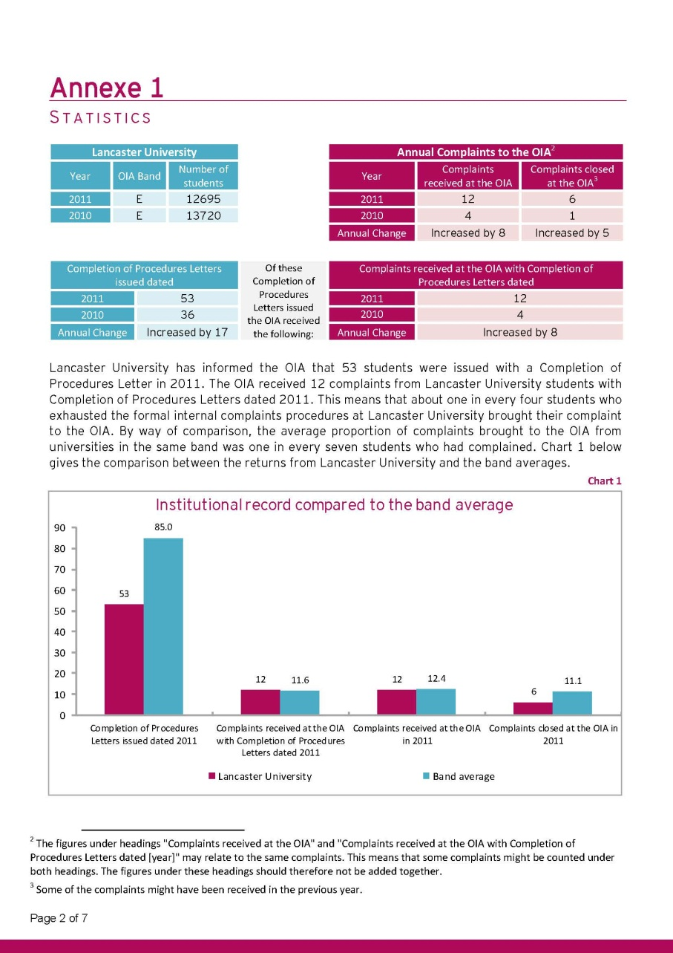
FEEDBACK AND GOOD PRACTICE
DISSEMINATION (2): PUBLISHED ANNUAL LETTERS

Slide 17
EARLY RESOLUTION INITIATIVE
Campus Ombudsmen as suggested by 2011 HE White Paper ?
Diversity of existing provision
Student Services Offices
Students Union Advice Centres
Student Conciliators
Graduate Interns
Complaint Mediation Schemes
Mediation
No “one size fits all”
Canterbury Christ Church – wider use of mediation
University of South Wales – Student Conciliators
Sheffield – facilitated discussion
Kingston – training in complaint handling and mediation
Huddersfield – student conciliators
ARC linking pilots to good practice procedure
Oxford University and Oxford University Students’ Union
Edge Hill University
Notes:
Campus Ombudsmen - Impractical to graft on to English and Welsh HEIs a campus ombudsman concept which sits uneasily with existing arrangements, not available at European universities.
Mediation - – an under-used and not always understood process in HEIs

Slide 18
FRAMEWORK OF GOOD PRACTICE
80 per cent of Pathway 3 submissions agreed that a framework focusing on operational complaints and appeals resolution would be extremely useful.
This framework will be:
Consultative
Jointly developed
Non- Regulatory
A living document (web-based) and
Complement QAA Quality Code

Slide 19
KEY LEARNING POINTS
Higher Education is a specialist area
But, an academic judgement is not ‘whatever an academic says on any issue’
Complaints not ‘private grief’ or a ‘gift’ but an aid to building Trust and greater professionalism
Universities are not Balkan states but need to be joined-up corporate bodies
Governors have a role in monitoring practice
Students’ unions are partners in educating students and managing expectations
The antidote to haphazard handling is not an overly legal approach
Justice Delayed is Justice Denied
Learn from the mistakes of others as well as their successes
19
Notes:
Learn from complaints – don’t be scared of them.
Importance of early resolution: don’t let it escalate – resolve it quickly. Defensive response will inflame it. Mediation – we have used it very successfully even post decision. Campus ombudsman idea – problem with terminology (independence?) – regional pilots coming out of Pathway 3. We should be very last result and should only see the very tip of the iceberg.
Completion of ICP and COP Letter – revised Guidance May 2010 – drawing a line under complaint and setting the time running against the student. If student has reached the end of the road (even if they did not escalate in time), issue COP letter and we will consider reasonableness of HEI’s final decision. –the more info the better.
Set out your store. Be careful what your perspective promises – can you deliver it? KIS – danger they might result in lower bar – if we have to make promises we will promise the minimum. Students end up getting less than they got previously?
Make sure SU is properly informed and working in partnership with HEI to manage expectations. SU should get complaints information and OIA decisions. Otherwise, how can it know what to look for, what to advise students?
Regulations: keep them simple. Make sure they are consistent – does your misconduct procedure work with your complaints or appeals procedures? If you amended one, do you need to amend the others as well? Do they say what you think they say – McCoy case? Does your mitigating circumstances form match your mit circs procedures? Have you shortcut your processes (for very good reason) and therefore is what you are doing contrary to the procedures? BUT is there an element of discretion to take account of the unusual case?
And have you thought about how your procedures might affect disabled students? Eg mit circs must be submitted by date of exam board – what if student is suffering from disability that evidence suggests might affect their judgment?
We cannot interfere with matter of AJ. One of few things actually set out in the HE Act. Last bastion of professional judgment which is exempt from interference from the courts – for how much longer?
We will not normally interfere with a matter of PJ – but must be evidence based. Decision to remove someone from placement will often be matter of PJ regarding their competence. Would expect to see that PJ supported by documented evidence – practice records etc. Would expect the University to check that evidence is there to support the decision.
Has work been plagiarised? – usually that is AJ. If intent is required, then did the student intend to plagiarise will not be AJ. Has Turnitin report been interpreted or applied blindly?
Plagiarism and fitness to practise: we look at procedural issues and fairness not the underlying academic or professional decisions

Slide 20
THE HUNTING OF THE SNARK
“For England Expects — I forbear to proceed.
Tis a maxim tremendous, but trite.
And we’d best be unpacking the things we need
To set ourselves up for the fight.“
Lewis Carroll, The Hunting of the Snark, 1876
20

