Slide 1
UK university research as a driver of economic growth?
HEPI Conference: University Research & the Economy: Opportunities for UK universities in the drive for innovation and growth
London, December 5th 2012
Dr Nick Fowler, Managing Director, Academic & Government Institutions, Elsevier

Slide 2
How UK universities drive economic growth
UK universities generate £59 billion for the UK (2009 UUK study)
Employ 382,000 members of staff
Develop/train future employees: 1.9MM undergraduates and 600,000 post-graduates per year
Spend £27 billion annually on goods and services
Develop ideas and IP, “Innovation”, business and community interaction
Commercialization of new knowledge
Delivery of professional training, consultancy, facilities and equipment, and services (£3.3B)
License income, patents, spin-offs, new businesses

Slide 3
University research as a driver of economic growth? UK, EU Government policy

Slide 4
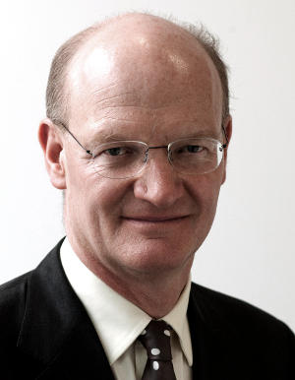
UK university research as a driver of economic growth: UK Government policy
Strategy
“Build on the UK’s recognised strengths”
“Work with business and the knowledge base to underpin private sector growth”
“Maximise the impact of our research base on economic growth”
Policies, instruments, actions
£4.6 billion budget: science and research programmes
£150MM each year supporting university-business interactions
“Catapult” technology and innovation centres
“Launchpad” (innovation clusters)
Technology Strategy Board
R&D Tax Credits for SMEs, £75MM “Smart” grants for SME R&D
Collaborations - China and India
“Design-driven innovation”
“Get rid of red tape”
“Make public sector data more accessible”
“Inducement prizes”

Slide 5
UK university strategy = UK Industrial Strategy?
“It’s all about creative interactions between science and business.
“You get innovation when great universities, leading-edge science, world-class companies and entrepreneurial start-ups come together.
“Where they cluster together, you get some of the most exciting places on the planet.
“What is where you find the creative ferment which drives a modern economy.”
Rt Hon George Osbourne MP, Chancellor of the Exchequer
Royal Society, 9th November 2012

Slide 6
UK Industrial Strategy: prioritised areas
Big data and energy efficient computing
Synthetic Biology
Regenerative Medicine
Agri-Science
Energy Storage
Advanced materials
Robotics and autonomous systems
Satellites, commercial applications of space

Slide 7
University research as a driver of economic growth? EU Government policy
European Commission Strategy
“...Stabilise the financial and economic system ... create the economic opportunities of tomorrow...
“...Research and Innovation...
...help deliver jobs, prosperity, quality of life and global public goods...
... generate the scientific and technological breakthroughs needed to tackle the urgent challenges society faces...
...have therefore been placed at the centre of the Europe 2020 strategy to promote smart, sustainable and inclusive growth.”

Slide 8
University research as a driver of economic growth? EU Government policy
European Commission Policies, instruments, actions
Three “pillars”
Excellent Science
Industrial Leadership
Societal Challenges
Initiatives:
Innovation Union flagship initiative
European Research Council
Future and Emerging Technologies
Marie Curie actions
Research infrastructures, E-infrastructures.
Overall: “prioritises spending with immediate impact on growth and jobs”.

Slide 9
University research as a driver of economic growth? EU Government policy
Word count
Research, researchers: 76
Industry, industries, enterprise(s), SMEs: 37
Finance, financial: 15
Economy, economic: 12
University, universities: 0

Slide 10
University research as a driver of economic growth? US developments.

Slide 11
The role of university research: time to reflect?
UK universities:2012 and beyond?
Three questions to reflect upon
What are universities for?
Just because universities can and do deliver economic growth, should they be managed to?
How will universities adapt, what will consequences be?

Slide 12
Reflection (1): What are universities for?
“At an absolute minimum, the modern university might be said to possess at least the following four characteristics:
...Provides some form of post-secondary-school education... more than professional training...
...Furthers some form of advanced scholarship or research... not wholly dictated by the need to solve immediate practical problems...
...Activities are pursued in more than just one single discipline...
...Enjoys some form of institutional autonomy ...”
Source: Stefan Collini, “What are Universities For?” Penguin Books, 2012, p7. Emphasis added.

Slide 13
Reflection (2): Should universities be managed to drive economic growth just because they can?

Slide 14
Reflection (3): How will universities adapt, what will the consequences be?

Slide 15
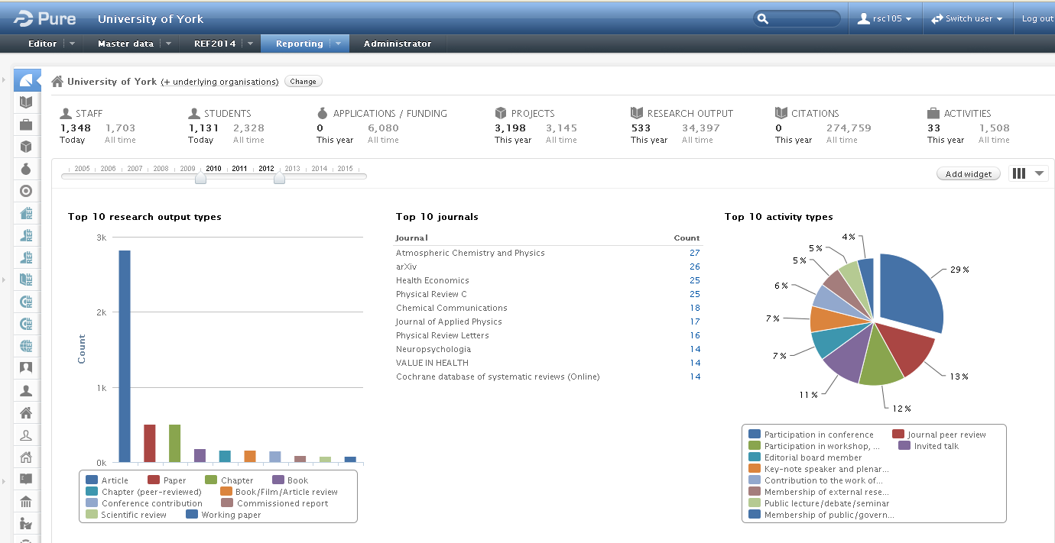
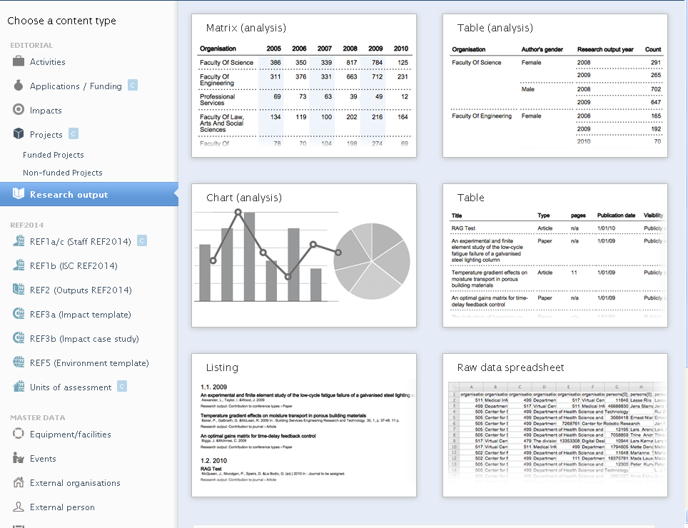
Rising demand for management information: (1) Current Research Information Systems (CRIS): example - Pure

Slide 16
Adoption of Current Research Information Systems in UK (Pure only)
2008: 0
2012: 20
Source: SciVal

Slide 17
Change in grant income from Research Councils, 2012 vs 2011
Universities with Pure
Universities without Pure
+12%
-11%
Income 2011 (£Million):
161
593
Income 2012 (£Million):
180
531
Change 2011-2012 (£Million):
+19
-62
Sample includes those 20 UK universities that account for the most research council grant income awarded, 2012
Source: SciVal

Slide 18
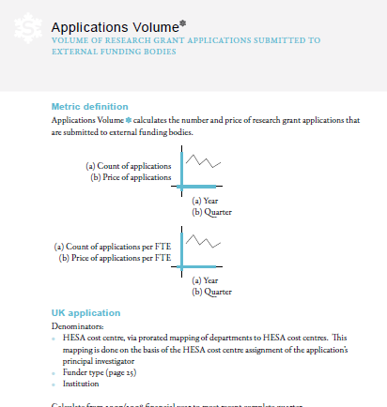
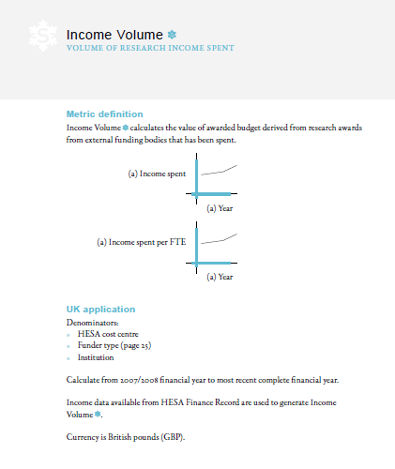
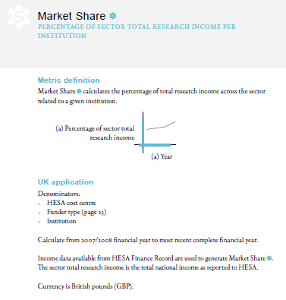
Rising demand for management information: (2) Demand for comparative data and metrics: example, Snowball Metrics
http://www.snowballmetrics.com/

Slide 19
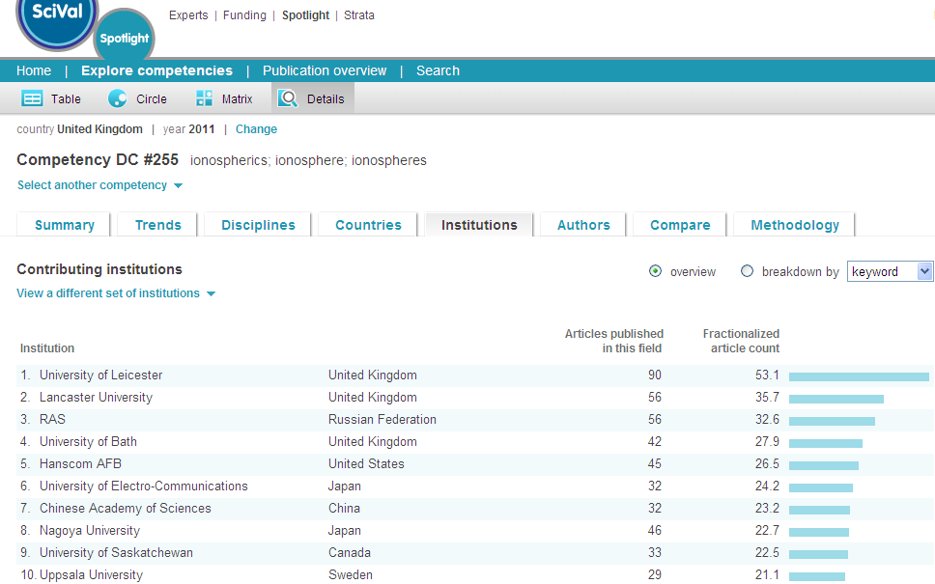
Rising demand for management information: (3) Demand for information tools
Source: SciVal Spotlight

Slide 20
Rising demand for management information: (4) Rise of Showcasing – UK examples
UK Universities
UK Funding Bodies
UK Government

Slide 21
Rising demand for management information: (4) Rise of Showcasing – US example, North Carolina
Research Networking Systems—ReachNC / SciVal Experts
http://www.experts.scival.com/reachnc/
Notes:
So what is the latest initiative that the North Carolina Research Triangle Park is involved in? We have built a network for the state of North Carolina that connects all 16 universities in the North Carolina State system and Duke University, the most important private research university in North Carolina. There are currently 13,000 researcher profiles in the system, and it is expected to grow to over 17,000 researchers by mid-2013. Research Triangle Institute Fellows have been added, and there are future plans to incorporate more profiles of industry scientists.
This is an example of a research networking system, a trend that is gaining substantial momentum in the US and is increasingly being implemented internationally. I will briefly show you a commercial system that Elsevier is providing to a number of leading academic institutions, but there other research network solutions as well, including an NIH-funded project called VIVO and other systems. I would like to go through it in a bit more detail to show some of the general capabilities of research networking systems. The great majority of institutions implementing our systems in the US, over 95%, make them available and discoverable via a public website. This is taken from the ReachNC’s site, which connects all 16 universities in the North Carolina State system and Duke University, a major private research university in North Carolina. The advantages of implementing these systems for enhancing industry-university partnerships are fairly obvious, and there is a lot of interest at the state levels in such systems. In addition to ReachNC, which is currently being fully built out, we are contracted to build the Michigan Research portal I mentioned earlier, and have a proposal out to the State of Illinois. We also have a contract to create a network for all 6 medical schools in Texas, a major biomedical research hub, and a number of other opportunities in earlier stages.
These type of collaboration systems are ones that I call researcher-centric, and use advanced semantic Web 2.0 web technologies to fingerprint a researcher’s publications, grants, and other scholarly output. Fingerprints can also be aggregated to get a departmental or group fingerprint for multiple researchers. Many institutions also fingerprint and interdisciplinary research centers.
One of the companies in RTP recently was looking for an academic partner in the U.S. for a $10M, 5-year joint research project in a variety of engineering disciplines, and was able to use the ReachNC system to quickly determine that the relevant engineering expertise was available at NorthCarolina State university, so in this particular case the system has already helped to facilitate an academic-industry partnership that could have gone to an institution in another state.
Let’s take a brief look at the ReachNC system to give you a feel of how this actually works in practice. 95% of these systems are publically accessible and open to all on the Web. (hyperlink) http://www.experts.scival.com/reachnc

Slide 22
Summary

