Slide 1
What is a Good Student Learning Experience?
Professor Craig Mahoney
Chief Executive
22 May 2012
Notes:
5 minute welcome (separate note)

Slide 2

One View
Skilling students including life skills
Employability
International experience
Relevant academic content
Quality and retention
Notes:
All the above are relevant across the 4 nations
There are differences in the challenges facing the individual nations

Slide 3
Challenges
England
Student numbers fluctuating
Enhanced expectations, value for money
Scotland
Widening access and social mobility - key issues
Northern Ireland
Cohort of 18-21-year-olds, will reduce in size by 9.4% between 2012 and 2020.
Wales
Reconfiguration proposals for the sector
Notes:
All nations watching what happens in England and the impact of fees
England
Fee changes and impact on numbers
Return on investment
Scotland
Worst ‘record’ in this area in UK. One of worst poverty gaps in Europe.
Northern Ireland
Cohort dropping – impact on income for HEI’s
Wales
Potential reduction in HEI’s

Slide 4

What we do know?
More choice & opportunity
UK ranked 10th in the developed world for higher education covering resources, environment, connectivity and outputs
(Telegraph 11 May – Universitas 21 research)
Access, quality of teaching and employability are important to all those who can benefit from higher education
Notes:
We also know that things will continue to change:
At end of April Government announced AAB policy has been extended even tough we don’t know the impact yet of the original policy
Also changed that institutions will be able to take as many ABB’s as they wish next year.
Britain was ranked 10th overall in the table, which was topped by the United States. it was claimed that Britain was let down because of a lack of investment.
On Government expenditure alone, the country was 41st out of 48 nations, it emerged.
“However, we continue to spend less on higher education as a percentage of GDP than the average of OECD countries. We should remain acutely aware that other countries are investing more than the UK and that our reputation as a world-class provider of higher education is not a foregone conclusion.” Nicola Dandridge.
The study said England, Scotland, Wales and Northern Ireland collectively performed strongly for the effectiveness of research and the production of a well-educated workforce.

Slide 5

Opportunities
Respect for the learner is centre stage
Student engagement
Reviewing curriculum to ensure its relevant
Graduate attributes
Internationalisation
Notes:
Respect for the learner is centre stage - their needs heightened, their awareness raised and their voices heard
Student engagement – the importance of getting this right, not to make knee jerk reactions to what “we” think students want
Reviewing the curriculum – I will be sharing some experience we at the HEA are having, supporting institutions in the UK
Graduate attributes and employability - this is being discussed continually and is important, but the university experience is much more than this.
Internationalisation - a range of opportunities here but what is key for students, is making sure they get every chance to benefit from

Slide 6

University has just Flipped
How online video is opening up knowledge to the world
Time for change in education
Open access to courses
Lecture ‘flipping’
In 2010 they taught 200 in 2011 160,000 from 190 countries
http://www.wired.co.uk/magazine/archive/2012/05/features/university-just-got-flipped
Notes:
Stanford University - last Summer professor Sebastian Thrun and Peter Morvig decided it was time for a change in education
Anyone with web access could take the course. Lecture and assignments - the same ones administered in the on-campus class would be posted and auto-graded on line each week
They had guessed that they might get 1000 students at a very optimistic level 10,000. It went from 200 to 160,000 in 190 countries in one year

Slide 7

University has just Flipped
Koller – (professor in Computer Science at Stanford )
"Once you have a set of video content with integrated activities and assessments, you can make the same content available to those not fortunate enough to attend the Stanford’s and Oxfords of the world.“
Paper published in Science (April 2011) found that students using an experimental ‘flip-learning’ approach did more than twice as well as those using traditional methods
Simon Bates (Professor of Physics Education at Edinburgh)
is following this lead in Edinburgh - OE learning
environment rather than just lecturing
Notes:
The traditional approach to teaching reduces education to a transfer of information.
Face-to-face time would remain, but instead of a one-way propagation of information, it would become a "much deeper interaction" -- case studies, discussions about particular problems.
taking the lecture out of the hall and replacing it with online, interactive content studied at home, teaching time is spent on just that -- teaching, not declaiming. And once the university is flipped, it's open to the entire world.

Slide 8
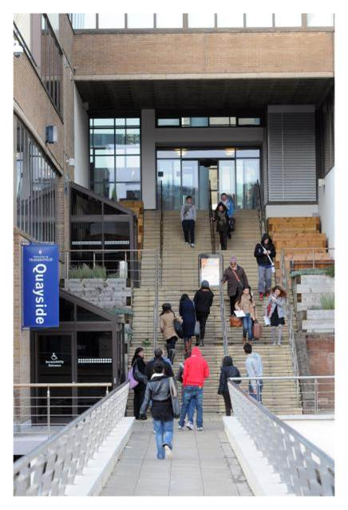
On-going development
Curriculum Relevance
Must develop a curricula robustly informed by a broader world view – not too British-centric or Euro-centric
Individual institutional mission
Enterprise
IT
Broader knowledge
Graduate and transferable skills
Notes:
Reviewing the curriculum -
Specific project work with individual institutions such as Southampton, Hertfordshire and Derby
Enterprise - Business Simulation Southampton invited students to work with small businesses in the university during Easter break 2012.
IT - More flexible approaches to delivery for changing student population comprised of part-time, international, work based and campus based. OER opportunities for sharing resources.

Slide 9

Employability
CBI forecast predicts GDP growth to hit 0.6% for 2012 rising to 2% in 2013 (May 2012)
Focus on employability is more embedded into the curricula
HEA’s Postgraduate Research Experience Survey (PRES) 2011:
50% agreed "I am encouraged to reflect on my professional development needs" (compared to 43% in 2009)
http://www.heacademy.ac.uk/resources/detail/employability/pedagogy_for_employability_update_2012
Notes:
In a recent report by the CBI suggest growth will return to the UK economy in the second half of 2012and pick up pace next year. The latest CBI forecast predicts GDP growth to hit 0.6% for 2012 rising to 2% in 2013.
The predictions, which follow data showing the UK economy contracted again in the first quarter, are broadly in line with those from the Office for Budget Responsibility which expects UK growth to hit 0.8% in 2012 and 2% next year.
We know from student experience surveys that students are concerned that their university experience equips them with skills and attributes for the workplace and maintains a focus on employability.
PRES 2011
44% agreed with the statement "I am encouraged to think about the range of career opportunities that are available to me" (compared to 37% in 2009);
47% agreed with the statement "I am encouraged to reflect on my career development needs" (compared to 40% in 2009.)
Not all about just employability – In Guardian on 1st May article about studying a degree and it not just a mean to an end. It is about personal development, confidence in ability, engaging and learning from others – broader purposes.

Slide 10
HEA projects – Employability
Departmental teaching development grants:
Developing inter-professional learning opportunities using simulated scenarios and evaluating the impact and transferability this has to the workplace - University of the West of Scotland
Enhancing Graduate Employability – a review model from the Learner Voice – University of Salford
A sustainable approach to embedding industry- essential employability skills in mathematics programmes – University of Reading
Architects-in-education working with architects-in-practice; developing employability skills in first year architectural undergraduates – University of Ulster
http://www.heacademy.ac.uk/teaching-development-grants
Notes:
A few examples of our projects. There are many more examples. We use these themes to focus the work that we do with the sector, and to help those in the sector to focus on the key areas that they have identified as being important to them.
Scotland, England and Northern Ireland examples

Slide 11
Competing internationally
Univertas 21 – UK falling down the league table are we still world leading? Are others developing quicker?
430,000 students in the UK not British
500,000 students outside the UK studying on UK programmes
Overseas students generate £5bn per year in the UK and this "export industry" could be worth £16.9bn by 2025 (BBC News 29 Feb 2012)
Challenges include accessibility and educational capacity development
An internationalised student experience is a key aspiration for many
Time out of the UK – more employable, valuable international experience, life skills, life changing
http://www.heacademy.ac.uk/seminars-themes#Internationalisation
Notes:
Broader world view students should be taught in a range of ways. Another key element is students’ uptake of opportunities to study and work in different environments and countries, learning about themselves, their disciplines and future professions in a global context.
The HEA is supporting others in India, Malaysia, Indonesia, Nigeria, United Arab Emirates, Saudi Arabic, Bahrain, as well as UK, taking forward new opportunities

Slide 12
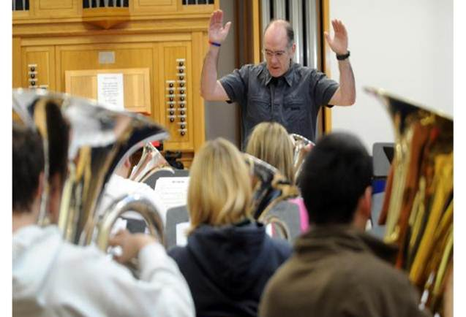
Excellent teaching
YouGov survey 2011 - >70% prospective learners in England said their most significant expectation with high fees would be quality teaching
HE must ensure the best teachers are in front of students; HEA mission – students have an outstanding learning experience
National Teaching Fellowships
Student led Teaching Awards
UK PSF – owned by the sector
More developed CPD frameworks
Embed professionalisation
Notes:
Best teachers – Students get the best possible learning experience.
Student Led Teaching Awards - HEA continues to jointly fund this, which builds on the very successful HEA/NUS Scotland initiative.
UK PSF – To demonstrate ability. The framework, which is owned by the whole sector, provides a general description of the main dimensions of the roles of teaching and supporting learning within the HE environment. It is written from the perspective of the practitioner and outlines a national framework for comprehensively recognising and benchmarking teaching and learning support roles within Higher Education.
Whilst we have http://www.thecompleteuniversityguide.co.uk/ with ratings in Student Satisfaction, Research Assessment; Entry Standards and Graduate Prospects we will always be comparing one institution to another.
Gibbs 2012 forthcoming ‘manual’ from HEA for PVC’s on quality in a market with case studies of institutional strategies.

Slide 13
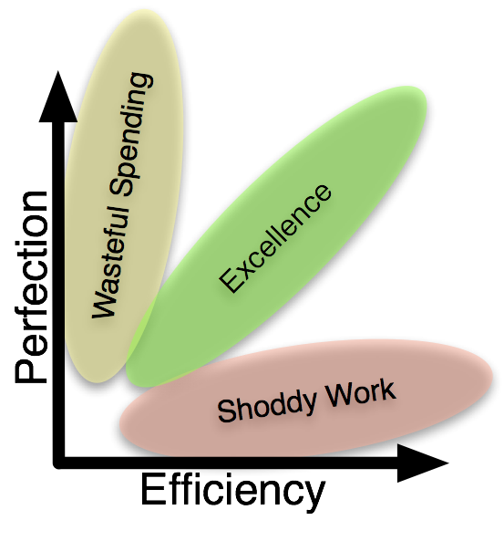
Efficiencies and Effectiveness in HE
Higher education cuts – inevitable
Host efficiency best practice in Resources Centre
There is a range of experience in the public sector to support this development
OER allowing institutions to share materials and information
Notes:
UUK Efficiency and Modernisation Task Group report (published September 2011) - Some recommendations which are relevant to HEA.
Under recommendation 6 : Support for Institutional Change there is a requirement for an efficiency hub, web space to promote services available within the sector that can signpost and highlight innovative developments. Recommends (UUK, HEFCE JISC and LFHE) work together to discuss how facility could be developed and funded. HEA could support this with resource centre.
Under recommendation 12: Procurement as a strategic asset they suggest looking for other effective examples of procurement
Within the public sector there are many examples of shared services and effective procurement so HEA supports looking at good practice elsewhere.
OER presents opportunities to save money by working collaboratively.
There is a range of experience in the public sector to support this development
This relates to one of the key findings in the report “Efficiency and effectiveness in higher education” that there is much evidence of good practice in the sector, but it need better dissemination. This is to do with shared services and effective procurement. There is a suggestion that an Academy for Procurement in Higher Education is established.
There is an opportunity for the HEA to support dissemination through our various channels. So this is an offer of assistance. You may/may not want to keep it in.

Slide 14
Higher Education Academy (HEA)
The HEA is the UK’s leading body working in the sector to advance standards in teaching and learning in higher education
Supporting higher education across the UK
National leadership; stimulating and disseminating
Recognising and rewarding teaching excellence
Supporting and enabling strategic change
Working to advance national priorities in higher education

