Slide 1
Fair access to Russell Group universities
Dr Wendy Piatt
Director General, The Russell Group
27 April 2010

Slide 2
The Russell Group of Universities
University of Birmingham
University of Bristol
University of Cambridge
Cardiff University
University of Edinburgh
University of Glasgow
Imperial College London
King’s College London
University of Leeds
University of Liverpool
London School of Economics and Political Science
University of Manchester
University of Newcastle
University of Nottingham
Queen’s University Belfast
University of Oxford
University of Sheffield
University of Southampton
University College London
University of Warwick

Slide 3
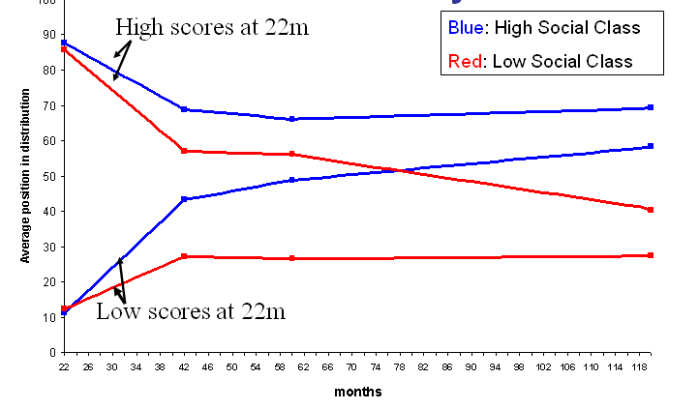
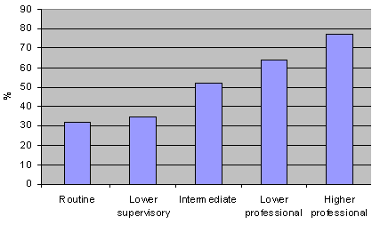
What are the root causes of the under-representation
of poorer students in Russell Group universities?
Change in test scores by social class, 22 months to 10 years
Attainment-background link starts early and widens rapidly
By 22 months of age, social class is a strong predictor of later educational outcomes
By the age of six, the ‘middle class’ children who had low scores at 22 months had not only caught up with but completely overtaken the few poorer children who had done well in those tests
Children in the top attainment quartile at 7yrs old 42% more likely to fall out of it by 11yrs if they are from a lower social group
Attainment of 5+ GCSE grades A*-C by Socio-Economic Group
Big access issue within the state system too
FSM eligibility at top 200 state secondary schools is 3.0%, compared to a
national secondary school average of 14.3%
You are 2.5 times more likely to get 5 good GCSEs if you are from a professional background than if your parents do routine jobs

Slide 4
The socio-economic gap in attainment widens as children progress through school
Significant increases in proportion of students receiving straight A grade.
The independent sector saw a 9.1
percentage point increase in the
proportion of A grades at A-level
between 2002 and 2008 – from
41.3 per cent to 50.4 per cent.
Over the same period, top grades
in comprehensives increased by
only 3.9 points to 20.4 per cent.

Slide 5
The challenges Russell Group universities face in selecting candidates
Candidates with highest grades are disproportionately from independent and grammar schools:
In 2009, the 22% of A-level students from independent (14%) and grammar schools (8%) accounted for over half (52%) of those gaining 3As
Overall, 8% of candidates in comprehensive schools gained 3As compared to 32% in independent schools and 26% in grammar schools
Increasing numbers of A level candidates with top grades:
27% of all A-levels were awarded an A grade in 2009
There were approximately 262,000 A-level candidates last year of which 32,800 (12%) achieved 3As.
RG courses often heavily over-subscribed:
In 2007-08, 97% of Oxford entrants had 3 As; 96% of entrants to Cambridge had more than 3As
LSE had 17,000 applications for just 1,200 places (i.e. 1 in 14 were successful)
In Bristol 1 in 11 home applications were successful; the average A-level tariff of entrants was 436 points (= 3.5 A grades). In some Bristol courses, there are 42 applications per place

Slide 6
Students in state schools are less likely to take key science subjects & foreign languages
Many courses at Russell Group institutions require qualifications in science, maths or modern languages. Up to half of all A-levels accepted by some universities are in these subjects.
But, independent and grammar school students are far more likely to take these subjects. E.g. pupils at independent schools are roughly 3 times more likely to be doing Further Maths and nearly 2.5 times more likely to be doing a language A-level than those at state schools.
35% of Further Maths entries and 34% of MFL entries are in independent schools.
Less than 1 in 10 students in mainstream and science specialised schools take one or more separate science subject at A-level, compared to roughly 1 in 3 at grammar and independent schools.

Slide 7
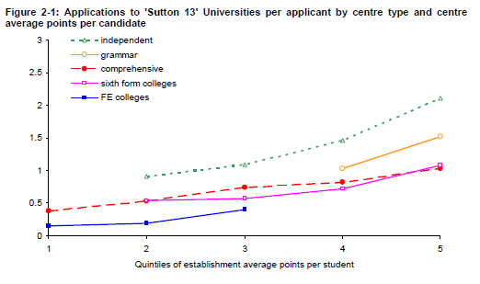
Information, advice and guidance (IAG)
Many of the most talented students from poorer backgrounds do not receive accurate information, advice and guidance about the benefits of studying at a Russell Group university:
A recent survey found that half of state school teachers would not advise even their brightest pupils to apply to Oxford or Cambridge.
Pupils from top independent schools, make twice as many applications to the most selective universities as their peers from the best comprehensive schools.
Source: Sutton Trust/ BIS, Applications, offers and admissions to research led universities

Slide 8
Supported entry routes to Russell Group universities
FOUNDATION YEARS: University of Leeds runs an Interdisciplinary Science Foundation Year as part of a four-year degree programme in any science degree programme, specifically designed for applicants who have not studied suitable subjects prior to entry but have attained the required academic level.
FURTHER EDUCATION TO HIGHER EDUCATION: The Universities of Warwick and Liverpool run various ‘1+3’ year and ‘2+2’ year foundation courses with local FE colleges as progression opportunities into university degrees. These include degree programmes in medicine and dentistry, science and engineering, computer science and information systems, earth sciences, geography, mathematics and physical sciences.
ACCESS COURSES: Access 2 Birmingham is an alternative entry scheme offering special consideration and alternative grade offers to applicants from educationally, financially and socially disadvantaged backgrounds. Applications are encouraged from students who meet the eligibility criteria and have the potential to study at the university but, for a variety of reasons, have not had the opportunity to demonstrate such potential at school.
CAMBRIDGE AREA LINKS SCHEME: Each college at the University of Cambridge is twinned with a Local Authority with the aim of developing long-term aspiration raising programmes. For example, St John’s College is twinned with a disadvantaged London borough and through the EAGLE project, the college provides extra tuition in the classrooms as well as information and advice during College visits. As of 2009, every area of the UK has a formal link with a Cambridge college.

Slide 9
In numbers: Russell Group universities’ work to widen participation
Russell Group universities engage with thousands of young people annually to help raise aspirations and attainment, and widen participation in HE:
In 2008-09, the University of Manchester's widening participation programmes engaged 13,803 pre-16 school pupils over a total of 59,787 contact hours, including academic enrichment activities in STEM, Languages, and Medical and Healthcare Sciences.
LSE runs an annual Summer School, offering 140 school pupils with no history of family involvement in higher education the chance to spend a week at LSE in the summer following their GCSEs.
Over 2,000 students have engaged in hand-on demonstrations in the University of Bristol’s mobile teaching units for the Medical Sciences and Chemistry. The new Chemistry LabSkills e-learning tool will support learning about scientific experimentation in up to 4,000 secondary schools.
The Pathways to the Professions scheme run by the University of Edinburgh works with all 46 state schools in Edinburgh and the Lothians, with over 700 students aged 15-18 registered at any one time. The scheme has engaged with more than 3,000 students since its inception in 2001.

Slide 10
Graduate contributions support fairer access to Russell Group universities
Evidence shows that the most important factors affecting participation are academic achievement and IAG not financial considerations. Evidence clearly shows that the new fees regime did not have an adverse impact on access.
There’s a strong case that graduates should make a fair contribution towards their education, but no one should be put off going to university for financial reasons.
Graduate contributions enable universities to invest in bursaries and in widening participation activities.
Institutional bursaries can be a useful tool for Russell Group universities in persuading students from under-represented groups to apply: In 2007-08 RG universities in England spent £40 million of additional fee income on support for lower income students.
There is a consensus that any reformed funding regime should build on our success in safeguarding access

