Slide 1
Responding to the Challenge
Professor Edward Acton
Vice-Chancellor
University of East Anglia

Slide 2
Responding to the Challenge
  Total Study Time at UK Universities
  Vice-Chancellors’ Response
  Why does it matter?
  Why did it happen?
  What is to be done?

Slide 3
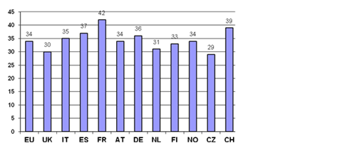
Average (mean) of study hours by country
Source: Report to HEFCE by Centre for Higher Education Research and Information,
The Open University, 2009

Slide 4
