Slide 1

Election 2015: Prospects overall and the role of student electors
Stephen D Fisher
University of Oxford
Presentation for the Higher Education Policy Institute seminar, House of Commons, 27th January 2015: “Election 2015: Threats & opportunities for the sector”

Slide 2
Election Cycle and Poll Effects
Governments lose support in the polls between elections, but recover in the final months
Oppositions gain and then fall back
Parties that happen to go up drop back down a bit by the next election, and vice versa
Polls have tended to over estimate Labour and under estimate the Conservatives

Slide 7
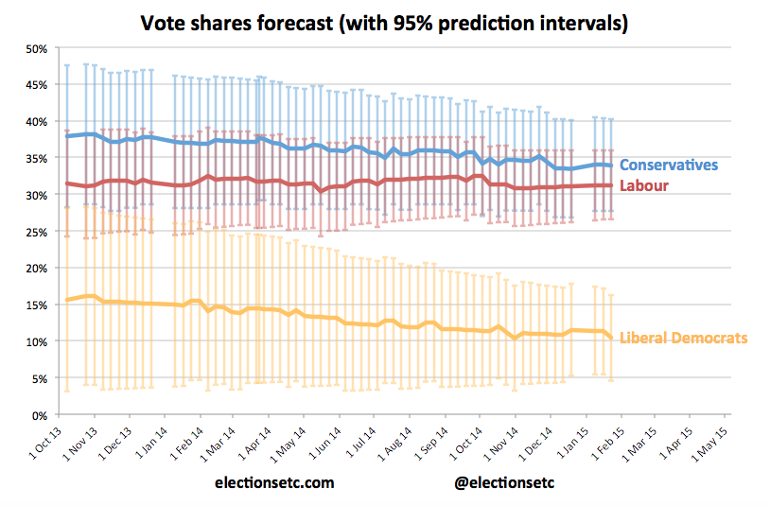

Slide 8
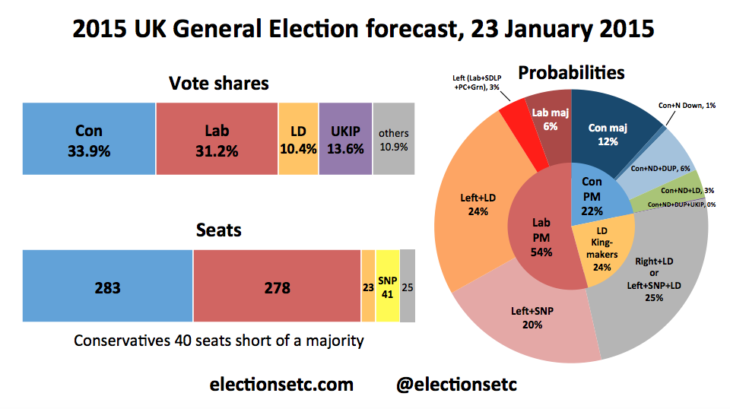

Slide 9
Power of the Student Vote
Individual Electoral Registration problems
Low student turnout
Student vote very sensitive to tuition fees policy proposals
  Likely to punish LD in 2015 more heavily than they did Labour in 2005
Students mainly in safe Labour seats
  But could affect 10 seats

Slide 10
IER and Missing Students
One million voters are "missing” from the electoral register in E&W
  Ed Miliband, 16th Jan.
30% of 18 to 24-year-olds are currently not registered to vote
  Electoral Commission
Numbers down particularly heavily in university towns and wards
Important role for universities

Slide 11
Student Turnout
Turnout 52% for 18-24 year olds in 2010
  65% overall
University student turnout 10 points higher than that for non-student 18-24 year olds
  But still lower than national average
  And much lower than that for graduates
  Sources: British Election Study, House of Commons

Slide 12
Which way will the student vote go?
Student vote since 1997 has tracked generosity of party tuition fees policy
  plus big penalty for Labour in 2005 after apparent breach of top-up fees 2001 promise
BES Sept/Oct 2014 suggests, among students:
  Labour narrowly most popular
  Lib Dems down from 44% in 2010 to 10%
  Greens doing 9 points better than nationally
  UKIP on just 5%

Slide 14
Seats Students might Swing
Bigger student LD to Lab swing could mean:
  2 seats from LD to Con
    Portsmouth S and Kingston and Surbiton
  1 from LD to Lab (Bermondsey and Old Southwark)
  Bristol West from LD to Lab or even Green
    Students also important for Greens defending current seat
  6 from Con to Lab (assuming not otherwise lost)
    Hendon, Lancaster and Fleetwood, Lincoln, Plymouth Sutton and Devonport, Brighton Kemptown and Loughborough
Only 10, but perhaps important for government formation
Ashcroft: Nick Clegg’s seat now a Lib-Lab marginal

