Slide 1
In metrics we trust? HEPI-Elsevier Conference, 31 March 2015 James Wilsdon @jameswilsdon #HEFCEmetrics http://www.hefce.ac.uk/rsrch/metrics/

Slide 3
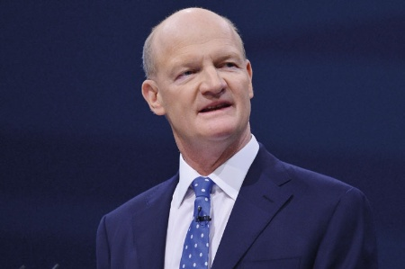
“I can announce today that I have asked HEFCE to undertake a review of the role of metrics in research assessment and management. The review will consider the robustness of metrics across different disciplines and assess their potential contribution to the development of research excellence and impact…”
David Willetts, Minister for Universities & Science, Speech to UUK, 3 April 2014

Slide 4
Steering Group
The review will be chaired by James Wilsdon, Professor of Science and Democracy at the Science Policy Research Unit (SPRU), University of Sussex. He will be supported by an independent steering group and a secretariat from HEFCE’s Research Policy Team:
Dr Liz Allen (Head of Evaluation, Wellcome Trust)
Dr Eleonora Belfiore (Associate Professor of Cultural Policy, University of Warwick)
Dr Philip Campbell (Editor-in-Chief, Nature)
Professor Stephen Curry (Department of Life Sciences, Imperial College London)
Dr Steven Hill (Head of Research Policy, HEFCE)
Professor Richard Jones FRS (Pro-Vice-Chancellor for Research and Innovation, University of Sheffield) – representative of the Royal Society
Professor Roger Kain FBA (Dean and Chief Executive, School of Advanced Study, University of London) – representative of the British Academy
Dr Simon Kerridge (Director of Research Services, University of Kent) – representative of the Association of Research Managers and Administrators
Professor Mike Thelwall (Statistical Cybermetrics Research Group, University of Wolverhampton)
Jane Tinkler (London School of Economics and Political Science)
Dr Ian Viney (Head of Evaluation, Medical Research Council) – representative of Research Councils UK
Professor Paul Wouters (Centre for Science & Technology Studies, University of Leiden)

Slide 5
Our approach and evidence sources
Steering group: diverse expertise and extensive involvement;
Broad-based TORs: opening up, rather than closing down questions;
Transparent: publishing minutes & evidence in real time;
In-depth literature review;
Formal call for evidence, open 1 May to 30 June 2014;
153 responses; 44% HEIs; 27% individuals; 18% learned societies; 7% providers; 2% mission groups; 2% other
Stakeholder engagement
6 ‘review’ workshops, including on equality & diversity, A&H. Invited fiercest critics!
Intensive, ongoing stakeholder engagement;
Social media, especially #hefcemetrics;
Quantitative exercise relating REF outcomes to indicators of research;
Linkage to HEFCE’s evaluations of REF projects;
Interim findings; followed by full report in July.

Slide 6
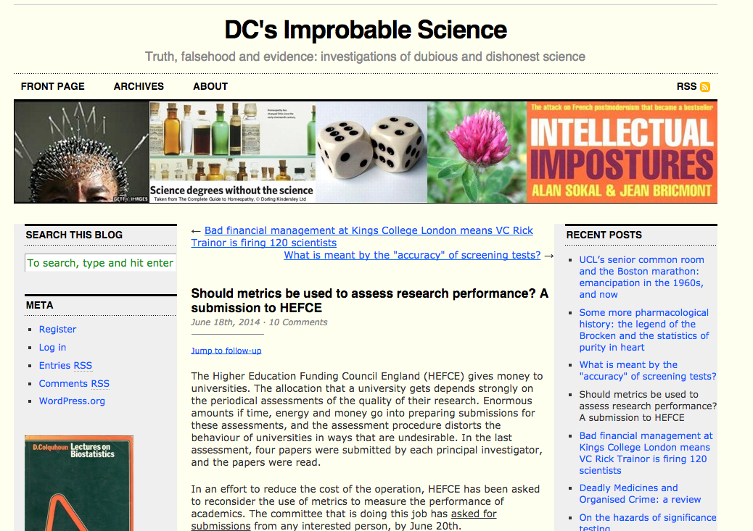
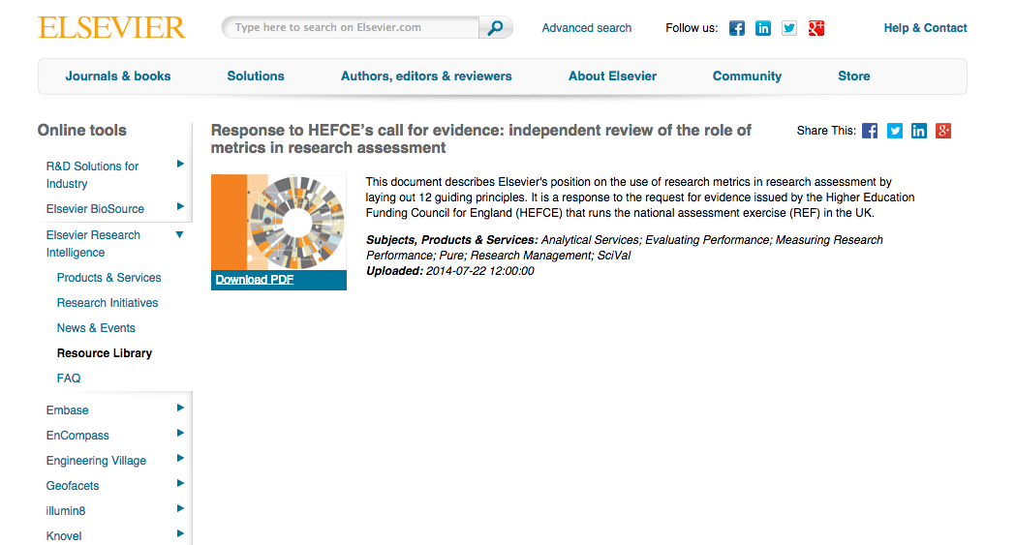
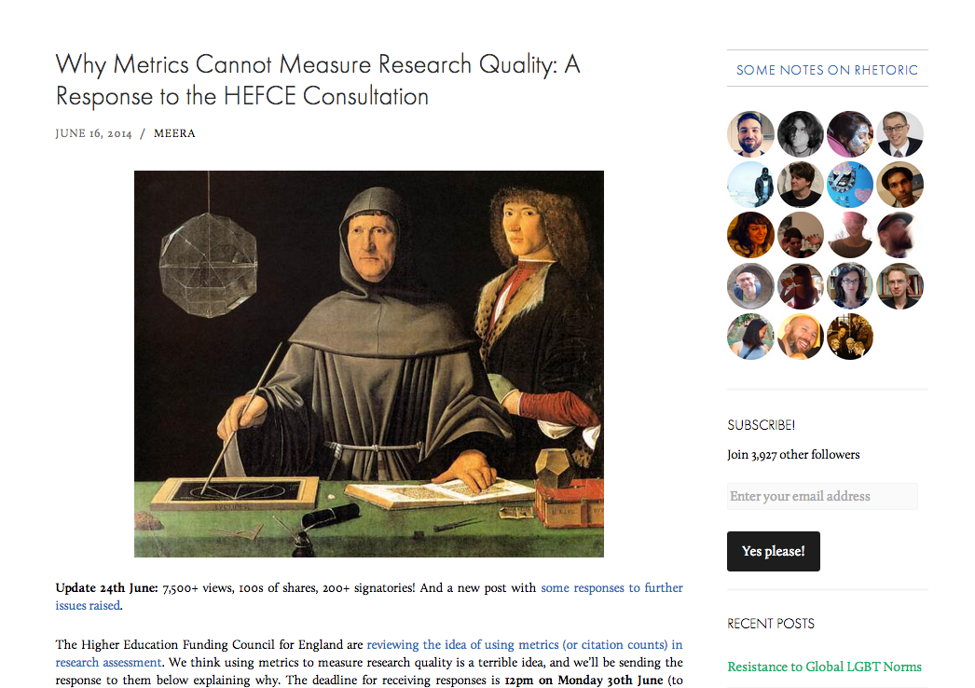
Notes:
These are the Call for Evidence screenshots used in Review workshops, collated onto one slide in case you wanted to use them?

Slide 7
The Metric Tide:
Report of the Independent Review of the Role of Metrics in Research Assessment & Management

Slide 8
Report structure
Chapter 1: Setting the context
Chapter 2: The use and abuse of metrics
Chapter 3: Research management in HEIs
Chapter 4: The research funding system
Chapter 5: The future of the REF
Chapter 6: Conclusions & recommendations
Notes:
I wondered if it would be worth saying something about the overall structure of the report, and then moving on to make the point that today’s presentation will focus on findings from chapter 5, though the final report will be much broader than this
Could say that
(1) While the terms of reference for this review are to consider the use of quantitative information for research assessment broadly, the role of of metrics in future national-scale research assessments, such as the Research Excellence Framework (REF) was an important part of our deliberations.
(2) Much of the evidence that the panel received, both in response to our written call for evidence and at the workshops that we organised, has been concerned with the potential benefits and challenges associated with increased use of quantitative data in the REF.
(3) We draw on all of the evidence sources mentioned earlier to inform this chapter, and use this
to draw conclusions that the four UK HE Funding Bodies should consider as they develop its successor.

Slide 9
But first, a few headlines on context:
The description, production and consumption of ‘metrics’ is contested, complex and open to misunderstandings;
There are deep feelings within the community; diverse and strong opinions voiced throughout the review (e.g. 57% of those responding to our call for evidence were ‘sceptical’);
Research assessment needs to be implemented with due regard for the variable geometry of research (specific to disciplines & contexts);
Need to respect the value of expert judgement, and continue to draw on it where appropriate;
High quality data/inputs are essential, with greater emphasis on transparency, openness and interoperability;
Need to behave responsibly, considering and pre-empting negative consequences.
However:
There is significant appetite and potential for greater/different use of indicators, metrics, data in the future, and…
If improvements can be made to the indicators themselves, the ethics of their use, and data infrastructure (which is currently too unsophisticated).
Notes:
We will need to add to these next week, but may not be able to update on all chapters, e.g. the REF correlation work, before 25 March

Slide 10
Towards guiding principles for metrics informed research evaluation, December 2014
Diana Hicks, Paul Wouters, Jonathan Adams, Ismael Rafols, Ludo Waltman and Sarah de Rijcke
1. Quantitative evaluation should support qualitative, expert assessment. Indicators do not substitute for informed judgment. Everyone retains responsibility for their assessments.
Measure performance in accordance with the research missions of the institution, group or individual researcher.
Enable indicators based on the domestic literature to promote excellent locally relevant research.
Make data collection and analytical processes open, transparent and simple.
Allow those evaluated to verify data and analysis
Account for variation by field in publication and citation practices.
Base the assessment of individual researchers on qualitative judgment of their portfolio.
Avoid misplaced concreteness and false precision.
Recognize systemic effects of assessment and indicators
Scrutinize indicators regularly and, if needed, modify them
Royal Society Science as an Open Enterprise (2012) https://royalsociety.org/policy/projects/science-public-enterprise/Report/
Identified 6 areas for action:
Scientists need to be more open among themselves and with the public and media
Greater recognition needs to be given to the value of data gathering, analysis and communication
Common standards for sharing information are required to make it widely usable
Publishing data in a reusable form to support findings must be mandatory
More experts in managing and supporting the use of digital data are required
New software tools need to be developed to analyse the growing amount of data being gathered
San Francisco Declaration on Research Assessment, 2012
http://www.ascb.org/dora-old/files/SFDeclarationFINAL.pdf
A number of themes run through DORA’s recommendations, which are to be found in full at the above webpage:
--‐ the need to eliminate the use of journal-based metrics, such as Journal Impact
Factors, in funding, appointment, and promotion considerations;
--‐ the need to assess research on its own merits rather than on the basis of the
journal in which the research is published; and
-
Canadian Academy of Sciences (2012) Informing Research Choices: Indicators and Judgment report Informing Research Choices: Indicators and Judgment Report
Key principles: Context matters; Do no harm; Transparency is critical; The judgment of scientific experts remains invaluable
Notes:
These details are for information only in case they are useful for the discussions at the Steering Group next week.

Slide 12
REF chapter: general points
Diverse views on:
purposes of the REF (& need for a richer account of these)
how and whether quantitative indicators of research quality should feature in the assessment;
Concerns over perceived and actual burden of REF, including opportunity costs;
Some see metrics and indicators as a means to reduce burden/costs;
Recognition that there are increasing opportunities to gather and use indicators and quant data within research assessment than in the past;
Metrics as well as peer review?
A majority feel that peer review should remain central. So adding metrics means burden increase, rather than dilution!
Concerns over unintended consequences of metrics/indicators;
Concerns that some disciplines will be disadvantaged.
Notes:
Not all the written evidence about the REF we received acknowledged the diversity of purposes of the REF, and there are clearly differences of opinion about the relative importance of the purposes. It is not surprising, therefore, that there are equally different views on how and whether quantitative indicators of research quality should feature in the assessment.
This slide captures some of the overall points and concerns gathered through the process of evidence gathering

Slide 13
Outputs
It is not currently feasible to assess the quality of research outputs using quantitative indicators alone;
Disciplinary coverage of citation databases still falls short of what is required, especially for outputs that are not journal articles;
Real concerns over bias and resultant effects on equality and diversity;
No set of numbers, however broad, is likely to be able to capture the multifaceted and nuanced judgments on the quality of research outputs that the REF currently provides;
However, quantitative data do have a place in informing peer review judgments. This approach has been used successfully in REF2014, and we recommend that it be continued and enhanced in future exercises.
Notes:
Should we highlight (again) the evidence base for looking at outputs in relation to metrics in the REF?

Slide 14
Correlation project
Why?
To establish the extent to which the outcome of the REF assessment correlates with a range of metrics-based indicators of research
Analysis/data
Analysis by Analytical Services Directorate, HEFCE;
Analysis is being undertaken at the level of individual outputs., using article level scores from REF for all outputs with a DOI (149,670 out of 191,080 REF outputs);
Article level metrics were provided by Scopus/Elsevier;
The data was linked into staff characteristics from HESA;
Data anonymised [DOIs and staff identifiers removed, HEI identifiers anonymised].

Slide 15
List of indicators
Variable name | Description | Type
citation_count | Absolute number of citations per publication | Numeric, continuous
fwci | Field weighted citation impact - this normalises citations in a field using the world benchmark in that field | Numeric, continuous, bounded
Percentile | Top 1st, 5th, 10th, 25th, 50th, over 50th percentile of highly cited publications | Categorical, numeric
SNIP | Source normalized impact per paper | Numeric, continuous, bounded
SJR | SCImago Journal Rank | Numeric, continuous, bounded
Collaboration | Single author, Same institution, Same country, At least one author from outside UK | Categorical, character
Authors | Number of distinct authors | Numeric, continuous
AuthorCountries | Number of distinct countries associated with authors | Numeric, continuous, bounded
CrossAcademicCorporate | At least one author from academia and one from the corporate sector | Binary
WIPO_patent_citations | Number of times cited by World Intellectual Property Organization | Numeric, continuous
MendeleyRead | Number of Mendeley article bookmarks/article sharing | Numeric, continuous
SciDir_Dwnld | Number of ScienceDirect publication downloads or full-text views | Numeric, continuous
ScopusFullTextClicks | No of full text requests on scopus.com (user must be subscribed to journal) | Numeric, continuous
Tweet | No of times tweeted (this is not restricted to the reference REF dates) | Numeric, continuous
GS_count | No of times cited on Google Scholar (this is not restricted to the reference REF dates) | Numeric, continuous

Slide 16
Correlation project
What we have established to date and what next?
Unsurprisingly, there is limited coverage in some disciplines within the citation database used, especially for Panel D subjects and law;
Raw correlations vary in strength depending on UOA and metrics examined;
However we need to look at practical predictive power rather than statistical correlations;
We are therefore building a model to ascertain the potential predictive ability of the metrics. Once built, the model will be run at UoA level, and will also consider gender and ECR;
Our analysis is yet to be completed but will be published as an annex alongside out main report in July.

Slide 17
Impact
It is not feasible to assess the quality of research impact using quantitative indicators alone;
Research impact in the REF is broadly defined, however, quantitative data and indicators are highly specific to the type of impact concerned;
Viewing quantitative data about impact needs to be seen in context, and is likely to require a narrative element;
There is potential to enhance the use of quantitative data as supporting evidence within a narrative case-study-based approach to impact assessment;
HE Funding Bodies should build on the analysis of the impact case studies from REF 2014 to develop a set of guidelines on the use of quantitative evidence of impact (cf Digital Science/KPI study);
These guidelines should provide suggested data to evidence specific types of impact and could also include standards for the collection of data.
Notes:
Again, should we reiterate the evidence bases drawn upon here?
Do we need to say something about the developments in Impact indicators upfront?

Slide 18
Environment
There is scope for enhancing the use of quantitative data for the assessment of research environment if:
panels are provided with sufficient context to enable their interpretation. As a minimum this needs to include information on the total size of the unit to which the data refers, and in some cases the collection of data specifically relating to staff submitted to the exercise may be preferable, albeit more costly.
The HE Funding Bodies should consider increased use of quantitative data for the assessment of research environment in the next national exercise. As well as collecting data on PhD student numbers and research income, consideration should be given to other sources of data including, but not limited to:
the age profile of staff; the representation of people with protected characteristics; bibliometrics measures of the academic impact of the whole set of publications from the assessed unit; quantitative data on broader research impact that is collected in the Higher Education Business and Community Interaction Survey (HEBCIS).

Slide 19
Costs of metrics-based research
Common assumption that a metrics-based exercise would cost less;
The collection of quantitative data and its processing to produce metrics and indicators is not itself cost free;
Experience from REF2014 suggests that even relatively straightforward data sources often require considerable effort to validate and sometimes correct (eg citation data & HESA statistics);
The review of the costs of the REF (Technopolis, 2015) indicate that the use of citation data in REF2014 encouraged HEIs to use this information in their preparations for the exercise, which resulted in additional costs locally;
Some costs of assessment are related to the structure, rather than the mechanism of assessment, e.g. significant costs to HEIs associated with selecting staff or outputs to be submitted for assessment (Technopolis, 2015);
If these features remain, the reduction in cost that resulted in using bibliometrics to assess outputs might be rather modest.

Slide 20
Underpinning infrastructure
If metrics are to be used, it is critical that they are as accurate & reliable as possible, otherwise they will be mistrusted
How underlying data is collected/processed is very important
We therefore need:
Unique, disambiguated, persistent, verified identifiers
Agreed standard data formats
Agreed standard data semantics
If we are to end up with:
Agreed standard metrics
Notes:
SRK – first draft of the ‘ORCID’ slide
Telling the ‘story’ of how, if metrics are to be used then it is crucial that they are as accurate as possible

Slide 21
Example: Academic ID
An open, universal, disambiguated identifier for academic staff would enable much greater accuracy in metrics
The Open Research Contributor ID (ORCID iD)
Possible ‘incentives’ for using ORCID iDs:
Mandate for REF submission
Mandate for RCUK (Je-S) proposal submission
Mandate for other funder submission (eg Wellcome Trust?)
Mandate for article submission (eg NPG?)
Institutional mandate (eg Imperial)
→ Better quality metrics
REF and other assessments
League tables
Promotion and hiring
Notes:
So – REF mandate would be a *big* lever
As would RCUK – but so far it is not even a field in Je-S – they need to get their finger out
Wellcome collect ORCIDs (but don’t yet mandate) as to NIH ans NSF in the USA. FCT in Portugal does mandate, as does Autism Speaks in the USA
Some publishes collect ORCIDs in their workflows. Mandates would help
HEI mandates are perhaps not as good (Imperial has done it.. But how many academic staff have bought in to it…)
In terms of the benefits… maybe we don’t’ want to mention these…. But the latter two does use them already, so this would help make them less bad… ;-)

Slide 22
Options for future REF design
Metrics only
Interim evaluations
Change to structure of assessment
Metrics for outputs
REF2014
Incremental change
Increasing use of quantitative data

Slide 23
Our provisional recommendations on REF
Outputs
Continue providing panel members with bibliometric and other data to support peer review judgments;
Increase sophistication of information provided;
Provide information to all panels, but leave them to decide how much (if any) if used.
Impact
Encourage use of quantitative evidence to support case studies; build on DS/KCL work to specify sets of quant data that can be used in specific types of case study.
Environment
Considerably enhance the use of quantitative data in the environment section, such as….
Increase the amount of contextual information to help panels interpret data.
Notes:
Say something about assumed timing of next REF

Slide 24
What’s next for the review?
Further report writing and stakeholder consultation;
Still in listening mode…
Final report out on 9 July, with launch event in London.
The full report will :
Outline key findings (including but also beyond the REF);
Set out a recommendations for target groups: HEIs; funders; research managers; publishers; data providers; libraries & information managers; government departments.
Quantitative evaluation should support qualitative, expert assessment. Indicators do not substitute for informed judgment. Make data collection and analytical processes open, transparent and simple. Account for variation by field in publication and citation practices. Avoid misplaced concreteness and false precision.
Neither ‘pro-’ nor ‘anti-’ but in favour of responsible metrics;
No instant solutions; a 15-year transition is required.
Notes:
See next 2 slides for further detail on underpinning infrastructure recommendation (provided by Simon K)

Slide 25
The Metric Tide:
Report of the Independent Review of the Role of Metrics in Research Assessment & Management

Slide 26
http://www.hefce.ac.uk/rsrch/metrics/ metrics@hefce.ac.uk ; #HEFCEmetrics j.wilsdon@sussex.ac.uk; @jameswilsdon

