Slide 1
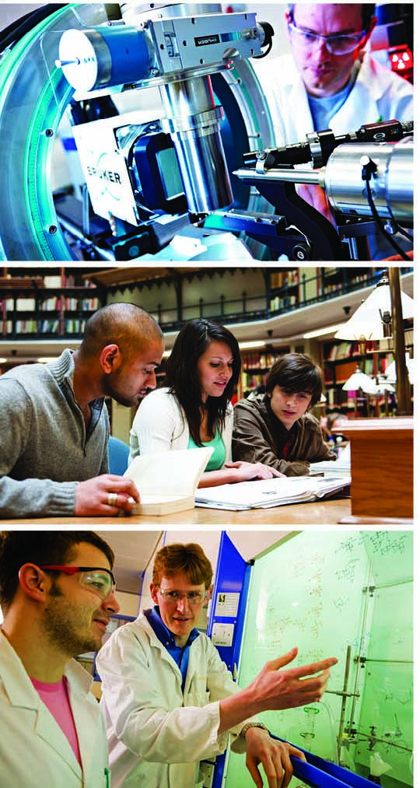


Impact in REF2014: what have we learned?
Steven Hill
Head of Research Policy
HEPI Conference
31 March 2015
@stevenhill

Slide 2
Summary
  Recap impact in REF 2014
  Outcomes
  What have we learned?
  Conclusions

Slide 3
Summary
  Recap impact in REF 2014
  Outcomes
  What have we learned?
  Conclusions

Slide 4

What was assessed
Panels judged the overall quality of each submission
Quality of research outputs
Impact of research on society
The research environment
65%
20%
15%
The review was based on data and information about the environment
191,150 research outputs by 52,061 staff were reviewed
6,975 impact case studies were reviewed

Slide 5
The definition of impact is broad
  “For the purposes of the REF, impact is defined as an effect on, change or benefit to the economy, society, culture, public policy or services, health, the environment or quality of life, beyond academia”

Slide 6
Summary
  Recap impact in REF 2014
  Outcomes
  What have we learned?
  Conclusions

Slide 7
For the first time, REF has demonstrated the impact of UK research in all subjects
Over 250 research users judged the impacts, jointly with academic panel members.
44% of impacts were judged outstanding (4*). A further 40% were judged very considerable (3*).
Impressive impacts were found from research in all subjects.
REF shows many ways in which research has fuelled economic prosperity, influenced public policy and services, enhanced communities and civic society, enriched cultural life, improved health and wellbeing, and tackled environmental challenges.

Slide 8
Impressive impact was found across institutions with submissions of all sizes

Slide 9
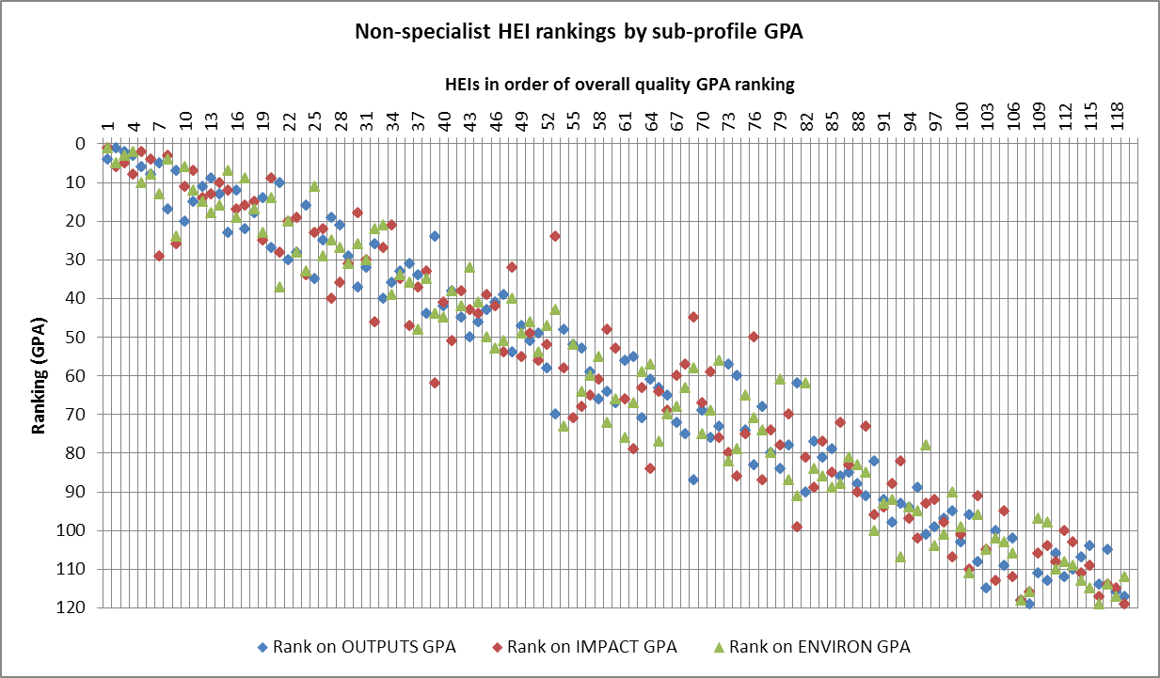
Impact and other scores related, but not perfectly

Slide 10
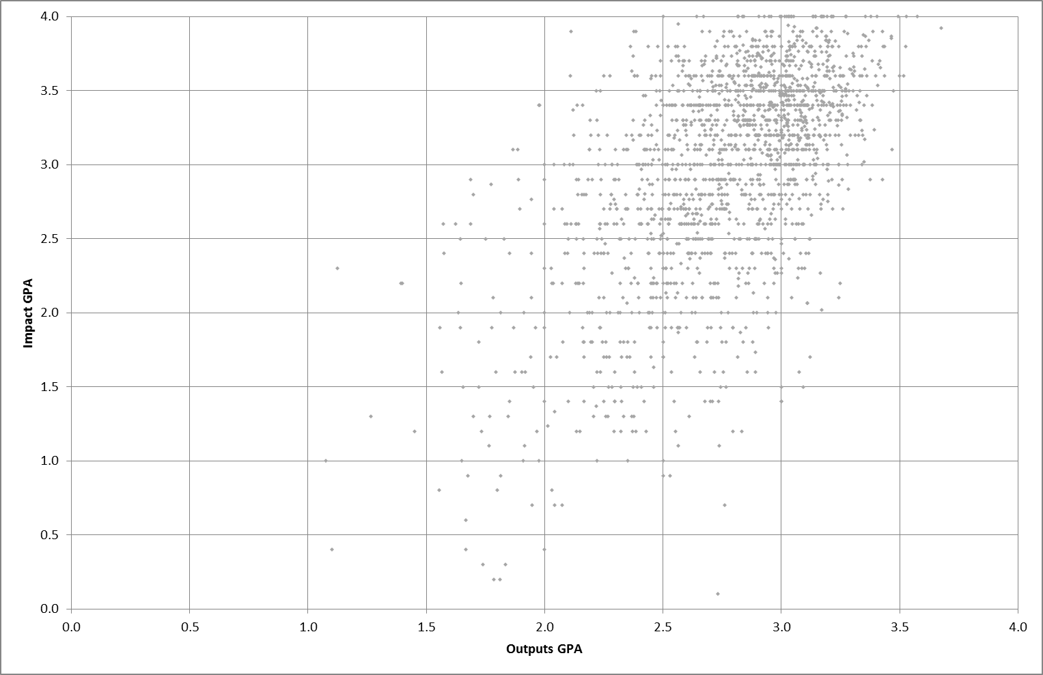
Impact and other scores related, but not perfectly

Slide 11
Summary
  Recap impact in REF 2014
  Outcomes
  What have we learned?
  Conclusions

Slide 12
Sources of evidence
  Feedback from HEIs (written, early 2014)
  Feedback from panel members (focus groups, Dec 2014/Jan 2015)
  Evaluation of impact element (RAND Europe, published Mar 2015)
    Preparation of submissions (fieldwork Dec 2013-Feb 2014)
    Assessment (fieldwork Oct-Dec 2014)
  Analysis of case studies (Digital Science, King's College London, published Mar 2015)

Slide 13
What have we learned?
  Preparing for impact has provided benefits and strategic insight to Universities

Slide 14
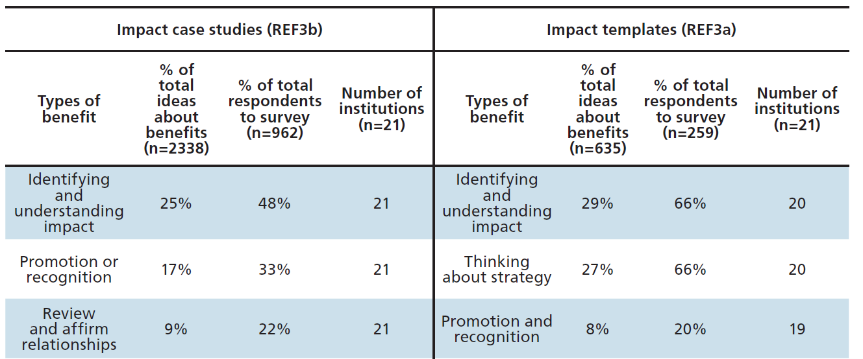
There was evidence that assessment of impact as part of REF 2014 along with other policies (such as RCUK’s ‘Pathways to impact’) and the broader ‘impact agenda’ has led to cultural change within HEIs
'I noticed my perception of research changing slightly and my passion to make an impact with my research enhanced; this was due to constant in-depth thinking about what we (and I) do in the unit and why we do it. I can say that I became totally immersed in the topic of impact and became fascinated by the area'
It would be useful to know how many people this came from as could be skewed if 1 person wrote no benefit 3 times
Jess – include Table 2-1 here instead
Notes:
As part of the project we carried out online surveys for the authors of the impact case studies and templates which described the impact strategy for each submission.
The most frequently mentioned benefit was the ability to identify and understand impact of research.
2/3 of impact template authors also appreciated the ability to reflect on strategy – for their own research or wider faculty or university
Role of promoting and recognising work of colleagues, enabling the value of their work to be recognised by colleagues, and more widely within the HEI
The final benefit I want to highlight to you is that the creating of impact templates and case studies enabled HEIs to review and affirm relationships with ‘research users’.

Slide 15
Feedback from participating HEIs
  “It is fair to say that over the period of preparation, the status and visibility of research activity; its relevance to the everyday work of staff and students; and its visibility to the [institution’s] large communities of members of the public and other academic and business collaborators, has been considerably invigorated and enhanced.”
  “The most positive aspect of preparing for REF 2014 was to illuminate the vast array of research impact which [the university] may not otherwise have realised it had.”
  “In short, we know more about ourselves as a consequence of making a REF submission.”

Slide 16






As a result of the impact agenda and changing culture, HEIs are changing their practice
‘REF3A is informing the [impact] strategies that are currently being written’
  Setting out an impact strategy
  Fixed-term posts becoming permanent
  Implementing systems to store evidence of impact
  Capturing evidence of impact on an ongoing basis
  Building a plan for impact into projects
  Inclusion of impact as a criterion for promotion
Notes:
Evidence of cultural change within HEIs.
Areas where practice is changing in the sector include resourcing, retention, promotion and recruitment of personnel

Slide 17
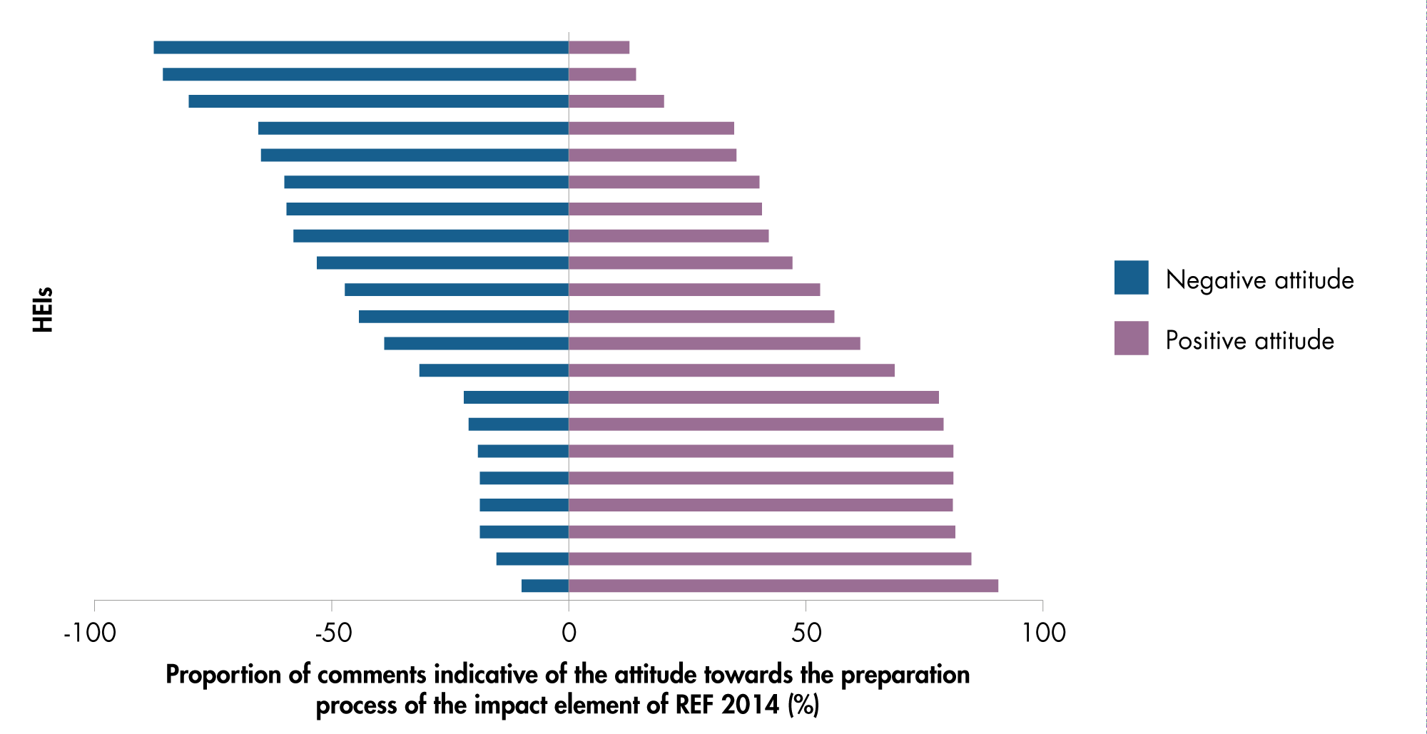
  HEIs within our samples had different attitudes towards the process and were positive or negative to varying extents
Notes:
A range of perspectives were expressed within individuals HEIs. But in general there were some institutions that were largely positive and some that were predominantly negative in their attitude

Slide 18
What have we learned?
  Preparing for impact has provided benefits and strategic insight to Universities
  The assessment of impact worked well, but there are areas for improvement

Slide 19
By a large majority, panellists felt the process enabled them to assess impact in a fair, reliable and robust way
‘I’ve been struck all the way through by… the efforts being made on the structure of the exercise to ensure that there was a fair and proper assessment.’
Total number of panellists involved in impact element: 1161
Survey: 572 Focus groups: 112 1-2-1 interviews: 20
Notes:
We spoke to at least 50% of panellists
The process created confidence
There was Consistency in the scores given by individuals assessing case studies/
Room for improvement, but that much of it had gone well.

Slide 20


Areas for further thought and improvement
‘There is much to commend [it] although there are improvements to be made and
much to be learned.’
Panellists felt they were able to differentiate between submissions in a more detail than the scoring process allowed them to express
There was variation in the way the process was conducted
There were particular challenges in assessing the impact templates
Lack of requirement to evidence meant quality of writing had a large effect
Options for the future:
  Combine with environment template
  Use of metrics and factual information
  Remove it

Slide 21
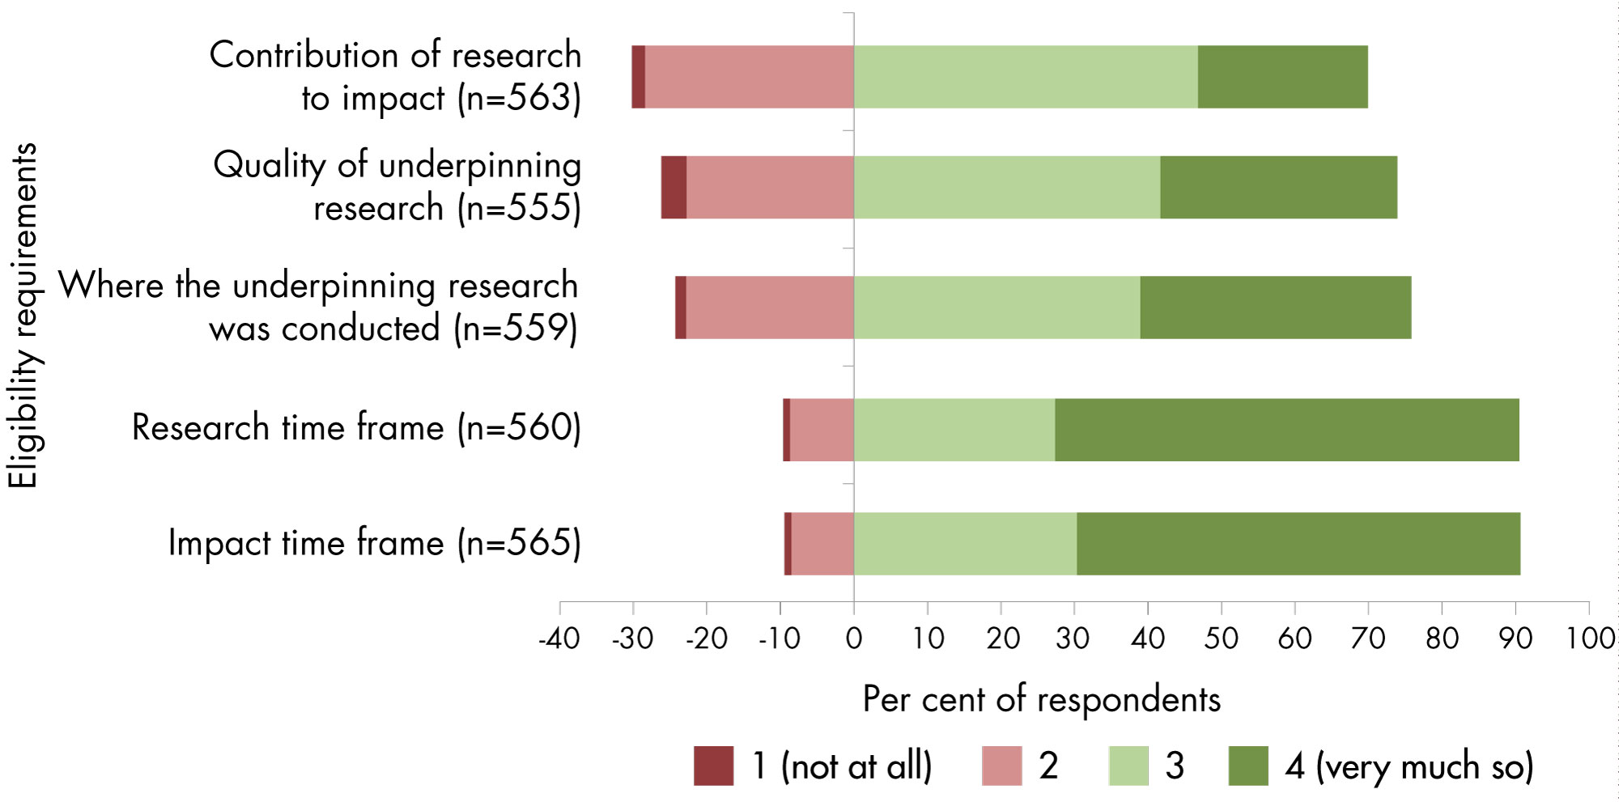
Review and scoring
‘Where there was a clear articulation of impact regarding the type of impact made and this was backed up with evidence, the case study was relatively easy to assess.’
Fig 5.1
Underpinning research
Contribution of research to impact
Notes:
5.2.6. Contribution of research to impact
There was a lot of discussion in the focus groups about the link between underpinning research and impact, and the need to articulate this link in the impact case studies.
Most but not all panellists found it relatively difficult to verify the link and there was agreement that links between research and impact were sometimes more tenuous than they would have liked.
Panellists raised examples of where a body of research had led to the reputation of a researcher enabling them to work with and advise public bodies and policymakers.
Key in areas of: public engagement, where the link was to a ‘high-impact individual’ rather than a particular piece of work. Focus group participants from all main panel areas referred to individuals with high media profiles and questioned the impact that they could claim, as a lot of the work they disseminate is not their primary research.
This links to the discussion of the role of researchers in achieving impact. Should intended and unintended impact should be rewarded equally? For example, a company or the government might choose not to implement something due to financial constraints or wider political factors and contextual considerations rather than as a result of the quality of the research.
5.2.4. Quality of underpinning research
Approximately 25 per cent of sub-panel members and impact assessors found it difficult to rate the criterion of the quality of underpinning research, in their assessment of impact case studies.
Focus group attendees noted that assessing whether work met the 2-star threshold created a lot of challenges, particularly where it spanned disciplines.
Often Research users left it to academics to determine

Slide 22



There is a strong desire by HEIs for the Funding Councils to issue clear guidance on the approach to be adopted for the next round of REF as soon as possible
'HEFCE need to tell us what they want right now'
The sector wants stability for the next REF
There is a need to announce the rules for the next REF as soon as possible, including any changes
Figure 5-1
  Definition
  Evidence gathering
  Impact template
Notes:
Regardless of the overall structure of the next REF, HEIs want to know as soon as possible how impact will be assessed
Desire for clarification of guidance in key areas – for example use of illustrative examples of reach and sig, guidance on the type and level of evidence required.
Any changes should be incremental in nature, rather than radical
Improvements:
Definition of impact – broader or aligned with RCUK
Evidence – how to facilitate the process on an ongoing basis
What to do with the impact template - which we will touch on again in the assessment process from the panellists perspective

Slide 23
What have we learned?
  Preparing for impact has provided benefits and strategic insight to Universities
  The assessment of impact worked well, but there are areas for improvement
  Considerable and diverse impacts were submitted for assessment

Slide 24
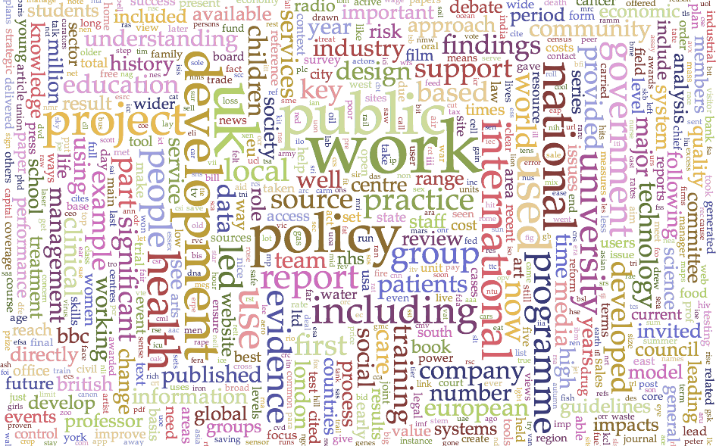

Slide 25
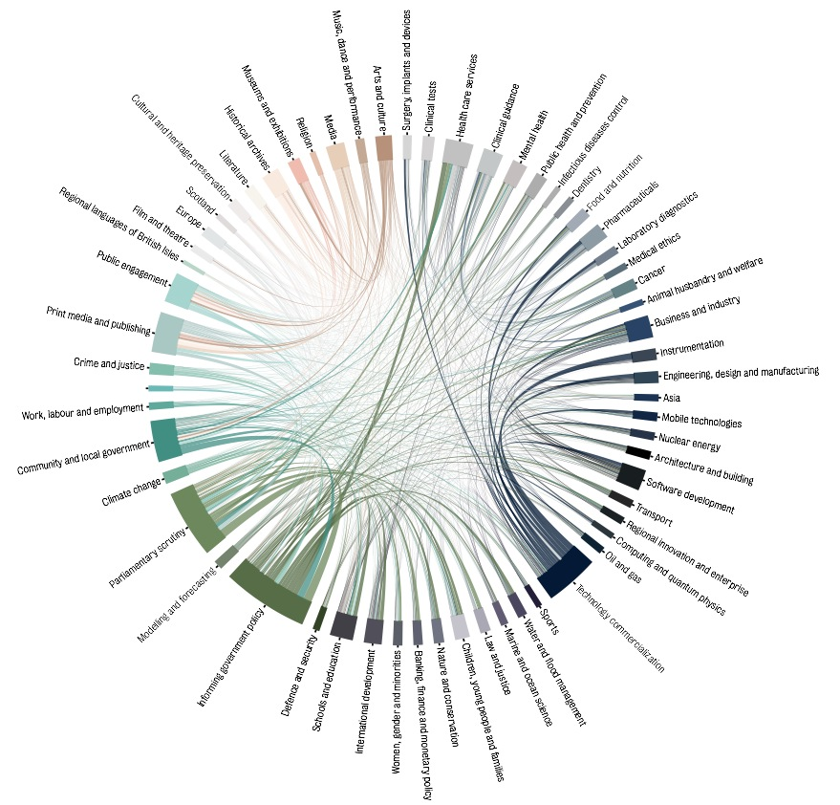
Multiple impact topics occur across the case studies

Slide 26
Different types of impact are more common in different disciplines (1)

Slide 27
What have we learned?
  Preparing for impact has provided benefits and strategic insight to Universities
  The assessment of impact worked well, but there are areas for improvement
  Considerable and diverse impacts were submitted for assessment
  Impact derives from the integration of disciplinary knowledge

Slide 28
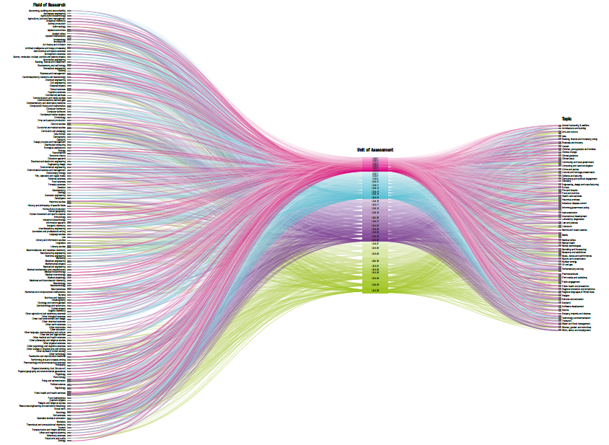
There is a diverse range of impact pathways

Slide 29
What have we learned?
  Preparing for impact has provided benefits and strategic insight to Universities
  The assessment of impact worked well, but there are areas for improvement
  Considerable and diverse impacts were submitted for assessment
  Impact derives from the integration of disciplinary knowledge
  The systematic collection of impact data has generated an important national asset, and provided new insight into the relationship between research and impact

Slide 30
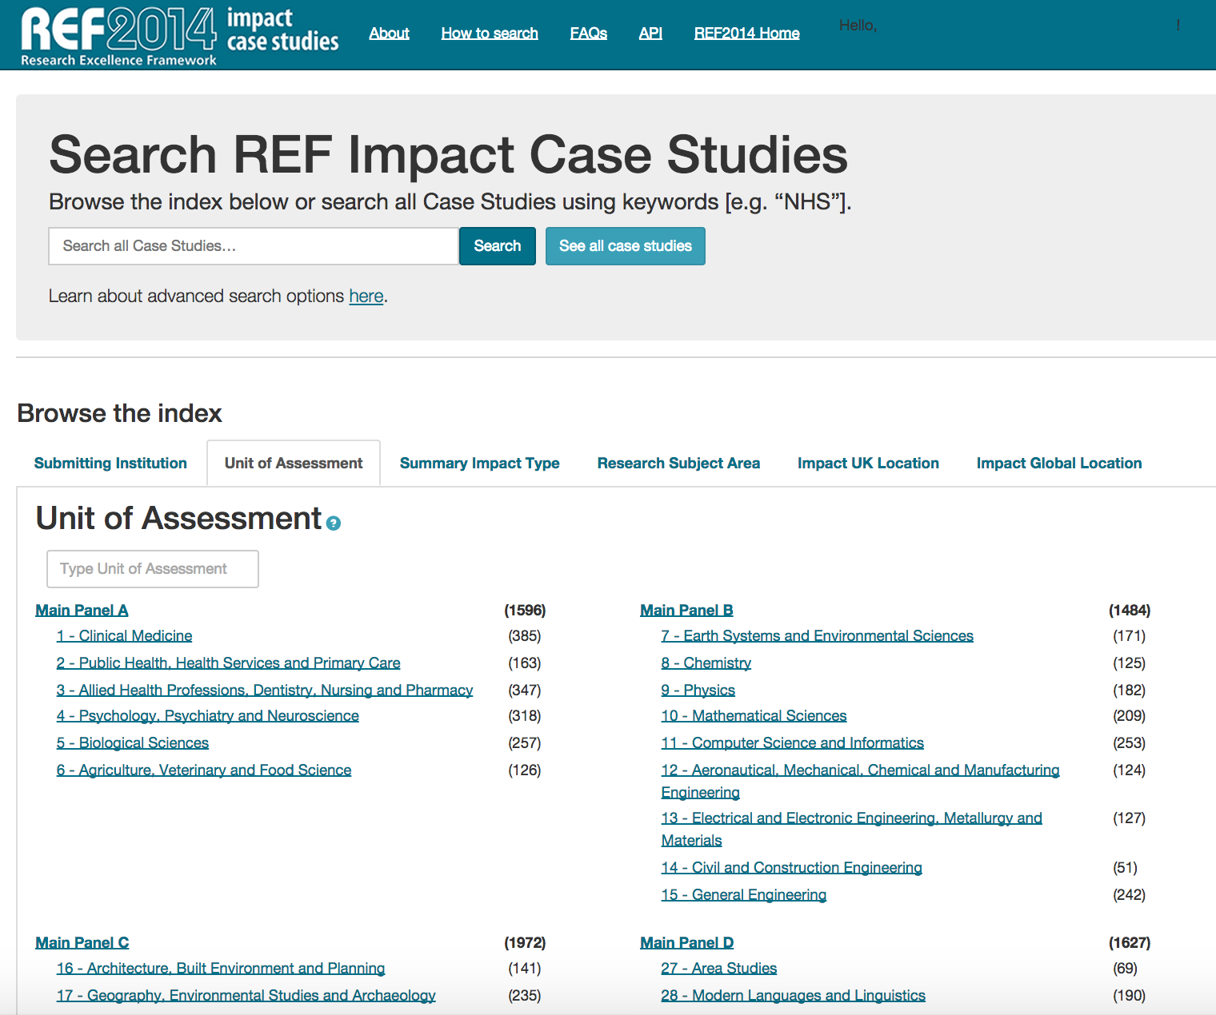

Slide 31
UK HEI research has had an impact on BRIC countries

Slide 32
Impact on BRIC countries was varied and comprehensive, sometime strategic
Selected a random sample of 50 case studies from each of the four BRIC countries (n=200 in total) for qualitative analysis
Impacts were strategic (i.e. collaboration with an international partner organization was created to conduct the research) or as incidental (i.e. positive but not specified intended outcomes in the specified country as a result of the research)
Examples of impacts include:
creation of spin-out companies and agreements of licenses
informing government policy in that country
the creation of new technologies to develop in that country
creation of online resources for wide public use

Slide 33
Conclusions
  No evidence to suggest the removal of the impact element or a radical change to the approach…
  …but some areas for review/reform:
    Impact template
    Evidence and data requirements
    FTE thresholds
    Etc.
  Case study database is an important source of evidence

Slide 34
Summary
  Recap impact in REF 2014
  Outcomes
  What have we learned?
  Conclusions

Slide 35
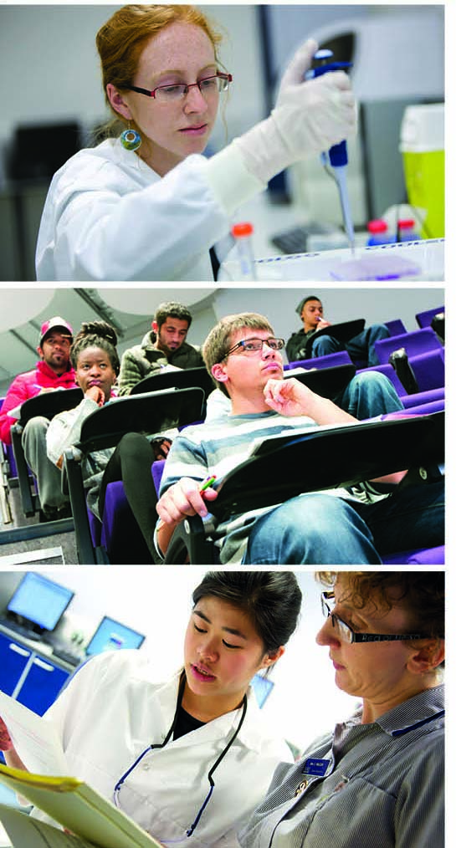
Thank you for listening
s.hill@hefce.ac.uk
@stevenhill

