Slide 1
How can information inform judgments?
Nick Fowler, Managing Director, Research Management, Elsevier
HEPI conference, London
March 31st 2015

Slide 2

Elsevier has a unique vantage point on research
Each year
1.2 million article manuscripts received by ~2,000 journals (all offer Open Access options)
350,000 new articles published, in addition to 11M existing articles
2,000 new books published
ScienceDirect: 800M digital article downloads
Scopus: 55M records, 21,900 titles, 5,000 publishers, 700M citations
SciVal: 75 trillion metrics values
Pure: current research information system: >200,000 researchers supported
Mendeley: 3M users globally
Grants:7,000 sponsors, 20,000+ active opportunities, ~5M awarded grants
Patents: >93m records, 100 patent offices
Primary publishing
Derived and aggregated data

Slide 3



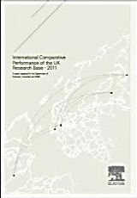
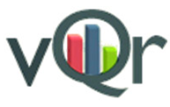








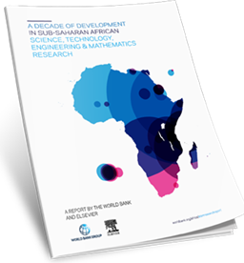
Elsevier has a unique vantage point on research
National research assessment and benchmarking reports
  UK REF, UK BIS reports
  ERA (Australia)
  FCT (Portugal)
  VQR (Italy)
Global University Rankings
  Times Higher World University Rankings
  QS rankings
  US News rankings (Arab Region)
Research reports conducted with
  UK Royal Society
  Science Europe
  European Commission, FENS, HBP, Kavli Foundation, RIKEN BSI
  World Bank
  EuroStemCell, Kyoto University

Slide 4
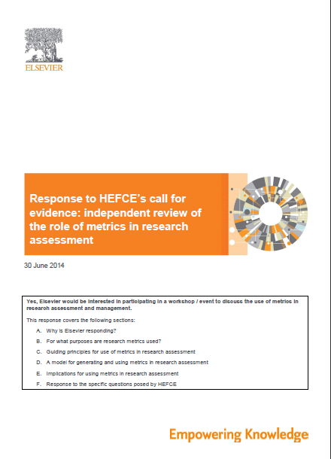
Elsevier’s perspective on metrics

Slide 5
Elsevier perspective 1:
Metrics should complement, not replace human judgment
Metrics should be used together with peer review and expert opinion

Slide 6
Elsevier perspective 2:
Metrics embody human judgment, they are not independent of it
When metrics and peer review or expert opinion give different answers, probe further

Slide 7
Elsevier perspective 3:
“Metrics” does not only mean bibliometrics
Metrics also describe activities related to funding, collaboration, commercialisation, and impact
Multiple metrics used together give the richest perspective

Slide 8

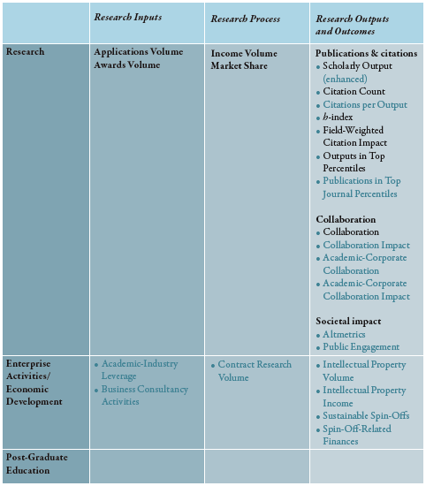
Q. Which metrics? A. Snowball Metrics!
Recipes in first recipe book
Recipes added in second recipe book

Slide 9

Common counter arguments against metrics
• Greater use of metrics will lead to “gaming” by researchers
• Metrics aren’t suitable for the Humanities
• Metrics risk perpetuating biases, such as gender biases

Slide 10

Counter argument 1: Gaming
Counter-argument
Counter-counter argument
Greater use of metrics will lead to “gaming” by researchers
Well-selected metrics drive positive behaviours
Multiple metrics make gaming very hard
Metrics plus peer review and expert opinion will detect gaming

Slide 11

Counter argument 2: Humanities
Counter-argument
Counter-counter argument
Metrics aren’t suitable for the Humanities
Data sources to cover humanities are becoming more complete
Research metrics are relevant for Humanities researchers

Slide 12

Counter argument 3: Biases
Counter-argument
Counter-counter argument
Metrics risk perpetuating biases, such as gender biases
Metrics reflect researchers’ activity
Metrics can help monitor and eliminate biases

Slide 13
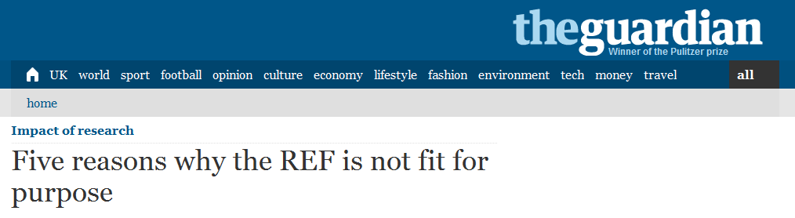
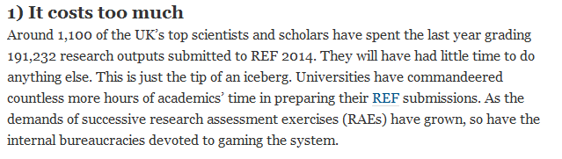
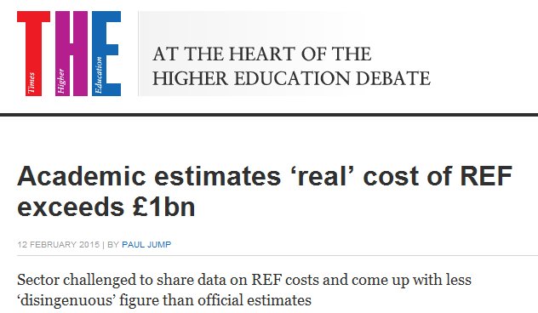
Consideration 1: cost

Slide 14
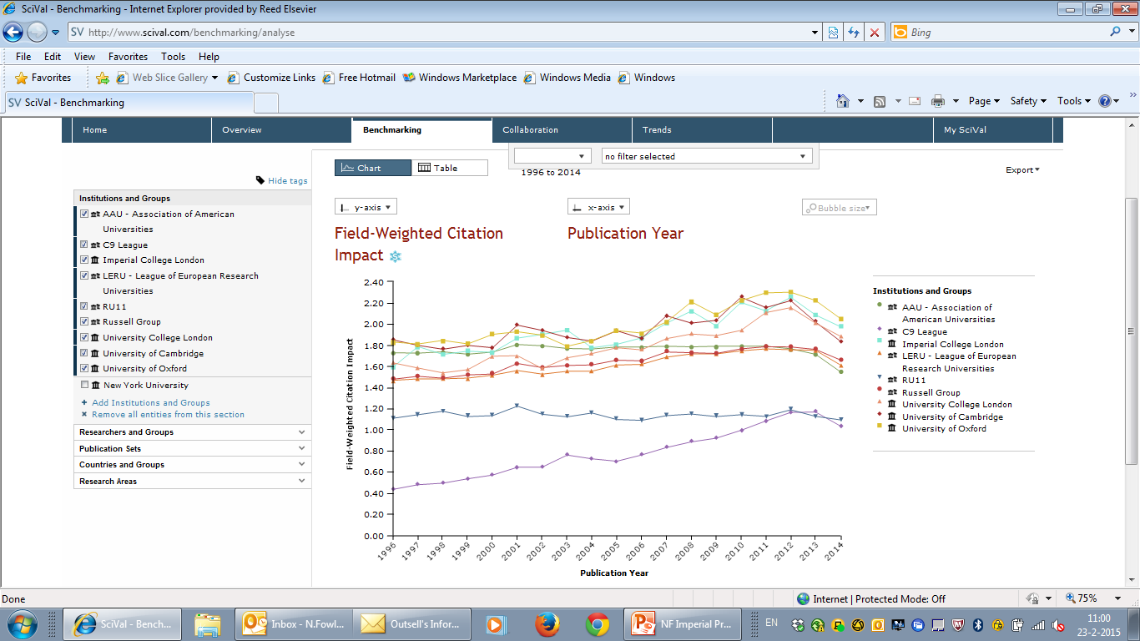
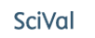
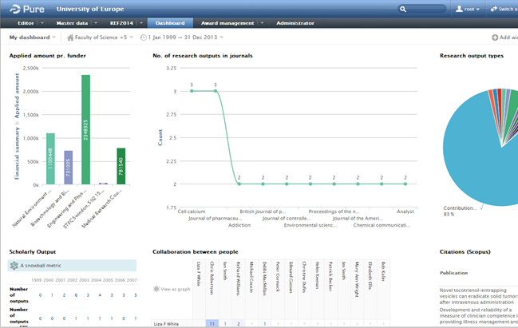
Consideration 2: availability of tools and systems

Slide 15
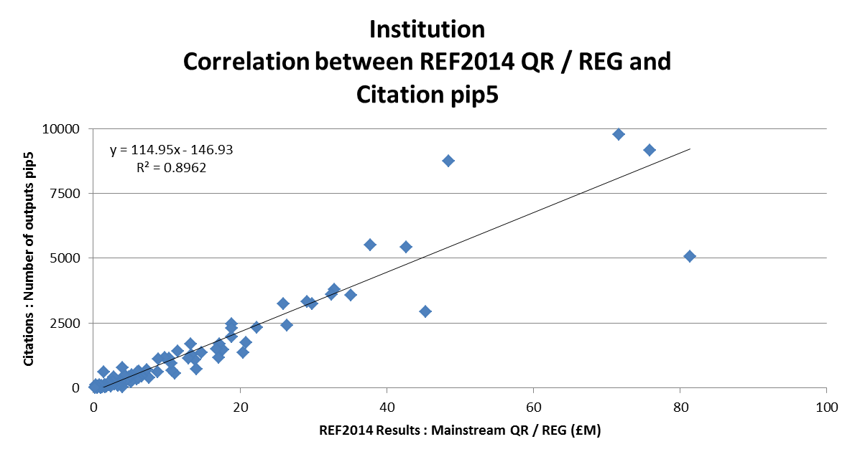
Analysis 1: QR vs number of top 5% publications
R² = 0.8962
Measure | Notes
REF QR / REG | £M Mainstream QR / REG awarded for 15/16
Citation pip5 | # outputs that fall within the global top 5% of indexed outputs within the relevant subject area, in terms of citations generated
Only those English and Scottish institutions with citation data available are represented

Slide 16
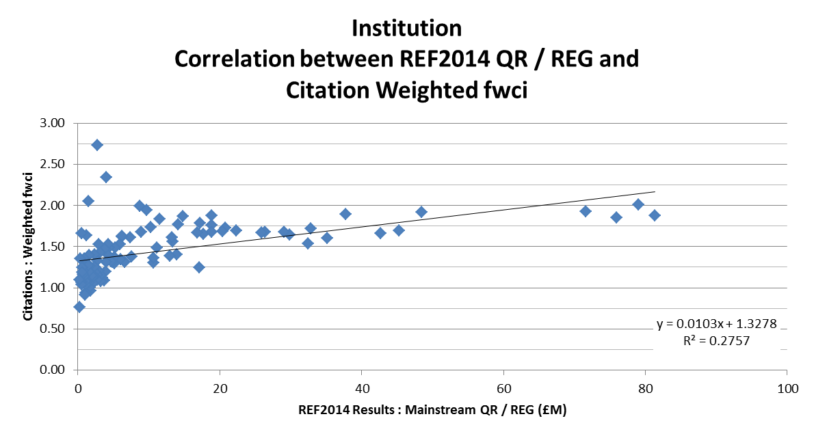
Analysis 2: QR vs field-weighted citation impact
R² = 0.2757
Measure | Notes
REF QR / REG | £M Mainstream QR / REG awarded for 15/16
Citation Weighted fwci | Field weighted citation impact
Only those English and Scottish institutions with citation data available are represented

Slide 17
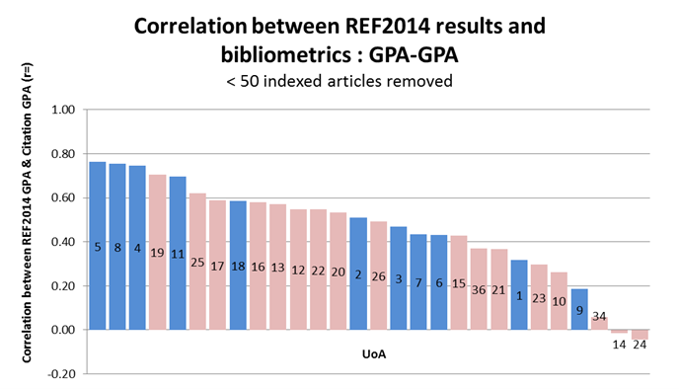
Analysis 3: REF GPA vs citation GPA per UoA
UoA number
Measure | Notes
Output GPA | GPA (4:3:2:1) of the Outputs sub-profile
Citation GPA | GPA (4:3:2:1) of the citation data profile (% top 1%, % top 5%, …)
Only those submissions with > 50 indexed articles were included

Slide 18
Conclusions
The case for change is real: costs, availability of new tools
Metrics should complement human judgment, not be a substitute for it.
Metrics are much more than bibliometrics
Multiple metrics should be used to address questions of research assessment.
Counter arguments can be addressed
Let’s seize the opportunity!

