Slide 1
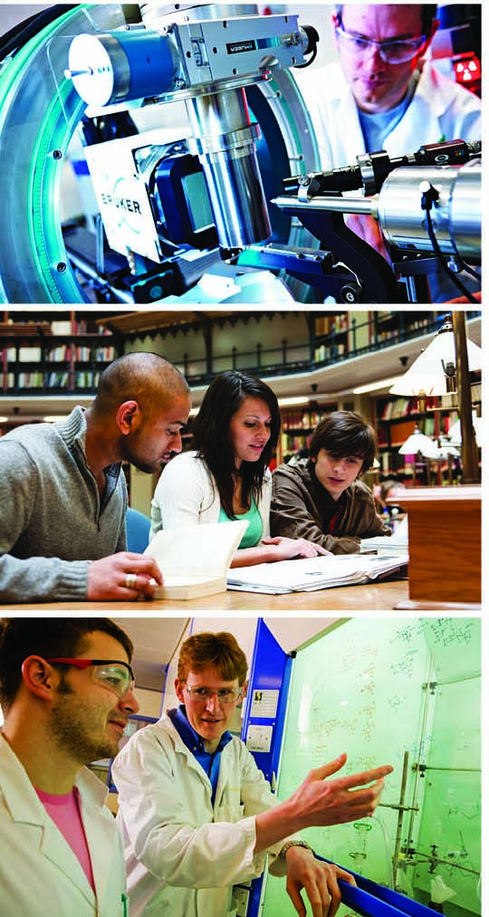
Delivering Strength Across the Piece
David Sweeney
Director, Research, Education and Knowledge Exchange
HEPI, Royal Society
31 March 2015

Slide 2
How it works
REF assesses the quality of research in all UK universities, in all disciplines. It is carried out by 36 expert panels, grouped into 4 main panels.
Main Panel A: Medical and life sciences
Main Panel B: Physical sciences and engineering
Main panel C: Social sciences
Main Panel D: Arts and humanities
2011-12
Preparation
Panels were appointed.
Guidance and criteria were published.
2012-13
Submissions
Universities made submissions in whichever subjects they chose to.
2014
Assessment
36 expert panels reviewed the submissions, guided by the 4 main panels.

Slide 3
What was assessed
Panels judged the overall quality of each submission
Quality of research outputs
Impact of research on society
The research environment
65%
20%
15%
The review was based on data and information about the environment
191,150 research outputs by 52,061 staff were reviewed
6,975 impact case studies were reviewed

Slide 4
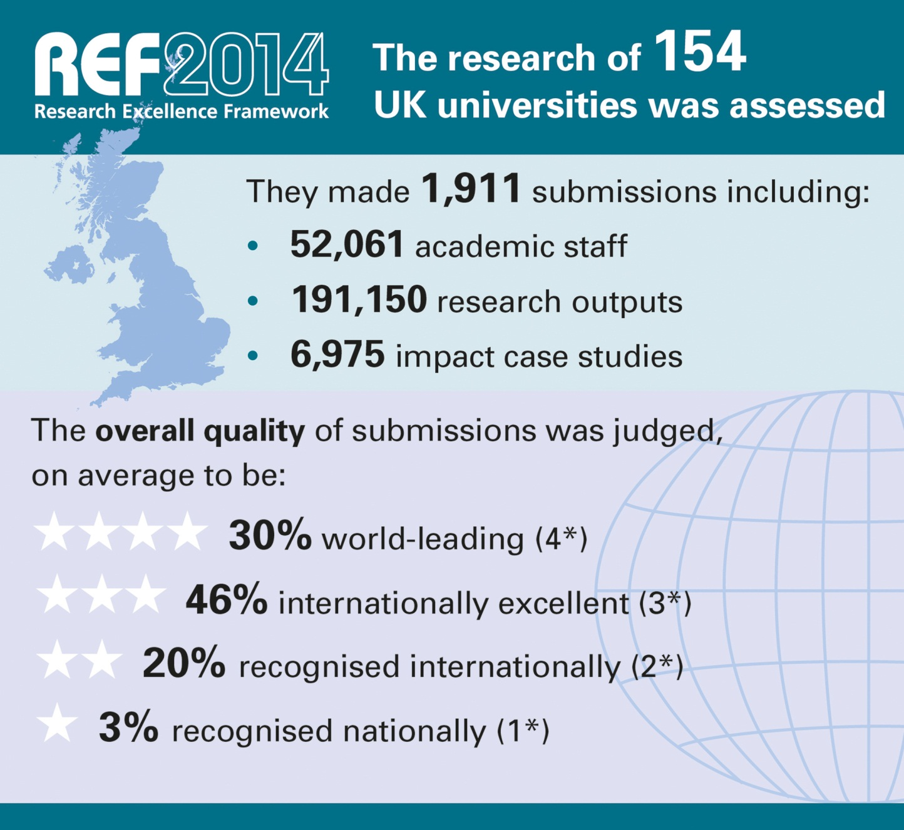
Notes:
The primary outcome will be an overall quality profile for each submission, this will show the proportion of research judged to meet each of the four starred quality levels and will indicate the (FTE) number of staff in each submission
The funding bodies intend to use the assessment outcomes to inform the selective allocation of their research funding to HEIs, with effect from 2015-16; as Graeme said, ~£2 billion per year.
We will also publish all submissions in spring 2015. We will remove personal and contractual details. HEIs may also redact textual parts of their submission which should be excluded for reasons of commercial sensitivity or security
As Vicky Said, submitting HEIs must also produce a Code of Practice on the selection of staff for the REF, these COPs will also be published at the end of the exercise.
Back to Graeme to wrap up.

Slide 5
World-leading quality was found in diverse submissions and institutions across the UK
Submissions from the 154 institutions ranged from 3 staff in a single subject to over 2,500 staff in 32 subjects
The top quarter have at least 30 per cent of their work graded as world-leading (4*).
Three-quarters have at least 10 per cent of their work graded as world-leading (4*).

Slide 6
UK research – Punching beyond its weight
World shares data derived from Elsevier - International Comparative
Performance of the UK Research Base – 2013

Slide 7
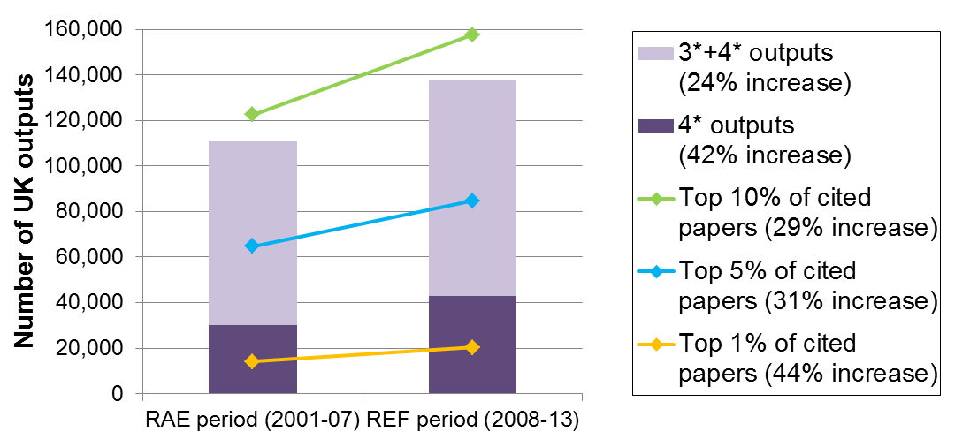
Research Excellence Framework 2014
22% of outputs were judged world-leading (4*), up from 14% in the 2008 RAE
50% were judged internationally excellent (3*), up from 37% in the 2008 RAE
This confirms independent evidence of UK research performance

Slide 8
The assessment celebrates the diversity of staff and excellent research of all types
New arrangements were made for early career researchers and staff with other circumstances:
28% were submitted with circumstances, up from 13% in the RAE
Their outputs were found to be of equally high quality
Excellence was found across all forms of research including applied, practice-based, basic and strategic research:
Interdisciplinary research was found to be of equally high quality
Most impact case studies drew on research from multiple fields
At least a quarter of journal papers involved collaboration across UK universities, and many involved overseas collaboration

Slide 9
Outputs by early career researchers and staff with other circumstances were found to be of equally high quality to other staff

Slide 10
Outputs identified by institutions as interdisciplinary* were graded equally to other outputs
* Note that these represent a small proportion of interdisciplinary work that was submitted

Slide 11
For the first time, REF has demonstrated the impact of UK research in all subjects
Over 250 research users judged the impacts, jointly with academic panel members.
44% of impacts were judged outstanding (4*). A further 40% were judged very considerable (3*).
Impressive impacts were found from research in all subjects.
REF shows many ways in which research has fuelled economic prosperity, influenced public policy and services, enhanced communities and civic society, enriched cultural life, improved health and wellbeing, and tackled environmental challenges.

Slide 12
Excellence was found across institutions with submissions of all sizes

Slide 13
Impressive impact was found across institutions with submissions of all sizes

Slide 14
Exceptionally strong environments were found across institutions with submissions of all sizes

Slide 15
Average profiles by main panel

Slide 16
The assessment produced more consistent results across subjects than in the 2008 RAE

Slide 17
Excellence was found in all types of research output

Slide 18
Research income increased since the RAE in all main panels and from almost all sources

Slide 19
Income sources vary by main panel

Slide 20
World-leading research
Impressive impacts were found from research in all subjects
Importance of peer review in research
Multi-disciplinary research and collaboration

Slide 21
Advances in gamma-ray detection and imaging: University of Southampton
Research on design of technology for gamma-ray detection influencing new counter-terrorism practices
Technological advances from research critical in fields of homeland security and nuclear safety
Spin-out company from the research, Symetrica, recognised as example of best practice

Slide 22
Collaborative Strategic partnership with BorgWarner: University of Huddersfield
Research into engine technologies resulted in a major new partnership with engineering multinational BorgWarner
Collaboration involves multi-million-pound investment, as well as significant job creation and safeguarding
Substantial contract with Jaguar Land Rover, furthering its R&D activities and upskilling its workforce for the benefit of the UK automotive supply chain and the local and national economy

Slide 23
Bringing recognition and improved welfare service provision to young adult carers: University of Nottingham
First major piece of published research on young adult carers
Led to recognition of a ‘new’ group of carers in policy and practice, and the development of two new psychometric instruments
Raising awareness has resulted in provision of new services and support and further education provision for young adult carers across the UK

Slide 24
‘Cold War Modern’: the international impact of modern design on public understanding and curatorial practice: Royal College of Art
A four-year research project exploring the impact of the cold war on modern art, architecture and design
Provided new interpretations of the history of design in the second half of the 20th century for a wide public, international audience
Impact in the fields of public and media understanding of post-Second World War cultural history and on the curatorial and collecting activities of museums around the world

Slide 25
World-leading research
Impressive impacts were found from research in all subjects
Importance of peer review in research
Multi-disciplinary research and collaboration

Slide 26
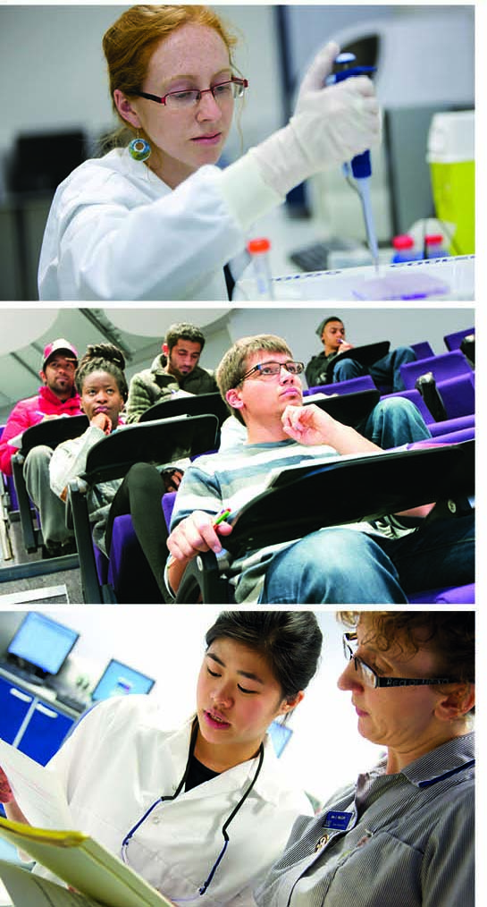
Thank you for listening
d.sweeney@hefce.ac.uk

