Slide 1
HEPI-Elsevier Research Conference: Reflections on REF2014 31 March 2015 Royal Society, London
Professor Cara Aitchison Member, Main Panel C: Social Sciences & Chair, Sub-Panel 26:
Sport and Exercise Sciences, Leisure and Tourism
Notes:
Thank you to HEPI for inviting me to join this session today.
I’m Vice-Chancellor at the University of St Mark & St John in Plymouth and have been there since 2013 having joined from the University of Edinburgh.
As you may know, VCs are forbidden from holding the role of Chair of REF Main or Sub-Panels – and for very good reason (I wouldn’t recommend it!).

Slide 2
From ‘REFlections’ to ‘REFereeing’: three insights from REF2014 and suggestions for balancing competing funding demands
Notes:
Having viewed REF2014 and RAE 2008 from institutions in all mission groups I’m struck by the ways in which these different institutions and disciplines are remarkably similar in their approach to research strategy, environment, outputs and impact and it’s impact I’m going to focus on today.
Most people involved in research are seeking to do just what the REF required – to generate new insights and to communicate them effectively. Our challenge now is to balance competing demands to ensure that excellent research is supported wherever it is found.

Slide 3
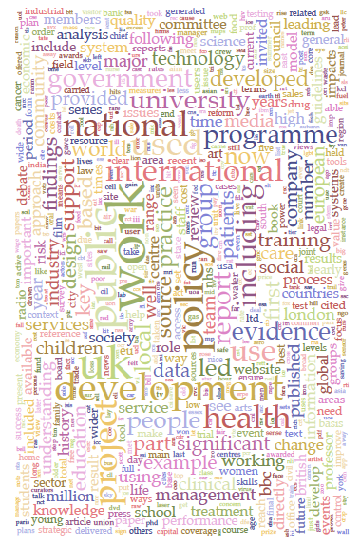
Word cloud of most frequent words from the ‘Details of Impact (Section 4) of case studies
(Kings College London & Digital Science, The Nature, Scale and Beneficiaries of Research Impact: An Initial Analysis of Research Excellence Framework (REF) 2014 Impact Case Studies, HEFCE, 2015: 29)
Notes:
If we are in any doubt about the contribution of UK research and, I would assert, the added value provided by the greater support and scrutiny of impact then the word cloud of the top 600 words from the text of 7,000 impact case studies says that research does make a difference to society, economy, culture and environment.

Slide 4
Insights from REF 2014
UK research is world leading and has a global impact:
how should we maintain current excellence while developing potential?
UK research demonstrates diverse pathways to impact:
how should we support mutli-, inter- and trans-disciplinary research?
Different types of HEIs specialise in different types of impact:
how should we support small and specialist institutions without diminishing the impact of the research-intensive universities?
Notes:
So what has the REF confirmed and what questions does it now raise for the management of resources and the next REF?

Slide 5
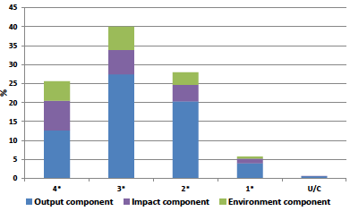
a) World Leading with Global Impact
Average overall quality profile for UoA 26:
Sport and Exercise Sciences, Leisure and Tourism
Notes:
Sport and Exercise Sciences, Leisure and Tourism is a useful Sub-Panel to use as an illustration of some of the challenges faced by REF and by research in general.
This Sub-Panel first appeared in the 1980s RAEs. It was small, dominated by polytechnics with a few exceptions like Bristol, Bath, Birmingham, Leeds and Loughborough. In RAE2001 performance was poor and, along with Education and Nursing it was classified as an ‘Emerging Subject’ and provided with a small amount of additional resource. Tourism was not explicitly include in the descriptor and in RAE2001 tourism outputs were submitted to 41 separate UoAs.
Following a poor performance for sport in RAE2008 the sub-panel was initially abolished. After lobbying from the field and its leaned societies it was reinstated and has experienced the highest level of growth and the greatest improvement of any of the sub-panels.
However, its performance is still well below average and Sport and Education had the two poorest performances in MPC for REF2014.

Slide 6
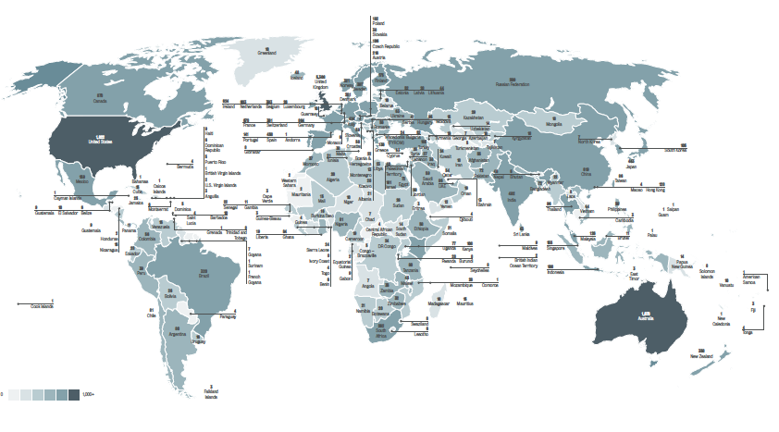
Fig. 13 The global reach of impact from research undertaken in UK HEIs
(King’s College London and Digital Science, 2015: 41)
Notes:
But we do know that REF impact case studies referring to all countries in the world were submitted to REF 2014.
Sport and tourism have both played very significant roles here.

Slide 7
b) Diverse Pathways to Impact
‘Case studies demonstrated widespread international impacts in tackling some of the most significant and entrenched global challenges of the 21st century including: the prevention of non-communicable diseases such as obesity, cardiovascular disease, depression and cancer; international development, conflict resolution and peace-building; sustainable economic development and regeneration; and child protection and athlete welfare (Sub-Panel 26 Overview Report).’
The majority of impact case studies were in two broad areas:
i) elite performance in sport
ii) physical activity and health
Notes:
I think reading the 128 case studies submitted to SP26 has been one of the greatest privileges of my academic career.

Slide 8
Diverse pathways to impact in sport
Catching the Drug Cheats: The Science Behind Anti-Doping for the London 2012 Olympic and Paralympic Games (King’s College London)
Child and athlete welfare: research and knowledge transfer in sport organisations (Brunel University)
Football4Peace (University of Brighton)
Injury and concussion in rugby (St Mary’s University Twickenham)
Modifying school playground environments to increase physical activity (Liverpool John Moores University)
Changing policy and practice to increase active travel to school (University of Bristol)
The effects of physical activity on mental health and nicotine addiction (Exeter University)
Improving functional performance, prosthetic rehabilitation and falls prevention in transtibial amputees (University of Hull)
The development of column-based mid-sole (‘Microwobbleboard’™) technology, leading to the creation of FitFlop Ltd, a global footwear brand (London South Bank University)
Notes:
The case studies demonstrated 128 different ways of having impact, making a difference, bringing change.
Focus on 1, 2, 3, 4 and 9

Slide 9
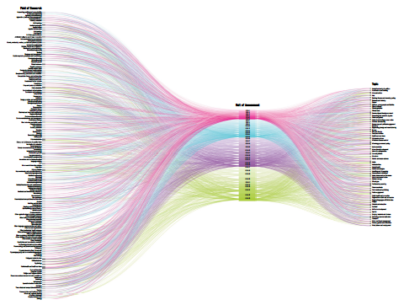
Fig. 12 Alluvial diagram linking ‘fields of research’ with UoAs to ‘impact topics’
(King’s College London and Digital Science, 2015: 41)
Notes:
The pathways to impact are not always predictable for each SP.

Slide 10
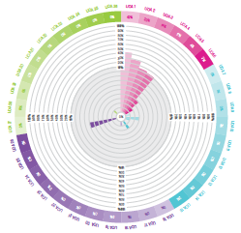
Fig. 19 Impact Wheel: ‘Clinical Guidance’ n=326
(King’s College London and Digital Science, 2015: 50)
Notes:
Impacts on health policy and practice can be made from a range of fields.

Slide 11
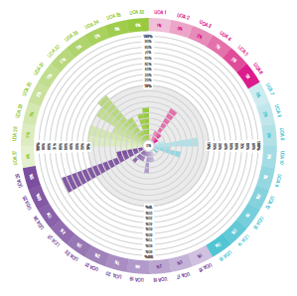
Fig. 9 Impact Wheel: ‘Schools and Education’ n=381
(King’s College London and Digital Science, 2015: 34)
Notes:
Similarly, impacts on education and schools can come from many SPs and not just from education.

Slide 12
c) Different types of HEI specialise in different types of Impact
‘Analysis of the impact topics by the size of HEI submission to REF2014 illustrates that…small institutions make a disproportionate impact contribution and to a larger number of topics than larger institutions…although some larger institutions make large contributions to topics such as ‘Clinical Guidance’ and ‘Dentistry’ small institutions make a greater than anticipated contribution to topics such as ‘Sports’, ‘Regional innovation and enterprise’ and ‘Arts and culture’. This raises some interesting policy questions with regard to the nexus of selective funding, concentration and research excellence.’
(King’s College London and Digital Science, 2015: 71)
Notes:
And some of these impacts can come from places well outside the Russell Group and including small and specialist institutions.
These institutions make a disproportionate contribution to research impact in art, music, drama, film and the wider cultural and creative economy that is now worth so much to the UK.

Slide 13
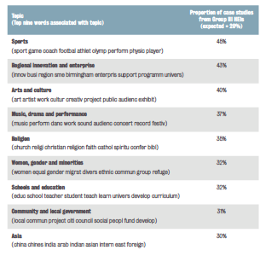
Table 3: Topics where less research intensive HEIs make a disproportionate contribution’
(King’s College London and Digital Science, 2015: 36)
Notes:
These institutions also make an important impact to the fabric of society, to education and inclusion and to building cohesion.
The Kings College research has listed these areas and, with the exception of ‘Asia’ which is probably SOAS, it’s the small and sometimes Cathedrals Group universities that have made an impact.

Slide 14
d) Supporting excellence and inter-disciplinarity
 | RAE2008 | REF2014
Submitting HEIs | 39 | 51 (31% increase)
Mean size | 12FTE | 16FTE
Staff entered | 500 | 790 (58% increase)
% Eligible HESA Cost Centre | 42 | 51
Large submissions (35+) | 1 | 2
Medium submissions (15+) | 10 | 14
Small submissions | 28 | 34
Total income | £31.2m | £80.323m
Mean income per FTE | £62,400 | £102,000
Total PhDs | 551 | 921
PhDs per FTE | 1.10 | 1.17
Notes:
Sport research is a success story just as sport is a success story for the UK since the hosting of the Olympics and Commonwealth Games. It’s a huge earner for the UK along with tourism and it is at the forefront of science and technology including, in my own institution, regenerative medicine.
We should continue to support excellence wherever it is found and REF2014 has certainly found excellence across the sector.

