Slide 1
The Impact of the REF2014
Professor Paul Boyle

Slide 2
Introduction
Each REF is a critical and influential milestone in a University’s life
Performance dictates funding allocation and the capacity to build on existing excellence
It impacts on reputation directly and through league tables
With so much at stake, it’s not surprising that institutions spend huge amounts of time and effort working towards a positive outcome
Notes:
…
We are also in the Top 2% world wide, which means that by studying with us, you will be earning a degree that is internationally recognised.

Slide 3
The Methodology
The methodology continues to be debated
REF2014 measurement of outputs, environment and impact is a welcome development
Conducted at UoA level, not Institution or individual – staff may be entered in the most relevant UoA
Gaming is inevitable, but is further encouraged if the rules of the game are not clearly spelled out up front
Would the downside of including every member of staff outweigh the benefits?
Notes:
…
We are also in the Top 2% world wide, which means that by studying with us, you will be earning a degree that is internationally recognised.

Slide 4
The Methodology
Once again the rewards have been pushed more towards the world class, 4*, performance
The focus on 4* excellence is persuasive
However, scientific breakthroughs often build upon incremental scientific developments
Is further concentration a good long-term strategy for the UK, which has unusual strength in depth compared to many countries?
How much of national funding should be focused on world-class research and and how much on the foundations?
Notes:
…
We are also in the Top 2% world wide, which means that by studying with us, you will be earning a degree that is internationally recognised.

Slide 5
The Inclusion of Impact
The inclusion of impact raises interesting questions about how blue skies research is valued
Reveals truly significant contribution to society
New insights within institutions about the contributions
And the barriers that exist
Encourages more focus on impact reward and recognition
Should strive to find new ways to articulate and evidence the full spectrum of academic research (including fundamental)
Notes:
…
We are also in the Top 2% world wide, which means that by studying with us, you will be earning a degree that is internationally recognised.

Slide 6
The REF Cycle
The REF cycle is every 5-6 years
The focus is rightly on quality rather than quantity
Academics are encouraged to produce 4 x 4* articles
Easier to accommodate in some disciplines than others?
Does it distort the natural process of scientific discovery?
Some fundamental breakthroughs have happened after years of less remarkable foundation work, often through serendipity
Notes:
…
We are also in the Top 2% world wide, which means that by studying with us, you will be earning a degree that is internationally recognised.

Slide 7
The Spread Across Disciplines
The relative output quality of UoAs is interesting
Top on outputs are: Chemistry; Physics; Electrical and electronic engineering, metallurgy and materials; Mathematical sciences
Classics highest ranked humanities subject
Economics and econometrics highest in social science, but most social science disciplines were poorly ranked
How do these relate to our understanding of UK strength? UK Social Science performs very strongly in ERC for example
Notes:
…
We are also in the Top 2% world wide, which means that by studying with us, you will be earning a degree that is internationally recognised.

Slide 8
Impact Analyses
The most common kinds of impact in the 6,679 unredacted case studies related to
Informing government policy
Parliamentary scrutiny
Technology commercialisation
Print, media and publishing
Was this predictable?
Notes:
…
We are also in the Top 2% world wide, which means that by studying with us, you will be earning a degree that is internationally recognised.

Slide 9
REF as a Management Tool
The most detailed nationally consistent analysis of research performance anywhere
Data available at UoA level
Mixture of measures, now including impact
Long time series of performance
Notes:
…
We are also in the Top 2% world wide, which means that by studying with us, you will be earning a degree that is internationally recognised.

Slide 10
REF as a Management Tool
Crude tool which needs careful use
Would not design it in this way for management purposes
Individual-level data hidden
Infrequent updates
The cost to produce it may not be justified
If we were designing a nationally consistent management tool to help identify research strength, how might we do it?
Notes:
…
We are also in the Top 2% world wide, which means that by studying with us, you will be earning a degree that is internationally recognised.

Slide 11
Pre-REF ‘Poaching’
Much like the Premier League, transfer deadlines create artificial mobility patterns
Outputs travel with the author when staff move institution
Flurry of pre-REF 4* transfers, with family implications
Some institutions provide the foundation to feed the top
Is the system carefully designed to maintain this bottom up provision?
Should the outputs follow the Impact ‘no travel’ rule?
Notes:
…
We are also in the Top 2% world wide, which means that by studying with us, you will be earning a degree that is internationally recognised.

Slide 12
Fostering the Best Research Ecosystem
UK has the world’s most efficient research system
Share of world citations by GERD
Notes:
…
We are also in the Top 2% world wide, which means that by studying with us, you will be earning a degree that is internationally recognised.

Slide 13
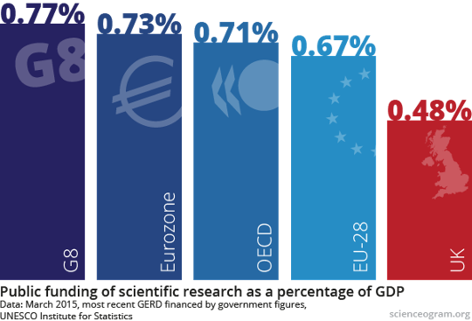
Fostering the Best Research Ecosystem
But public funding is falling behind
Notes:
…
We are also in the Top 2% world wide, which means that by studying with us, you will be earning a degree that is internationally recognised.

Slide 14
Fostering the Best Research Ecosystem
There is a risk if we focus too much on efficiency
Is our performance because of the focus on excellence, or despite it?
REF concentration of funding
Some of the most fundamental breakthroughs happen in unpredictable places
Should the QR allocation match the allocation of Research Council funding or not?
Notes:
…
We are also in the Top 2% world wide, which means that by studying with us, you will be earning a degree that is internationally recognised.

Slide 15
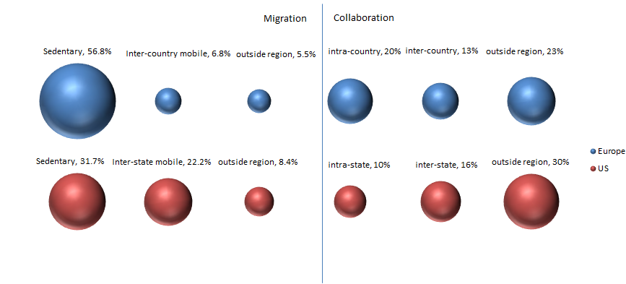
Mobility in Europe and the US
Even though there is significantly less inter-country mobility in Europe than inter-state mobility in the US, differences between inter-state and inter-country collaboration are much smaller.
22.2%
6.0%

Slide 16
Conclusion
The UK research system is envied across the world
We have a strong system which produces world-class discovery
Impact is more embedded now
Public engagement is starting to be taken seriously
Changes made to the REF have been good for equal opportunities (1/5 of submitted staff were early career)
Notes:
…
We are also in the Top 2% world wide, which means that by studying with us, you will be earning a degree that is internationally recognised.

Slide 17
Conclusion
However, the REF approach is not being replicated in many leading nations
The cost is substantial
There is a feeling among some nations that we focus too much on impact, and this might undermine fundamental science
It introduces artificial behaviour into the market
Would a citations / research grants system provide much the same results, annually?
Notes:
…
We are also in the Top 2% world wide, which means that by studying with us, you will be earning a degree that is internationally recognised.

