Slide 1

REFLECTIONS ON REF 2014
Julia M Goodfellow
Notes:
V1.0
To change the footer on every slide:
1. On the menu go to Insert > Header and Footer…
2. Select the Footer checkbox and enter the footer text in the accompanying text box
3. Click “Apply to All”

Slide 2
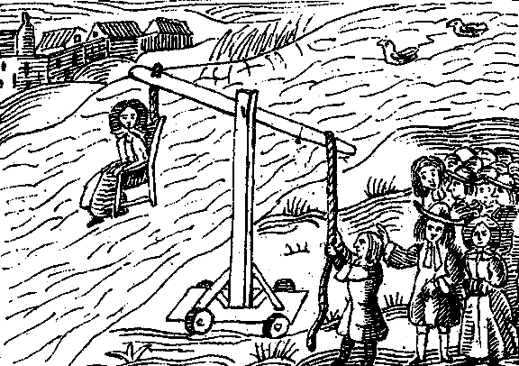
Total Immersion Research Assessment Impact Matrix
Notes:
The Deputy Head of REF Strategy at Poppleton University, Brian Bryan, was concerned about metrics ‘robustness, relevance outside the sciences, and the potential negative effect on early career researchers and women. He is advocating the Total Immersion Research Assessment Impact Matrix. The finer details are abstruse but in essence, this involves tying a small rock around the research submission, throwing the whole bundle in a nearby pond and waiting to see whether the research displays its impactfulness by floating to the surface.

Slide 3
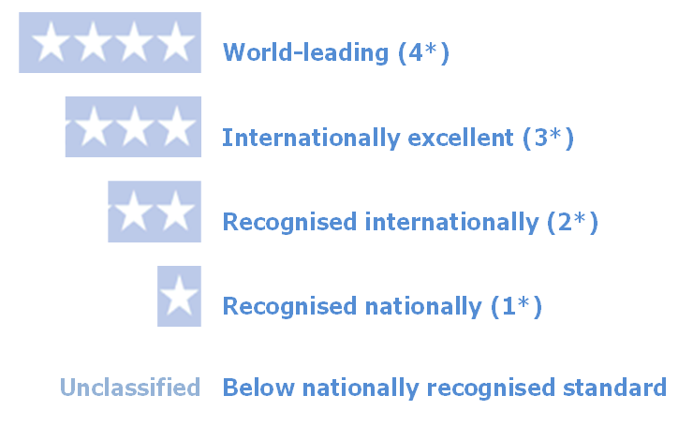
Positives
The professional way in which it is run by HEFCE
Focus on quality not quantity of output
Increasing focus on inclusivity of staff
Publication of HESA data to coincide with REF
Magnet to engage staff and students
Notes:
2090 publications submitted from Kent
80 impact case studies
Inclusivity at Kent 84% (67% RAE). 85% ♂ 81% ♀ (69% ♂ 61% ♀ RAE)

Slide 4

IMPACT
The inclusion of Impact was hard work but is useful if not essential for institutions individually and for universities generally in which to demonstrate the economic, social and cultural impact of their work.

Slide 5
Some Issues
Increase in quality - average in 2014 (2.895) the same as Cambridge (2.807) in 2008!
Staff inclusion - can lead to game playing. Types of contract; % t and r submitted. Etc
Correlations between size and quality especially in science – especially in environment scores
Notes:
Effort: Technopolis work on costs of the REF will be reporting after the election
Cambridge figures are for outputs only as these are the only directly comparable ones (RAE Cambridge output GPA 2.807. 23.5% 4* and 42.0% 3*). Note. Kent RAE 2008 GPA 2.500, 14% 4* 37.3% 3*
Average 4* is just under Cambridge but 3* markedly more

Slide 6

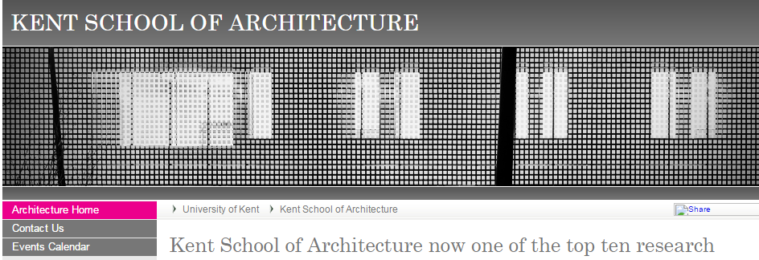
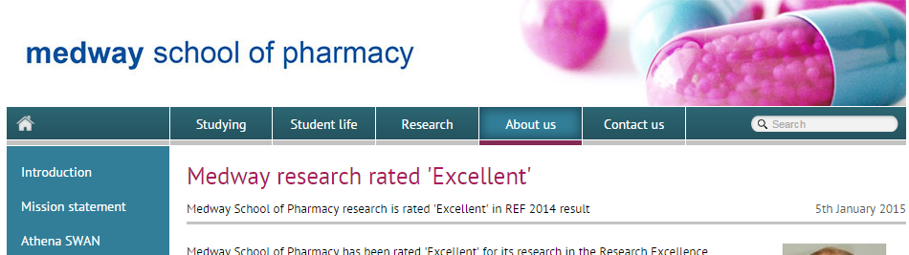
Issues continued
Five point scale when really only two points count!
Inclusion of new entry to a UOA – Kent entered three areas for the first time. Very risky!

Slide 7
Going forward
Why are we doing this?
Block grant to university
International comparator
Keeping government happier
Comparisons across UK universities to feed newspaper league tables
Increase salaries of our top researchers
Do we need another REF?

Slide 9
Notes:
This

