Slide 1
A dis-united Kingdom? UK Universities and the EU referendum Robert Ford Professor of Political Science, Manchester University HEPI-HEA Parliamentary Breakfast Seminar 23rd February 2016 Rob.ford@manchester.ac.uk twitter: @robfordmancs

Slide 2
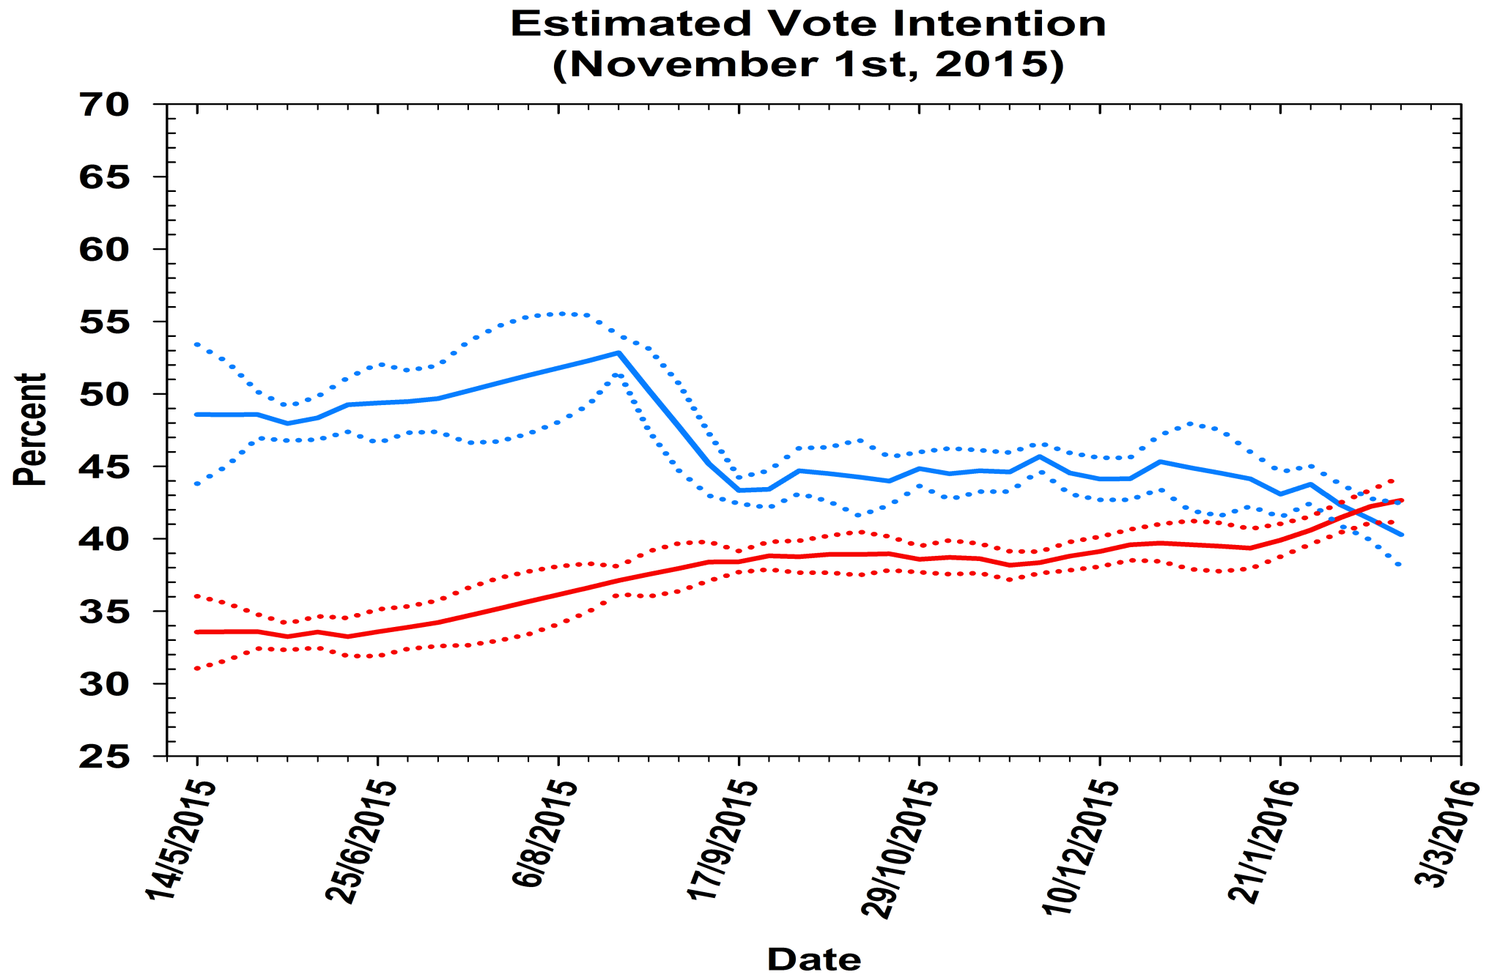
Public opinion on the referendum May 2015-Feb 2016
Source: Pickup, Jennings , Wlezien and Ford “Polling Observatory” poll aggregation estimates

Slide 3
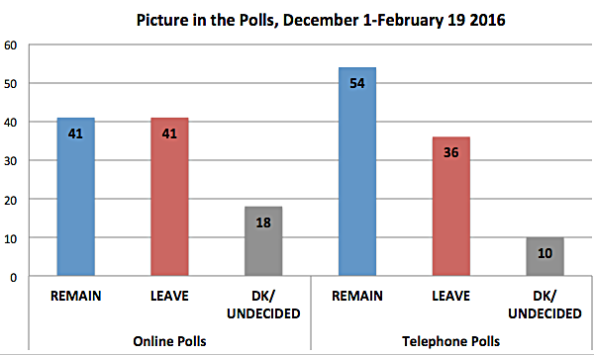
The phone-internet divide
Source: Professor Matthew Goodwin

Slide 4
Why the divide?
“Soft in?” – people who say they don’t know online, but shift to “in” on the phone?
Social desirability effects: people less willing to support contentious view (out) on phone?
Sample effects: opt-in panels recruit more interested – in some groups (e.g. 65 plus) may over-represent out?
We have been here before:
Phone polls gave higher shares for “No” in Scottish independence referendum campaign
Phone polls gave lower shares for UKIP in 2015 election campaign

Slide 5
Social divides: age and referendum preference, 6 pollster average

Slide 6
Social divides: Class and referendum preferences, 6 pollster average

Slide 7
Social divides: profs & students vs pensioner & plumbers
Professional middle classes, the young, graduates, ethnic minorities tend to back “remain” more strongly
Working classes, pensioners, school leavers, white voters tend to back “leave” more
Implications?
“Remain” has stronger support from more informed/politically engaged groups (except young) – firmer support?
More undecided votes in “leave” leaning groups” – greater potential growth?
Turnout: hard to call. Each side has support from some high & some low turnout groups

Slide 8
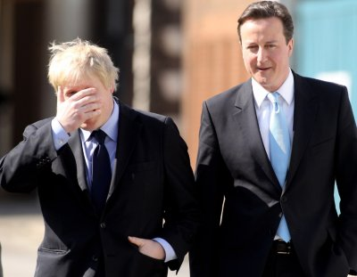
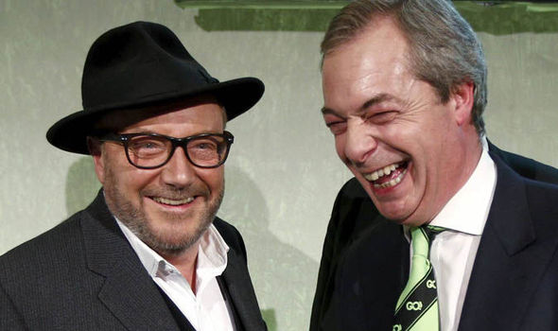
Leadership: Who can swing votes?

Slide 9
How will opinion move through the campaign?
Source: Dr Alan Renwick

Slide 10
Campaign: advantage “remain”?
Historically, moves to the “status quo” option much more common in final month of campaigning (Renwick, 2014)...
....but not always. Move towards “change” in one third of cases (incl. Scottish indyref)
“Change” option has done best historically when:
Larger share of “change” voters have firm, well-informed views pre-campaign
“Change” can convince uncertain voters that change is not risky
“Change” can explain what the change will mean in concrete terms
“Change” can portray status quo as risky
“Change” manage to portray their option as a low-risk anti-establishment vote
Most of these conditions don’t obtain this time:
Lot of undecided voters, low information levels generally, little understanding of what “Brexit” would mean, vote is very important and recognised as such
“Change” has few credible/reassuring leaders (though: Boris)

Slide 11
Could the polls be wrong? If so, in what direction?
In 17 recent/relevant referendum campaigns, final polls underestimated “status quo” option in 13 (Fisher, 2014):
Including AV referendum (5 points), Scottish independence (3 points), Welsh devolution (4 points), 1975 EU referendum
Only cases where polls underestimated “change” were when “change” well ahead (60% plus) – Scotland 1997, Ireland May 2012
When final polls are close, “status quo” is often underestimated, but has never been over-estimated
Why:
Poll bias? Possible, but unlikely given systematic pattern
Late deciding don’t knows tend to break for status quo
Turnout effects – close vote mobilises low interest voters anxious about change (some evidence for this in Scotland 2014)

