Slide 1
Higher Education in New Zealand: What might the UK learn?
Professor Michael C R Davies
Pro-Vice-Chancellor (Research)
University of Sussex

Slide 2
Scope
Background
Quality
International students
Research
Conclusions

Slide 3

Formerly: Dean of Engineering at the University of Auckland and Pro-Vice-Chancellor of The University of Auckland Tāmaki Innovation Campus

Slide 4
Population
New Zealand 4.6 million
UK 63.4 million
Scotland 5.3 million
Wales 3.1 million
Zhengzhou 4.8 million
China 1.4 billion

Slide 5
Scope
Background
Quality
International students
Research
Conclusions

Slide 6
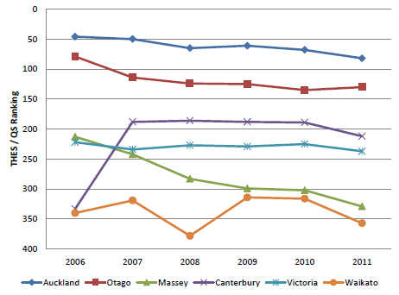
Rankings of New Zealand universities in the Times Higher Education/QS system 2006 to 2011
2016-2017
81
169
214
228
324
343
Stuart McCutcheon “Never mind the quality – feel the price”, Universities New Zealand, 2012

Slide 7
Relationship between the Times Higher-QS 2008 world ranking of each university (top 200 only) and its total expenditure per student
Stuart McCutcheon “Never mind the quality – feel the price”, Universities New Zealand, 2012

Slide 8
Student numbers (headcount) at The University of Auckland 1883-2011
Stuart McCutcheon “Never mind the quality – feel the price”, Universities New Zealand, 2012

Slide 9
Scope
Background
Quality
International students
Research
Conclusions

Slide 10
New Zealand international education strategic roadmap

Slide 11
New Zealand international education strategic roadmap

Slide 12
UK HESA Student Record (2014-2015)

Slide 13
Scope
Background
Quality
International students
Research
Conclusions

Slide 14
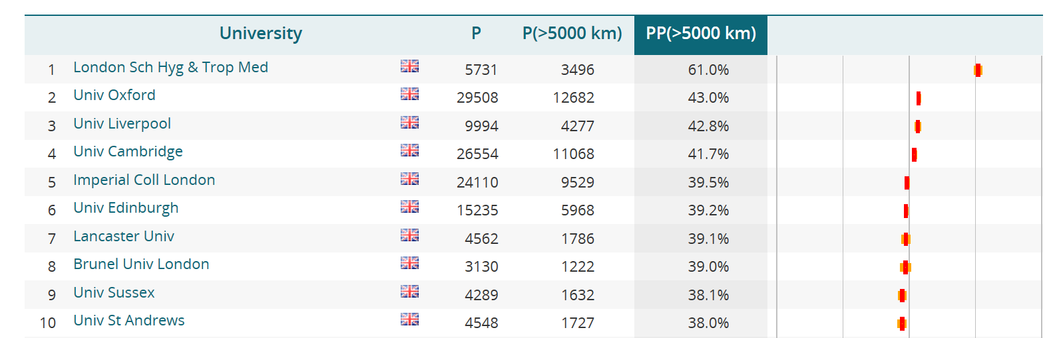

Proportion of long distance collaborative publications
(>5000 km) - CWTS Leiden Ranking 2016

Slide 15
Scope
Background
Quality
International students
Research
Conclusions

Slide 16
Conclusions
Compared to the HE sector in England the New Zealand university sector is relatively small:
  allows easier communications across the sector
  facilitates innovation
  necessitates collaboration
Similarly to the HE sector in the UK the New Zealand university sector is very international:
  similar trends in proportion of international staff and students as UK research intensive universities
  international collaboration in research in New Zealand universities is comparable to that at UK research intensive universities
The New Zealand university sector is internationally competitive in both teaching and research – as recognised in international rankings

