Slide 1


Social Value for Money (SVFM)
££
£
Private Benefit
Social Benefit
Marginal Social
Cost
P
Societal (marginal) Benefit
Private (marginal) Benefit
Q

Slide 2
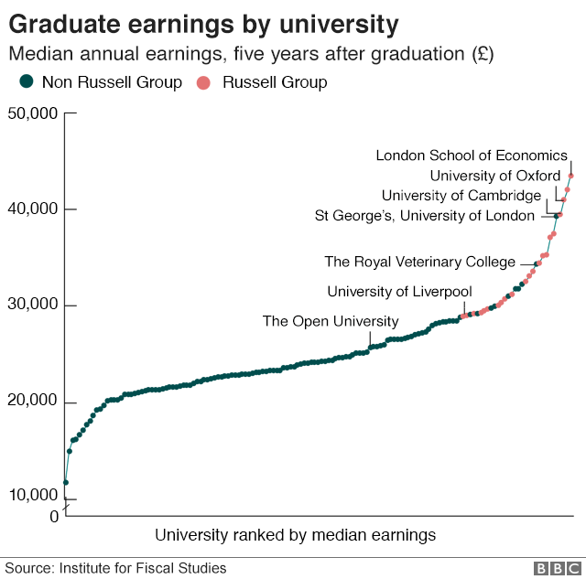
Who decides?
Fit for 21C?
Median salary 25-29 yrs (ONS/HMRC)

Slide 3
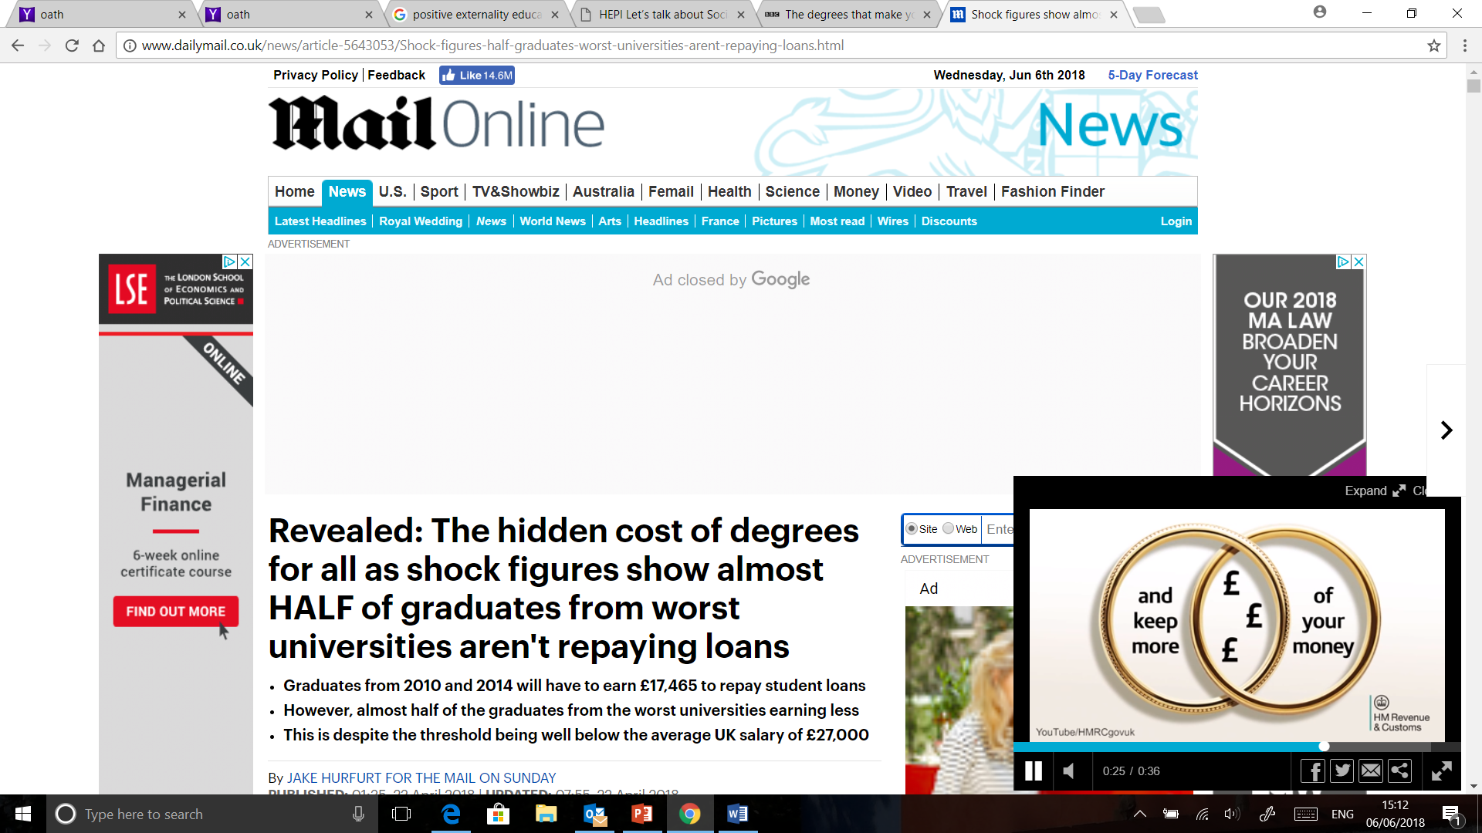
High
Relative Starting Salary
Low
Perceived Value for Money
Social Value for Money
High
Low

