Slide 1
HEPI Annual Conference The challenge for the sector: The 4th Education Revolution
Anthony Seldon
Vice-Chancellor of University of Buckingham
Thursday 7th June 2018

Slide 2
Metal & coach workers pose in front of the Benz & Co factory in Mannheim.
“AI is coming. To understand the stage we are with
Its arrival, we can draw an analogy from the car
Industry in 1886. Karl Benz had just invented the
Internal combustion engine. People had no idea
how the invention would take off, or that it would
transform human life across the planet. The
comparison is wrong though in one respect.
AI is far more wide-ranging than the car, and
will carry humans much further.”

Slide 3
AI is infinitely seductive. It will know us better
than our best friends, our parents, our partners.
It probably already does. Under the guise of
plausibility, is it opening our eyes, shielding our
sight, or blinding us?

Slide 4
“AI will be 'either best or worst thing' for humanity”
“Every aspect of our lives will be transformed. In short, success in creating AI could be the biggest event in the history of our civilisation”
Steven Hawking

Slide 5
“Artificial intelligence is the biggest risk we face as a civilisation and needs to be checked as soon as possible”
Elon Musk

Slide 6
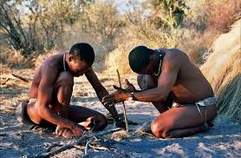
The First Revolution - The Dawn of Learning
some five million years ago

Slide 7
The Second Revolution – Organised Learning
6000 years ago, cities sprung up on four rivers
Logical

Slide 8
The first schools and the first universities

Slide 9
Europe’s first University – Bologna 1088

Slide 10
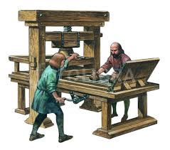
The Third Revolution – The Printing Press

Slide 11
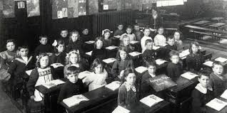
and mass education at the time of the Industrial Revolution

Slide 12
We are still living in the third education revolution model
Until…

Slide 13
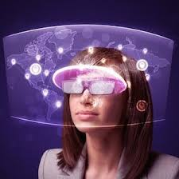
The Fourth Revolution – AI

Slide 14
AI/digital is already transforming
Healthcare
Transport
Shopping
Law firms
Accountancy
Agriculture
Banking
But not education

Slide 15
The British Government understands
The impact of AI on transport, health, industry etc.
It fails to understand the impact of AI on education
And on the jobs that education is preparing our students for
And on the kind of skills that students need to cope

Slide 16
The University Journey
Key – Impact on Digital
Transformative
Very significant
Little/none
Tutorials
Classes
Articles
Web
Books
Assessments
Tests
Academic Core
Lectures
Seminars
Libraries/
Research
Exams/Tests
Admin
Comms
Matriculation
Graduation
Admin
Comms
Broader Benefits
Social
Co-curricular
Skills
Sport
Arts
Job
Personal
Social
AS
18.11.12

Slide 17
What is intelligence?

Slide 18
The third education era had a very narrow, mean, and limiting
understanding of intelligence which is completely out of date in 2018.

Slide 19
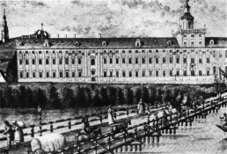
Narrowly defined in 1912 as intelligenzquotient, first used at the University of Breslau

Slide 20
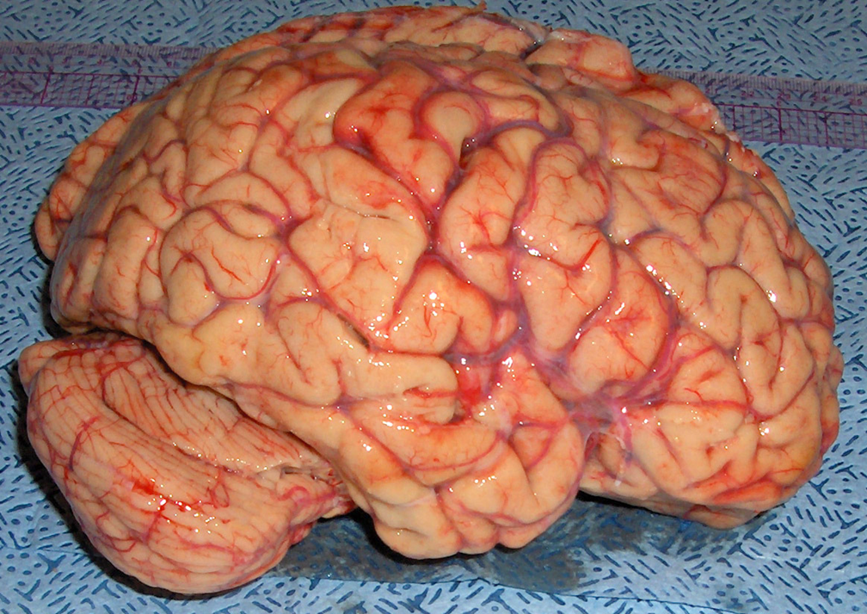
Logical

Slide 21
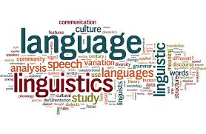
Linguistic

Slide 22
Social

Slide 23
Personal

Slide 24
Moral

Slide 25
Spiritual

Slide 26
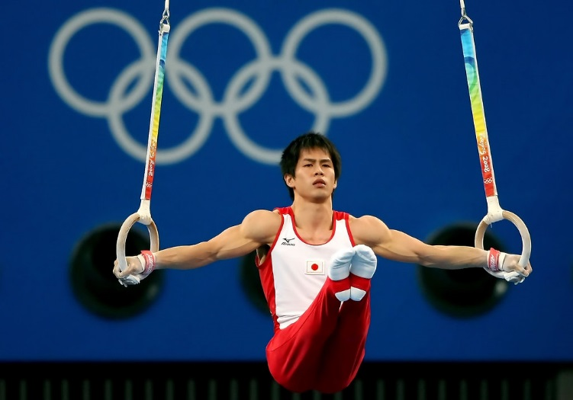
Physical

Slide 27
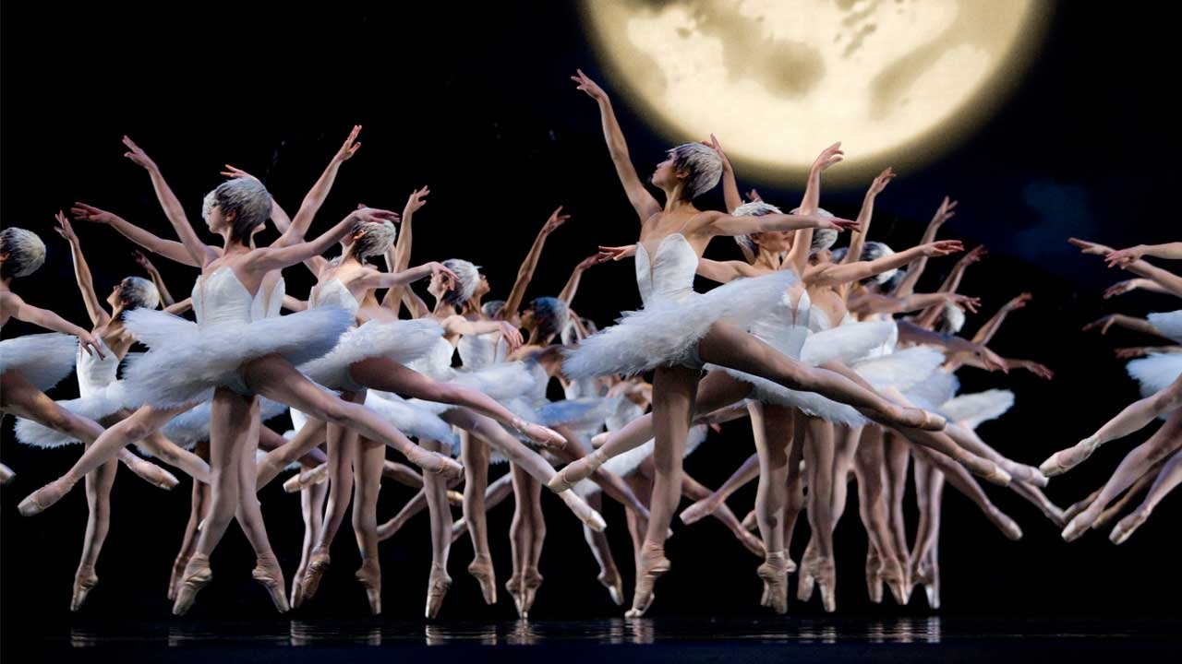
Cultural

Slide 28
We are not even preparing our students for the world of work.
Oxford Martin School 2013
David Deming - Harvard working paper 2015
Richard and Daniel Susskind – The future of the professions 2015
McKinsey Global Institute January 2017
IPPR, Carys Roberts, 2017
PriceWaterhouseCoopers March 2017
Oxford Martin/Pearson/Nesta 2018

Slide 29
Important to distinguish
Quantity of work from quality of work that will be available
Optimists versus realists
Is AI merely the latest technological revolution, or is it qualitatively different?

Slide 30
Need for a common core of life skills (adapted from Joseph E Aoun-Robot-proof: HE in the Age of AI (2017)
New literacies:
Data of literacy
Technological literacy
Human literacy
Cognitive capacities:
Systems thinking
Entrepreneurship
Cultural agility
Critical thinking

Slide 31
Potential Dangers of AI
Infantilisation of students
Infantilisation of teachers
Focus on “Information” not “Understanding” still less “Wisdom”
Homogenisation and loss of diversity
Students no longer learn facts but rely on machines

Slide 32
Will AI replace the factory model of education which marginalised the many by a “Satnav” model of education that dehumanises the many?

Slide 33
Focus Needed
Universities need to take AI (and VR, AR and MR) much more seriously
AI will transform every facet of universities utterly within twenty five years
They will transform learning, teaching, research and administration
We need to emphasise the human skills
Too many British universities are ignoring AI

Slide 34
The Fourth Education Revolution
Will it liberate or infantilise humanity?

Slide 35
Max Tegmark’s Three Steps
1. Life 1.0. Biological stage. Evolution rules
2. Life 2.0. Cultural stage. Humans learn and can change physical environment but not themselves
3. Life 3.0. Technological, post-human stage. Humans can redesign their software and hardware. “Life” will be limitless.

Slide 36
The Singularity
What? AI will trigger runaway change, with humans the equal or subordinate to machines
When? No one knows. Some say 2040.
Some later. Some never

Slide 37
Some advances in education already
Machines plan and mark student work
Machines plan and roll out curriculum
Speech recognition and generation
Empathetic tailored responses
Comprehensive understanding of individual learning needs
Machines are beginning to transform university administration

Slide 38
Ten problems facing 21st century universities
Mental Health
Students not ready for independent learning
Public perception
Uncertain leadership
Affordability and questions over value for money
Teaching quality and perception of relevance of research
Rising student demands
Decline in image of a liberal arts education
Lifelong education
Brexit

Slide 39
The three drivers of change
Technology
Evolution and understanding of learning and the brain
The impact of AI and automation on jobs

Slide 40
The six types of universities
Global universities
National universities
Regional universities
Professional universities
Digital universities
Local universities

Slide 41
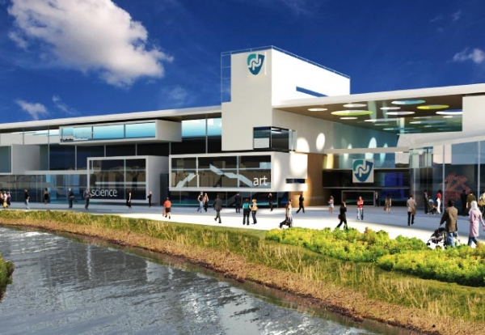
The five examples of dismembered universities
1. The end of the lecture hall at the University of Northampton

Slide 42
2. The ‘C-Campus’ or bilateral/trilateral degree

Slide 43
3. Virtual degrees or ‘nanodegrees’ from Udacity

Slide 44
4. The Blockchain, the University of One and Woolf University

Slide 45
5. No universities at all

Slide 46
We need AI machines to teach our students to become more fully human - the education system currently deploys humans to teach our young to become more like machines.

Slide 47
The End

