Slide 1
Value for Money- the student perspective
Notes:
Megan Introduces

Slide 2
What do you get?
BhS
Shoes
Clothes
Eyebrow threading
Food
Accessories
Luggage
Gifts
HE
Friends
Employment prospects
Connections
Degree
Intellectual capacity
Personal development
Notes:
Jim explains overall VFM question

Slide 3
Value for Money?
Students’ Unions told us that students view VFM from multiple perspectives
Sometimes “the tuition fee”, sometimes their “overall spend”
Keen to think about
  Outputs
  Other charges
  Outcomes and broader value
Notes:
Jim explains overall VFM question

Slide 4
What’s going on?
The excess and waste of the university with regards to spending is obvious so I can only assume a tiny fraction of the tuition fee actually goes towards tuition.
£9,000 a year for a degree, are you joking? The library was always overcrowded with half the amount of plug sockets for the number of seats. I will be paying this off for the rest of my life.
Notes:
Ed explains comments about what’s going on

Slide 5
What’s going on?
The excess and waste of the university with regards to spending is obvious so I can only assume a tiny fraction of the tuition fee actually goes towards tuition.
£9,000 a year for a degree, are you joking? The library was always overcrowded with half the amount of plug sockets for the number of seats. I will be paying this off for the rest of my life.
I can't comprehend how the money spent each year is used as I get the absolute bare minimum of contact with actual members of the department. I expected to have at least a weekly tutorial every week before I came to university but that isn’t the case.
£33.4 per hour and I do 600 hours of semester of self-study time could’ve just got a part time job and a library card, but I wouldn’t have the piece of paper which says I can do it.
Notes:
Ed explains comments about what’s going on

Slide 6
What’s going on?
The excess and waste of the university with regards to spending is obvious so I can only assume a tiny fraction of the tuition fee actually goes towards tuition.
£9,000 a year for a degree, are you joking? The library was always overcrowded with half the amount of plug sockets for the number of seats. I will be paying this off for the rest of my life.
The staff from my course are supportive, knowledgeable and I am definitely getting good value for my money.
I can't comprehend how the money spent each year is used as I get the absolute bare minimum of contact with actual members of the department. I expected to have at least a weekly tutorial every week before I came to university but that isn’t the case.
£33.4 per hour and I do 600 hours of semester of self-study time could’ve just got a part time job and a library card, but I wouldn’t have the piece of paper which says I can do it.
The lecturers are fantastic as I learn and enjoy my classes
Notes:
Ed explains comments about what’s going on

Slide 7
What’s going on?
The excess and waste of the university with regards to spending is obvious so I can only assume a tiny fraction of the tuition fee actually goes towards tuition.
£9,000 a year for a degree, are you joking? The library was always overcrowded with half the amount of plug sockets for the number of seats. I will be paying this off for the rest of my life.
The staff from my course are supportive, knowledgeable and I am definitely getting good value for my money.
"Good value for money" in HE means, in my opinion, personal and high-quality supervision and support, excellent teaching, small group sizes, and a sufficient number of academic and administrative staff who are not overworked and overburdened. This is more important than shiny new buildings and shockingly high salaries for senior managers.
I can't comprehend how the money spent each year is used as I get the absolute bare minimum of contact with actual members of the department. I expected to have at least a weekly tutorial every week before I came to university but that isn’t the case.
£33.4 per hour and I do 600 hours of semester of self-study time could’ve just got a part time job and a library card, but I wouldn’t have the piece of paper which says I can do it.
The lecturers are fantastic as I learn and enjoy my classes
Notes:
Ed explains comments about what’s going on

Slide 8
Overall VFM
Dissatisfaction in the comments is focussed on the facilities, services and experiences
  Does it work (for me)
  Volume of it (space, contact)
  Not knowing (trusting) where the money goes
Satisfaction is broader and whilst still focussed on outputs and their quality, includes career aspirations and learning goals
Notes:
Ed delivers light analysis of the free text comments

Slide 9
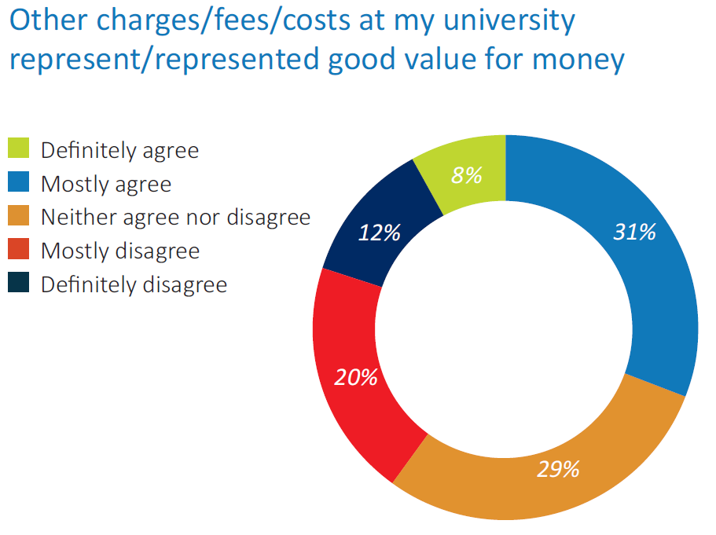
39% agreement
Notes:
Jim summarises the “other costs” question

Slide 10
What’s going on?
£9000 a year for horrific organisation and then 25p to print a sheet of paper. Really?
Accomodation has increased by 30% as of two years ago. Library fees (due to returning laptops a few minutes late) from a year ago are being chased up with monthly emails, affecting my anxiety and adding further stress. Gym is expensive Canteen food is disgusting and overpriced- no healthy options whatsoever
Notes:
Jim goes through some indicative comments

Slide 11
What’s going on?
£9000 a year for horrific organisation and then 25p to print a sheet of paper. Really?
The price for books that you "have to have" but only look at once is disgusting. The price of trips is still too much for the average student. The price of accommodation has gone up so that it is more expensive than the amount of loan that I get. That is not including food, trips, social life and anything else the university wants us to participate in.
Accomodation has increased by 30% as of two years ago. Library fees (due to returning laptops a few minutes late) from a year ago are being chased up with monthly emails, affecting my anxiety and adding further stress. Gym is expensive Canteen food is disgusting and overpriced- no healthy options whatsoever
why do we get charged an admin fee for paying our fees for the course? its a con the course fee should include all costs - this is not ryanair!
Notes:
Jim goes through some indicative comments

Slide 12
What’s going on?
£9000 a year for horrific organisation and then 25p to print a sheet of paper. Really?
The price for books that you "have to have" but only look at once is disgusting. The price of trips is still too much for the average student. The price of accommodation has gone up so that it is more expensive than the amount of loan that I get. That is not including food, trips, social life and anything else the university wants us to participate in.
I am able to access anything I need at University for a reasonable price that doesn't have a negative impact on my way of living.
Accomodation has increased by 30% as of two years ago. Library fees (due to returning laptops a few minutes late) from a year ago are being chased up with monthly emails, affecting my anxiety and adding further stress. Gym is expensive Canteen food is disgusting and overpriced- no healthy options whatsoever
A lot of costly extra's have been supplied or covered by the university where possible. Great Library service.
why do we get charged an admin fee for paying our fees for the course? its a con the course fee should include all costs - this is not ryanair!
Notes:
Jim goes through some indicative comments

Slide 13
Other charges/fees
Dissatisfaction in the comments has four themes
  Unexpected charges
  Unnecessary costs
  Perception of being “milked”
  Intersection with student hardship
Satisfaction related to
  Inclusivity of costs
  Perception of subsidy
  Perception that efforts made to keep costs down
Notes:
Jim delivers light analysis of the other charges question comments

Slide 14
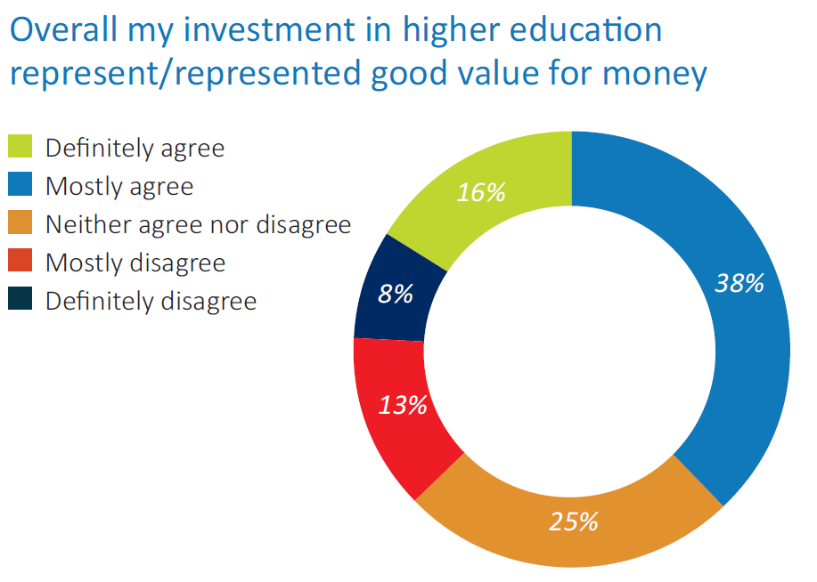
54% agreement
Notes:
Ed explains results for overall investment

Slide 15
Overall investment
I feel like I could have been doing something in these 3 years to help further my career. My 3 years of university were not exactly fruitful because although I achieved a good grade, countless employers constantly point to my lack of experience as being a reason why they can’t employ me. Even graduate jobs and schemes, which I find ridiculous.
Notes:
Ed talks through key student comments

Slide 16
Overall investment
I feel like I could have been doing something in these 3 years to help further my career. My 3 years of university were not exactly fruitful because although I achieved a good grade, countless employers constantly point to my lack of experience as being a reason why they can’t employ me. Even graduate jobs and schemes, which I find ridiculous.
My investment has gone to waste is there is no guarantee that I will make money . I am literally losing money. We need to integrate a compulsory work experience teaching program into our Universities to guarantee a good investment.
Notes:
Ed talks through key student comments

Slide 17
Overall investment
I feel like I could have been doing something in these 3 years to help further my career. My 3 years of university were not exactly fruitful because although I achieved a good grade, countless employers constantly point to my lack of experience as being a reason why they can’t employ me. Even graduate jobs and schemes, which I find ridiculous.
My investment has gone to waste is there is no guarantee that I will make money . I am literally losing money. We need to integrate a compulsory work experience teaching program into our Universities to guarantee a good investment.
I have taken on large amounts of debt at a very young age to fund my University tuition. I wish there were not such portrayals on TV/from politicians/schools who say going to University 'gets you a better job' 'gives more opportunities' - it's all rubbish.
Notes:
Ed talks through key student comments

Slide 18
Overall investment
I feel like I could have been doing something in these 3 years to help further my career. My 3 years of university were not exactly fruitful because although I achieved a good grade, countless employers constantly point to my lack of experience as being a reason why they can’t employ me. Even graduate jobs and schemes, which I find ridiculous.
I invested to increase my knowledge and skills so that I could improve my visibility to employers. One year after my graduation I got my dream job.
My investment has gone to waste is there is no guarantee that I will make money . I am literally losing money. We need to integrate a compulsory work experience teaching program into our Universities to guarantee a good investment.
From increase in my knowledge, to shifts in my perspectives and increased opportunities, the overall investment in higher education has been good.
I have taken on large amounts of debt at a very young age to fund my University tuition. I wish there were not such portrayals on TV/from politicians/schools who say going to University 'gets you a better job' 'gives more opportunities' - it's all rubbish.
Gaining skills you would get at home, other than academia you get to live away from home and develop Independence. Those skis are difficult to develop when living with family.
Notes:
Ed talks through key student comments

Slide 19
Overall investment
Dissatisfaction in the comments has three themes
  Employment prospects
  Outputs and quality
  Opportunity cost
Satisfaction is related to
  Employment prospects
  Learning Gain
  “Rite of Passge”/Adulthood
Notes:
Ed talks through light analysis of the comments on overall investment

Slide 20

VFM Perceptions
Emerging sense of similarity to Herzberg
Dissatisfaction related to outputs and quality
Can’t get to motivationals without addressing hygiene factors
Notes:
Jim junction to next part- emerging theme of hygiene and motivators

Slide 21
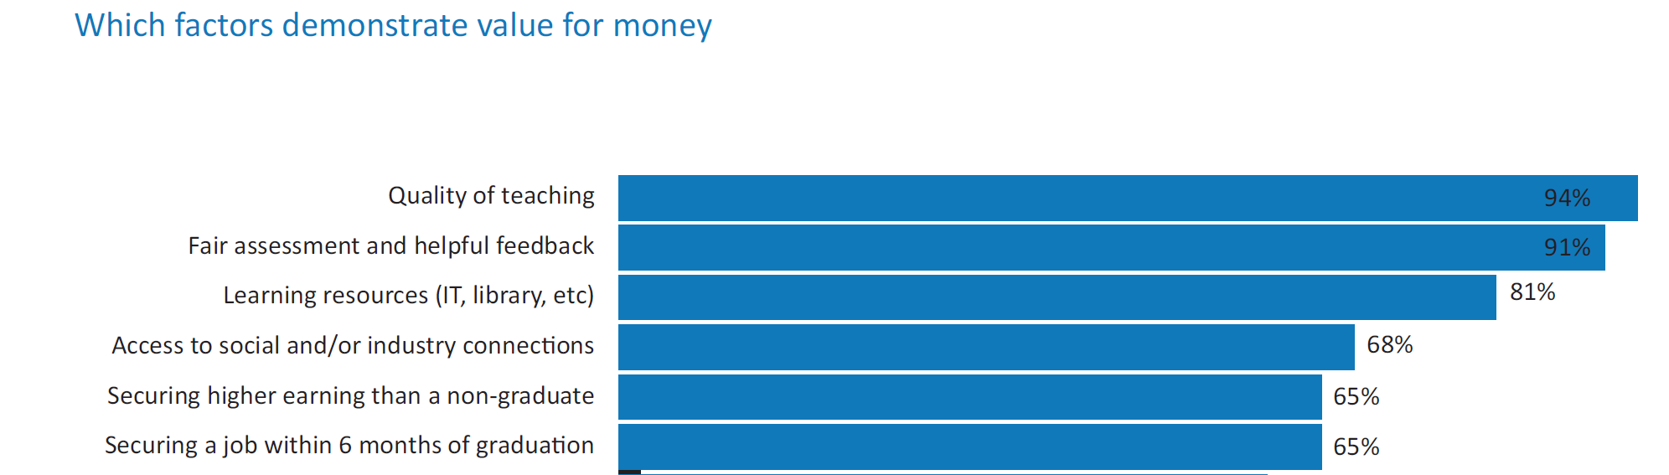
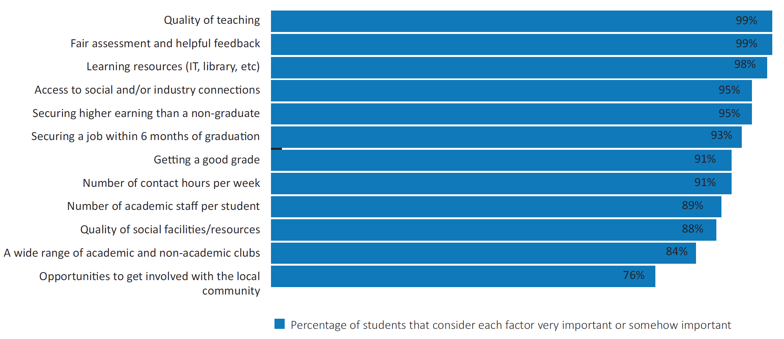
Outputs and Outcomes
Notes:
Ed- This slide looks at overall agreement- most factors are in there

Slide 22
Outputs and Outcomes
NOTE: These don’t change for applicants or for graduates
Notes:
Ed- more differentiation when you ask for very important- quality factors trump outcomes factors
Comments suggest that students believe responsibility for quality factors is a provider’s but outcomes is a shared responsibility
Also highlight that these don’t change for applicants or for graduates

Slide 23
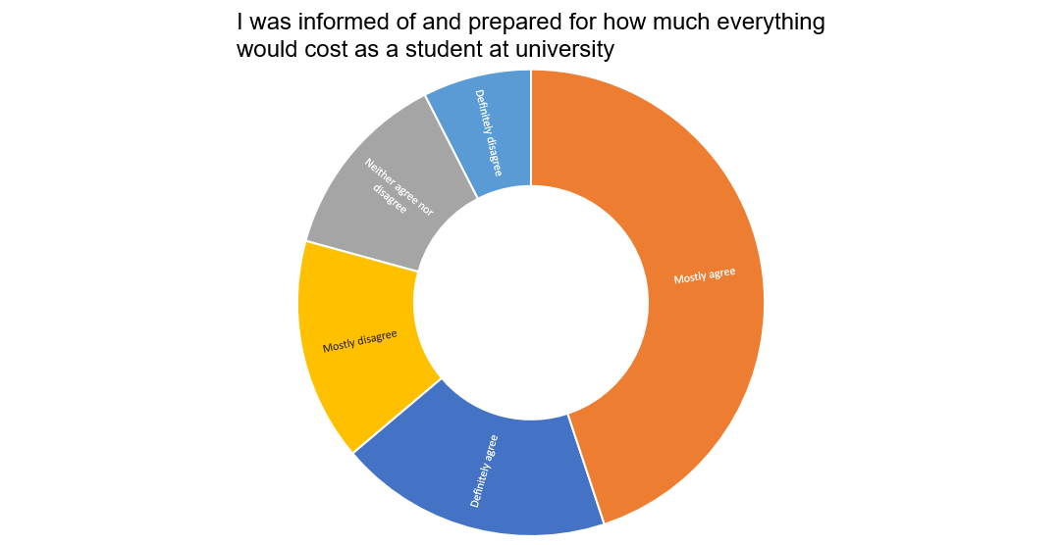
Informed about costs?
Worse for wp factors
Notes:
Jim- note that these worsen when you look at the WP factors

Slide 24
What’s going on?
I knew how much travel would cost, but the food at the university and cost of resources needed for my course are ridiculously high
Notes:
Jim talks through comments

Slide 25
What’s going on?
I knew how much travel would cost, but the food at the university and cost of resources needed for my course are ridiculously high
nobody cares enough to explain to you that if you're middle class you don't get enough money from parents nor from the government so you're stuck in the middle with a small loan and a small amount of help from parents.
Notes:
Jim talks through comments

Slide 26
What’s going on?
I knew how much travel would cost, but the food at the university and cost of resources needed for my course are ridiculously high
nobody cares enough to explain to you that if you're middle class you don't get enough money from parents nor from the government so you're stuck in the middle with a small loan and a small amount of help from parents.
The only costs explained were those for tuition. The course had additional costs for printing and binding of theses which were not mentioned. No further information was offered about living costs, travel expenses etc.
Notes:
Jim talks through comments

Slide 27
What’s going on?
I knew how much travel would cost, but the food at the university and cost of resources needed for my course are ridiculously high
At school was always told ‘everyone can afford to go to university’ however if your parents, like mine, earn just over the cut off point for loans it is actually quite unaffordable. For example I live in the cheapest accomadation on campus and my loan is short nearly £2000 a year on rent, not including food and everything else, so actually I can’t really afford to be here. There isn’t any support or warning about how expensive it all really is, and unless your parents are on very low wages you don’t get any help whatsoever despite any other circumstances
nobody cares enough to explain to you that if you're middle class you don't get enough money from parents nor from the government so you're stuck in the middle with a small loan and a small amount of help from parents.
The only costs explained were those for tuition. The course had additional costs for printing and binding of theses which were not mentioned. No further information was offered about living costs, travel expenses etc.
Did not take into consideration that professors would force us to buy their own books or we would 'fail' the course.
Notes:
Jim talks through comments

Slide 28
What’s going on?
I knew how much travel would cost, but the food at the university and cost of resources needed for my course are ridiculously high
At school was always told ‘everyone can afford to go to university’ however if your parents, like mine, earn just over the cut off point for loans it is actually quite unaffordable. For example I live in the cheapest accomadation on campus and my loan is short nearly £2000 a year on rent, not including food and everything else, so actually I can’t really afford to be here. There isn’t any support or warning about how expensive it all really is, and unless your parents are on very low wages you don’t get any help whatsoever despite any other circumstances
I looked online and made estimates of everything I needed before I enrolled to be sure that I would not run out of money at any time.
nobody cares enough to explain to you that if you're middle class you don't get enough money from parents nor from the government so you're stuck in the middle with a small loan and a small amount of help from parents.
I have been on many away days and widening participation schemes and they all told of the costs of university
The only costs explained were those for tuition. The course had additional costs for printing and binding of theses which were not mentioned. No further information was offered about living costs, travel expenses etc.
Did not take into consideration that professors would force us to buy their own books or we would 'fail' the course.
Notes:
Jim talks through comments

Slide 29
What’s going on?
I knew how much travel would cost, but the food at the university and cost of resources needed for my course are ridiculously high
At school was always told ‘everyone can afford to go to university’ however if your parents, like mine, earn just over the cut off point for loans it is actually quite unaffordable. For example I live in the cheapest accomadation on campus and my loan is short nearly £2000 a year on rent, not including food and everything else, so actually I can’t really afford to be here. There isn’t any support or warning about how expensive it all really is, and unless your parents are on very low wages you don’t get any help whatsoever despite any other circumstances
I looked online and made estimates of everything I needed before I enrolled to be sure that I would not run out of money at any time.
nobody cares enough to explain to you that if you're middle class you don't get enough money from parents nor from the government so you're stuck in the middle with a small loan and a small amount of help from parents.
Nobody told me waitrose is more expensive than lidl
I have been on many away days and widening participation schemes and they all told of the costs of university
The only costs explained were those for tuition. The course had additional costs for printing and binding of theses which were not mentioned. No further information was offered about living costs, travel expenses etc.
Did not take into consideration that professors would force us to buy their own books or we would 'fail' the course.
Notes:
Jim talks through comments

Slide 30
Costs
Dissatisfaction related to
Lack of info re participation costs
Perception that costs levied by provider are rip off
Maintenance funding not covering costs
Satisfaction related to
Clear information re direct costs
Social capital
Access to information re est participation costs
Notes:
Jim talks through summary

Slide 31
Transparency
Transparency is a key government objective, key OfS duty and a key student concern
Features heavily in SU Officer manifestos
Reg Framework suggests transparency statements
We wanted to test different approaches to transparency
Notes:
Jim summarises the transparency question

Slide 32
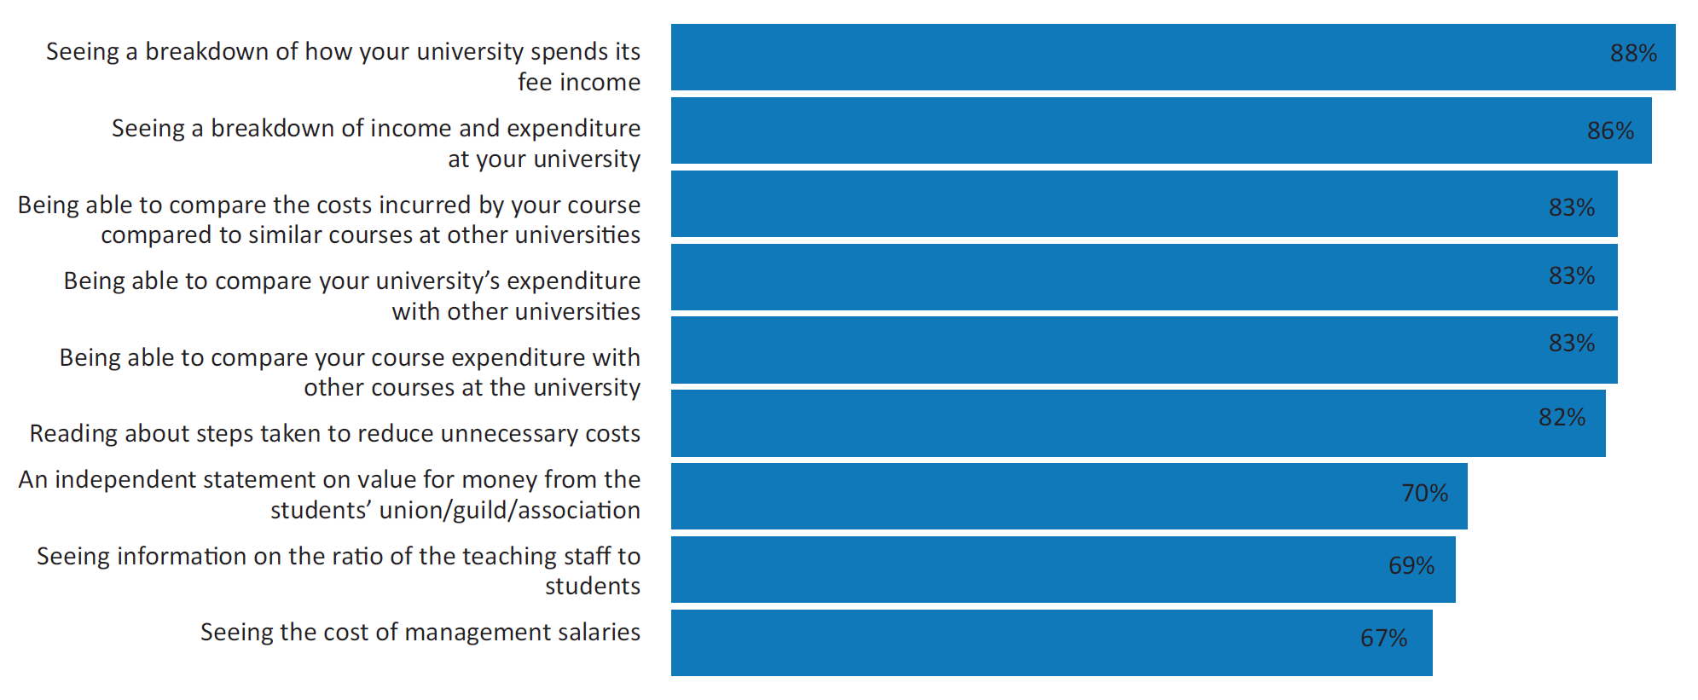
Course level is important
Comparability is key
Notes:
Jim summarises the two key factors from comments

Slide 33
So what should be done?
A monthly compulsory email sent to students on how the tututios fees/income has been spent on different areas.
ALLOW STUDENTS TO HAVE MORE OF A SAY ON INVESTMENTS - e.g. make universities consult student body on investments like new buildings/maintenance which sometimes seems unnecessary/overpriced
Notes:
Ed talks through the comments we collected from students

Slide 34
So what should be done?
A monthly compulsory email sent to students on how the tututios fees/income has been spent on different areas.
ALLOW STUDENTS TO HAVE MORE OF A SAY ON INVESTMENTS - e.g. make universities consult student body on investments like new buildings/maintenance which sometimes seems unnecessary/overpriced
I believe a minimum teaching hours and/or tutorials for courses would help. A minimum number of hours where you can see each staff member. Ensure spending from tuition fees is relevant to the courses i.e. spending is mostly spent on things that benefit the students who have paid those fees. Ensure that tuition fees do not subsidise social mobility, accommodation(for commuting students) and to some extent research.
Notes:
Ed talks through the comments we collected from students

Slide 35
So what should be done?
A monthly compulsory email sent to students on how the tututios fees/income has been spent on different areas.
ALLOW STUDENTS TO HAVE MORE OF A SAY ON INVESTMENTS - e.g. make universities consult student body on investments like new buildings/maintenance which sometimes seems unnecessary/overpriced
Appoint a Office for Students student rep at each university to be visible and report on how students feel about value for money. Put a question about value for money in the NSS
I believe a minimum teaching hours and/or tutorials for courses would help. A minimum number of hours where you can see each staff member. Ensure spending from tuition fees is relevant to the courses i.e. spending is mostly spent on things that benefit the students who have paid those fees. Ensure that tuition fees do not subsidise social mobility, accommodation(for commuting students) and to some extent research.
Publish clear, well explained information on where money is ACTUALLY spent.
Notes:
Ed talks through the comments we collected from students

Slide 36
So what should be done?
A monthly compulsory email sent to students on how the tututios fees/income has been spent on different areas.
ALLOW STUDENTS TO HAVE MORE OF A SAY ON INVESTMENTS - e.g. make universities consult student body on investments like new buildings/maintenance which sometimes seems unnecessary/overpriced
Make Universities think about the costs that they charge to students and require them to do their best to reduce them rather than charge what they can get away with
Appoint a Office for Students student rep at each university to be visible and report on how students feel about value for money. Put a question about value for money in the NSS
I believe a minimum teaching hours and/or tutorials for courses would help. A minimum number of hours where you can see each staff member. Ensure spending from tuition fees is relevant to the courses i.e. spending is mostly spent on things that benefit the students who have paid those fees. Ensure that tuition fees do not subsidise social mobility, accommodation(for commuting students) and to some extent research.
Publish clear, well explained information on where money is ACTUALLY spent.
Notes:
Ed talks through the comments we collected from students

Slide 37
So what should be done?
A monthly compulsory email sent to students on how the tututios fees/income has been spent on different areas.
ALLOW STUDENTS TO HAVE MORE OF A SAY ON INVESTMENTS - e.g. make universities consult student body on investments like new buildings/maintenance which sometimes seems unnecessary/overpriced
Make Universities think about the costs that they charge to students and require them to do their best to reduce them rather than charge what they can get away with
Appoint a Office for Students student rep at each university to be visible and report on how students feel about value for money. Put a question about value for money in the NSS
Allow students to complete an annual survey for every year they spend at university, where they are able to express their views on the course studied, the university attended, the support received and the costs incurred in their studies. The survey should be submitted to both the university involved and the higher education regulator, so that immediate actions can be taken in case the overall satisfaction of students is below average.
I believe a minimum teaching hours and/or tutorials for courses would help. A minimum number of hours where you can see each staff member. Ensure spending from tuition fees is relevant to the courses i.e. spending is mostly spent on things that benefit the students who have paid those fees. Ensure that tuition fees do not subsidise social mobility, accommodation(for commuting students) and to some extent research.
Publish clear, well explained information on where money is ACTUALLY spent.
Notes:
Ed talks through the comments we collected from students

Slide 38
Transparency
Surpluses and losses from different activities
Research and teaching
Cross-subsidies
Comparability
Notes:
Jim and Ed describe the conversations we’ve had without officers as a result of the survey findings

Slide 39
Key issues
Students are highly capable of assessing VFM of the outputs as well as the longer term value of the outcomes
There is a link between appreciating value of the former as the gateway to valuing the latter
They want to know where the money goes and we should be proactive about that
When they know where it goes, when the “stuff” works for them and when they don’t feel “overcharged” they are v positive/optimistic about the long term value
We need them to be – or 50% of YP will spend their voting years not supporting investment in HE
Notes:
Jim and Ed describe the conversations we’ve had without officers as a result of the survey findings

Slide 40
Value for Money- the student perspective
Any Questions?
Notes:
Megan takes questions

