Slide 1
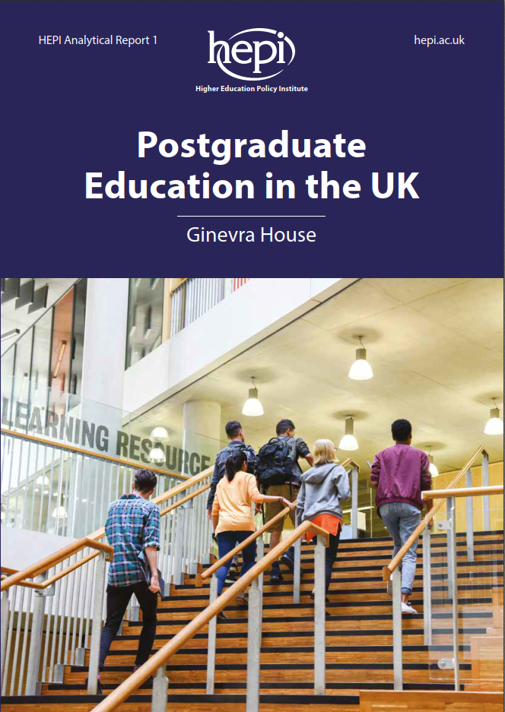
Doctoral education in the UK: an overview
by
Ginevra House
Ebor Research

Slide 2
Doctoral students at UK higher education providers
There were 356,995 first-year postgraduate students in the UK in 2017/18
29,510 of them were doctoral students
which amounts to 8% of the cohort
Data source: HESA Student Record, bespoke data request
Unless stated otherwise, all statistics in this report are from the same source

Slide 3
How have doctoral student numbers changed?
Doctoral student numbers have grown by 23% since 2008/09

Slide 4
Where are doctoral students from?
Despite strong growth from all domiciles since 2008/09, progress has not been steady. Likely factors affecting student numbers include:
Unemployment in the wake of the 2008 financial crisis
Falls and rises in the value of the pound
The UK referendum on leaving the EU
23% growth
24% growth
44% of doctoral students are international students
23% growth
Postgraduate researchers from other EU countries have declined by 9% since 2016/17, according to HESA’s 2018/19 data release.

Slide 5
What is the gender balance among doctoral students?
Doctoral students are the only postgraduate cohort in which males still outnumber females – and only just.
In fact, among UK students, the balance is an even 50-50.
In 2017/18, there were:
14,230 (48.2%) female
15,195 (51.5%) male
80 (0.3%) other
first-year doctoral students registered in UK institutions

Slide 6
How well represented are the UK’s ethnic minorities at doctoral level?
19.7% of UK 20 to 34-year-olds are estimated to be ethnic minorities or of mixed ancestry*
*ONS, based on 2011 census
18.8% of doctoral students in 2018/19 identified as an ethnic minority
3.2% of doctoral students did not answer the ethnicity question – a level of uncertainty which makes it hard to pin down levels of representation.

Slide 7
At what age do people study for doctorates?
34-35 = median age of full-time
36-37 = median age of part-time doctoral students in 2018/19

Slide 8
Has there been a change in the proportion studying full-time?
The proportion of part-time doctoral students among the UK-domiciled cohort has fallen from 29% to 23% since 2008/09.

Slide 9
What subjects are doctoral students studying?
The hard sciences remain the most popular subjects for doctoral study
STEM
Non-STEM

Slide 10
How do UK doctoral students fund their tuition fees?
At least 61% of doctoral students receive some form of funding or waiver for their fees

Slide 11
Have doctoral loans increased participation?
£25,700 = 2019/20 loan to cover
3 years’ fees and living costs
The greatest interest is from Arts and Humanities students, where funded doctorates are sparse; interest from STEM students was much lower.
Participation increased by 5.2% after loans were introduced, compared to 3.2% increase the previous year. If this was due to loans, the effect is mild, compared to the effect of Master’s loans, which resulted in a 31% increase in uptake.
Source: Mark Bennett, Understanding the Journey to Doctoral Education: Results from the 2019 FUTURE PhD STUDENT SURVEY
https://www.findauniversity.com/comment/5829/understanding-the-journey-to-doctoral-education-results-from-the-2019-future-phd-student-survey

Slide 12
Do doctoral graduates have an advantage when jobseeking?
 | Doctorate research % | Master’s taught % | First degree %
Employment (full/part-time) | 50 | 43 | 41
Study (full/part-time) | 5 | 5 | 6
Employment and further study | 1 | 3 | 5
Unemployed | 1 | 2 | 3
Other, including travel, caring for someone, volunteering, retirement | 4 | 3 | 4
Non-respondents | 38 | 44 | 42
51% of UK-domiciled doctoral students who graduated in 2017/18 were employed, compared to
41% of those graduating with a Master’s degree
Only 1% of doctoral students were unemployed, compared to
2% of those graduating with a Master’s degree and
3% of those with a first degree
Source: HESA Graduate Outcomes 2017/18 experimental statistics

Slide 13
Is there a doctoral premium in terms of salary?
84% of female and 86% of male doctoral graduates who responded to the Graduate Outcomes survey were earning over £30,000 15 months after graduation in 2017/18
For those graduating with a Master’s degree,
only 41% of females and 47% of males earn over £30,000
For those graduating with a first degree,
only 16% of females and 29% of males earn over £30,000
The male salary advantage diminishes with the level of study, which suggests higher qualifications are helping females achieve salary parity.
Source: HESA Graduate Outcomes 2017/18 experimental statistics

