Slide 1
UK Research Landscape- food for thought
Dr Lesley Thompson
L.Thompson@elsevier.com
October 2020

Slide 2
Today I will touch on
The UK’s comparative research performance
Diversity and inclusion
Collaboration between UK researchers national, international, corporate
Slides will be available after this seminar- for more information, please just ask.

Slide 3
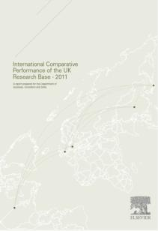


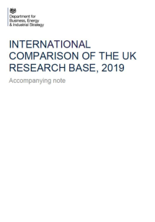
Motivation for today’s presentation
From Reports in 2011, 2013 and 2017 to data for 2019 Report

Slide 4
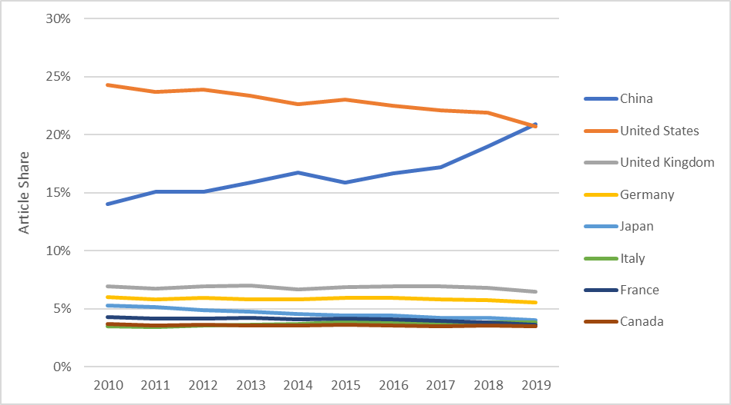
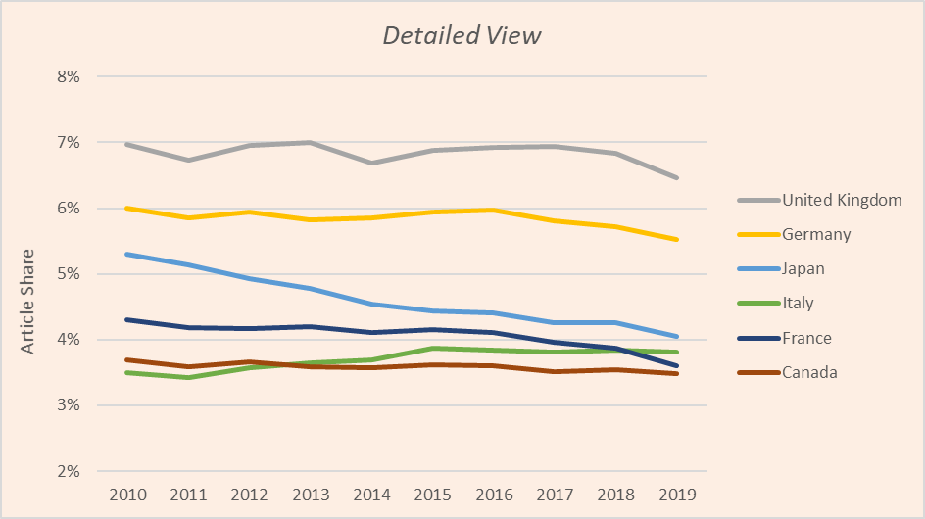
UK continues to perform well
Share of world articles for UK and comparator countries 2010-2019
Comparator countries are those used in BEIS Reports

Slide 5
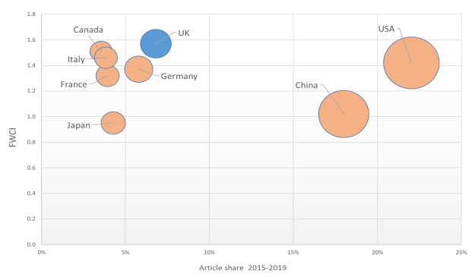
Field Weighted Citation Index-strong
United Kingdom:
Scholarly Output 1,058,264
World share 6.8%
Overall FWCI 1.57
Comparator countries are those used in BEIS Reports

Slide 6
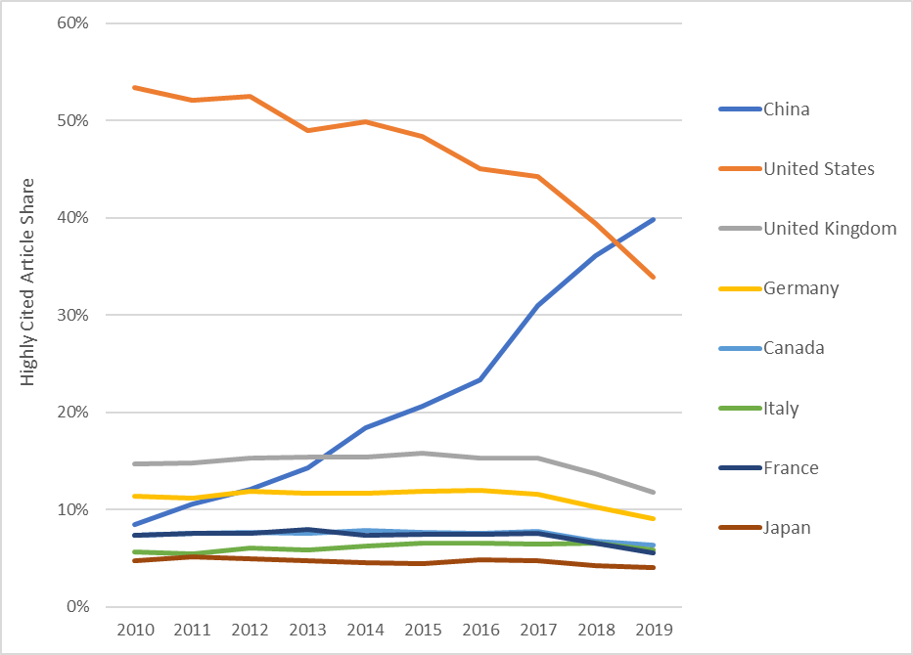
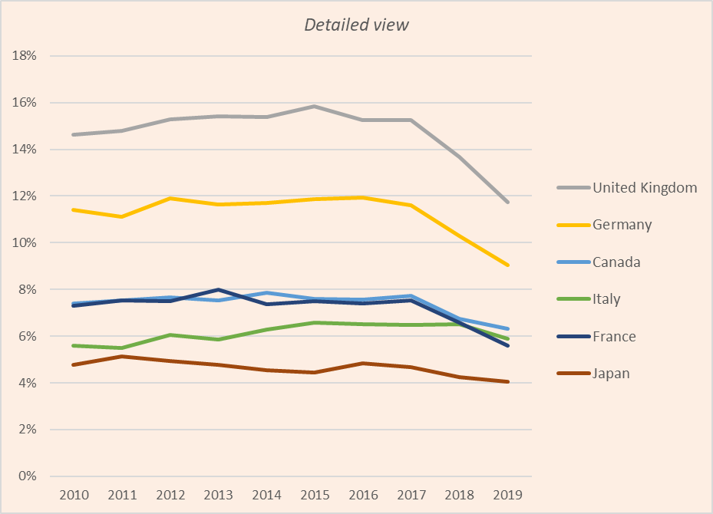
However…….
Share of world’s most highly cited articles (Top 1%) for the UK and comparator countries
13.7
Comparator countries are those used in BEIS Reports

Slide 7
Diversity and Inclusion

Slide 8

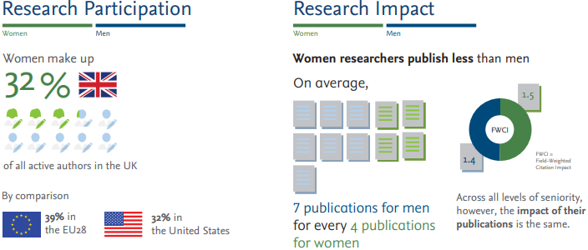
The Researcher Journey Through a Gender Lens
The Researcher Journey Through a Gender Lens
Download the full report, visit www.elsevier.com/gender-report
Notes:
For Gender, would some shots from the infographic be of interest?

Slide 9
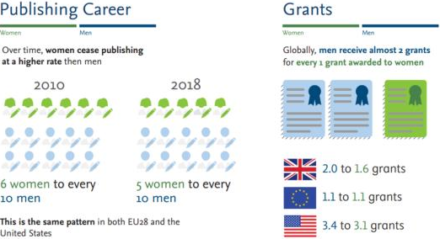
The Researcher Journey Through a Gender Lens
The Researcher Journey Through a Gender Lens
Download the full report, visit www.elsevier.com/gender-report
Notes:
For Gender, would some shots from the infographic be of interest?

Slide 10
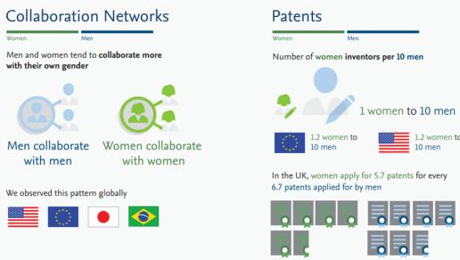
The Researcher Journey Through a Gender Lens
The Researcher Journey Through a Gender Lens
Download the full report, visit www.elsevier.com/gender-report

Slide 11
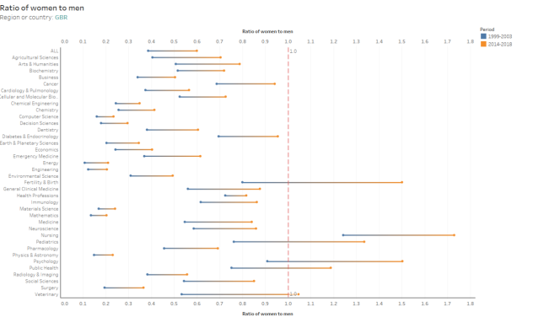

Slide 12
Some Covid-19 Observations
Time window: Feb.-May(Weeks 6-22), 2020 and the corresponding months in 2018 and 2019
Submission: Women submitted 1,960,973 manuscripts against 4,370,176 manuscripts submitted by men.​
Peer review acceptance: Women accepted to do a total of 736,368 reviews while declining 568,415 ones, with a proportion of 56.4% accepted invitations. Men accepted 2,233,801 invitations and declined 1,694,489 ones, with a similar acceptance proportion (56.9%)​
https://papers.ssrn.com/sol3/papers.cfm?abstract_id=3712813

Slide 13
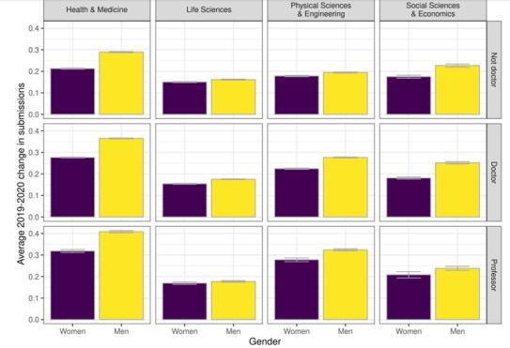
∆S (Submission difference index for each author) = The number of new submissions in February-May 2020 minus the average number of submissions for the same author in the corresponding months of
2018 and 2019. ​
Given the overall increase of submissions in 2020, for most authors ∆S ≥ 0.​
Across most research areas and seniority levels, men increased their ∆S more than women

Slide 14
All collaborations are not equal
UK author collaboration

Slide 15
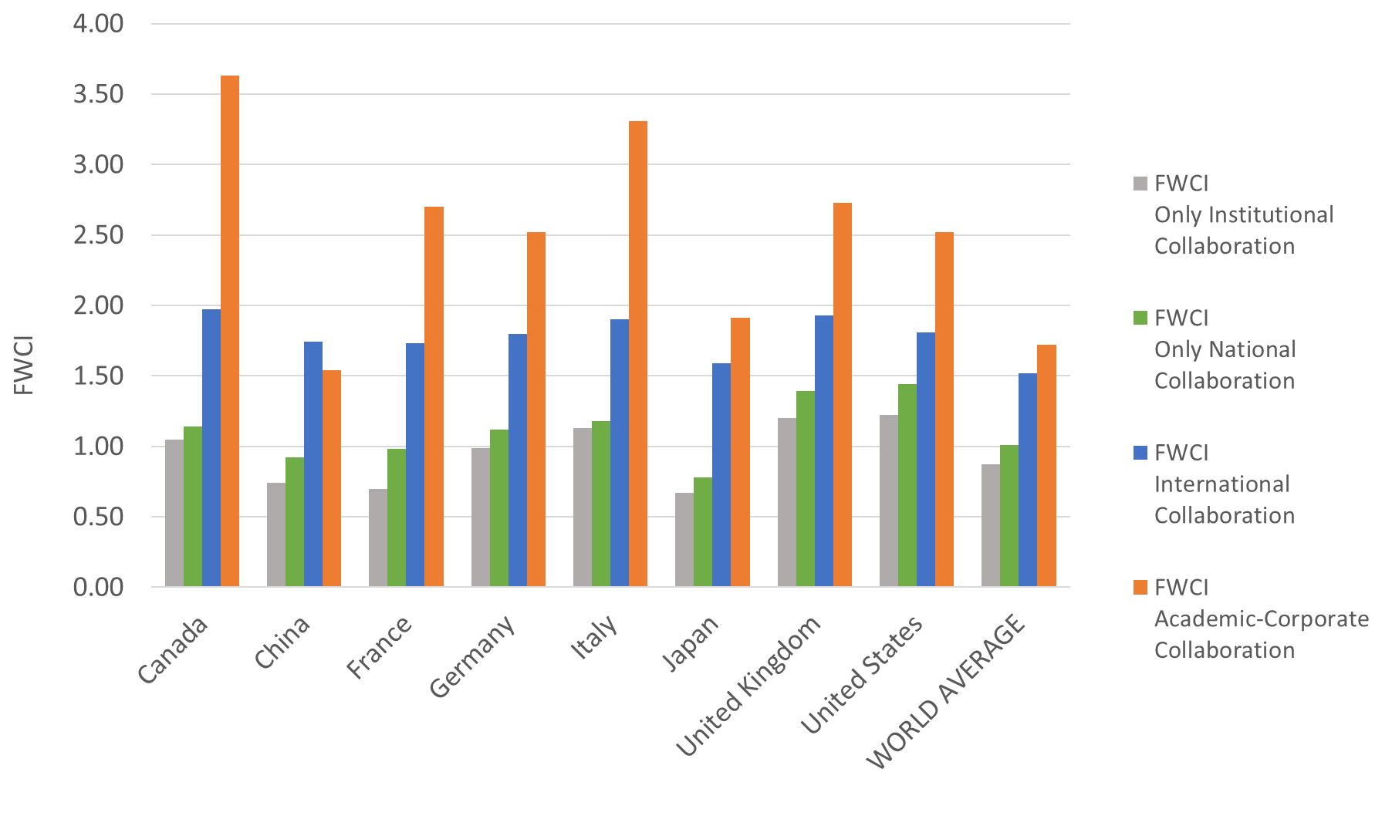
All things are not equal
Co-author type and FWCI

Slide 16
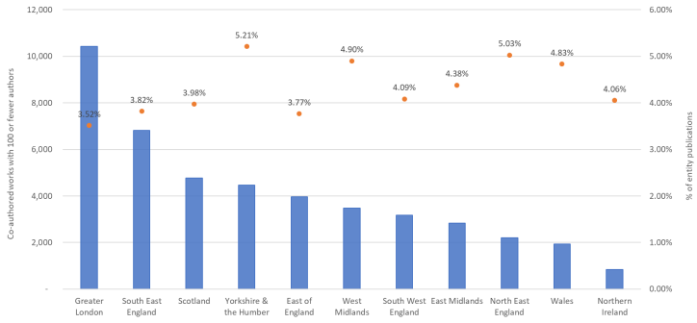
National collaboration universities in North West England 2014-2018
Works with 100 or fewer authors

Slide 17
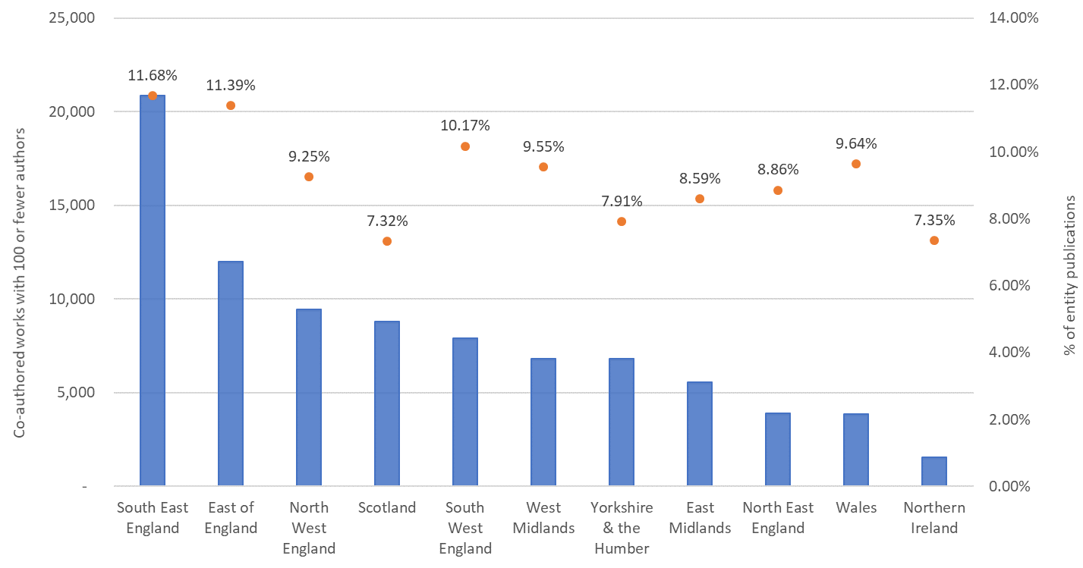
National collaboration universities in Greater
London 2014-2018
Works with 100 or fewer authors

Slide 18
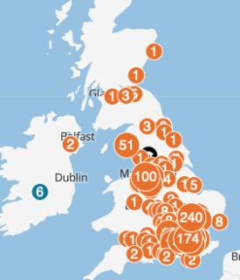
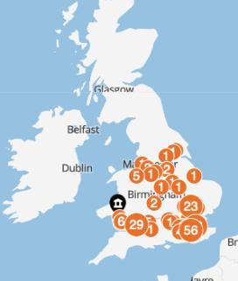
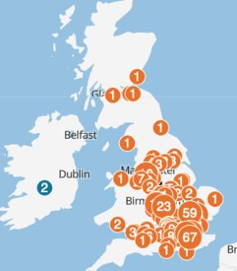
Location of UK companies co-publishing with specific universities
Manchester
Swansea
Birmingham
Manchester
Birmingham
Swansea

Slide 19
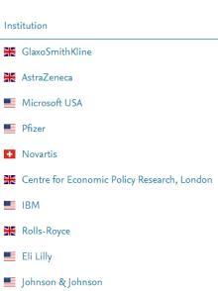


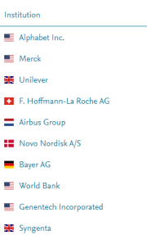

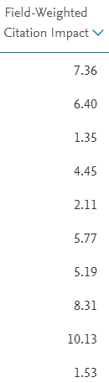
Top corporates co-authoring with UK institutions
2015-2019
5.2% of all UK papers are with academic corporate collaboration

Slide 20
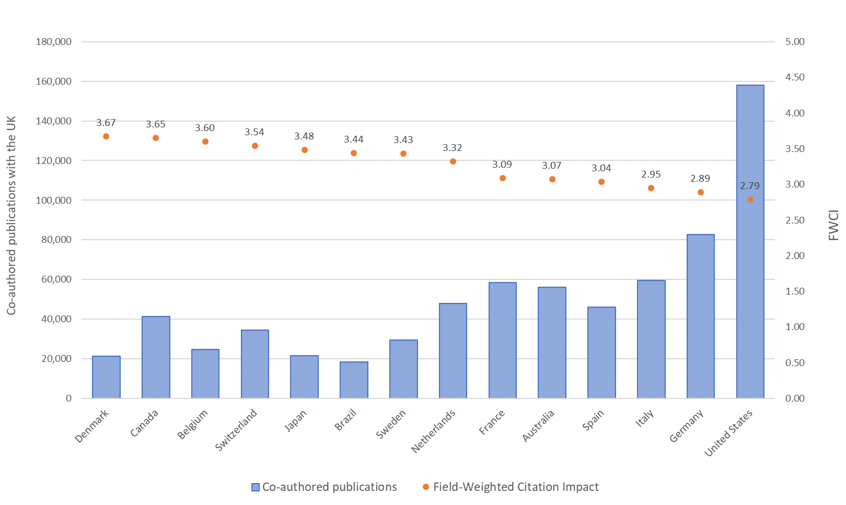
International collaboration: UK’s 15 top collaborating countries
52% of UK publications are with international collaboration

Slide 21
The UK continues to punch above its weight
All things are not equal
Diversity and inclusion- gender
Author collaborations, National, International and Corporate collaboration

Slide 22
World share of UK for key indicators
And in 2024…….?
 | 2011 Report | 2013 Report | 2016 Report | 2018
Data date | 2010 | 2012 | 2014 | 2018
Population | 0.9 | 0.9 | 0.9 | 0.9
R&D spend | 3.0 | 3.2 | 2.7 | 2.5
Researchers | 4.2 | 4.1 | 4.1 | 3.9
Highly cited articles | 14.0 | 15.9 | 15.2 | 13.7

Slide 23
Thank you for listening
L.Thompson@elsevier.com

Slide 24
Annex 1- SDG Data

Slide 25
Annex 1
United Nations Sustainable Development Goals -
UK outperform USA, Germany, France, Italy and China for those SDG’s where UK is highlighted in green
Further details available on request!
Notes:
2 slides: 1st with uk, us and china
2nd slide uk, Germany and France. Put a note saying other countries available on request

Slide 26
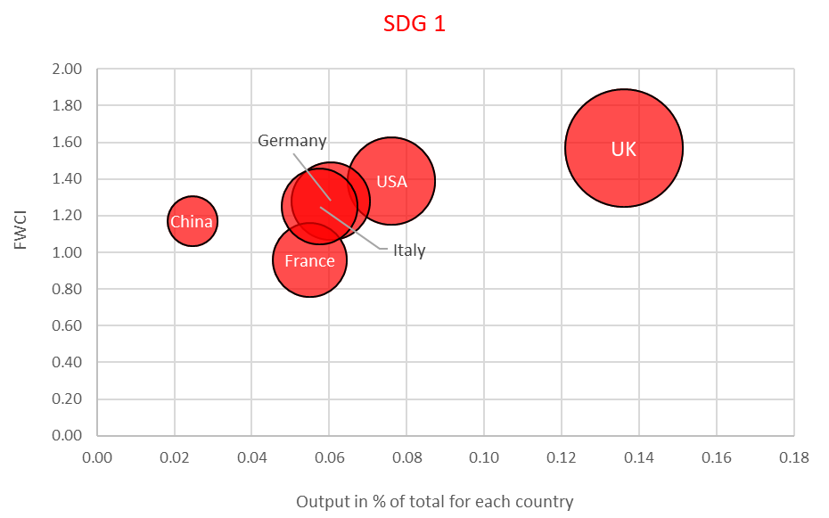

United Nations Sustainable Development Goals -For UK, USA, Germany, France, Italy and China-2015-2019
Other comparator countries are avaliable on request
Notes:
2 slides: 1st with uk, us and china
2nd slide uk, Germany and France. Put a note saying other countries available on request

Slide 27
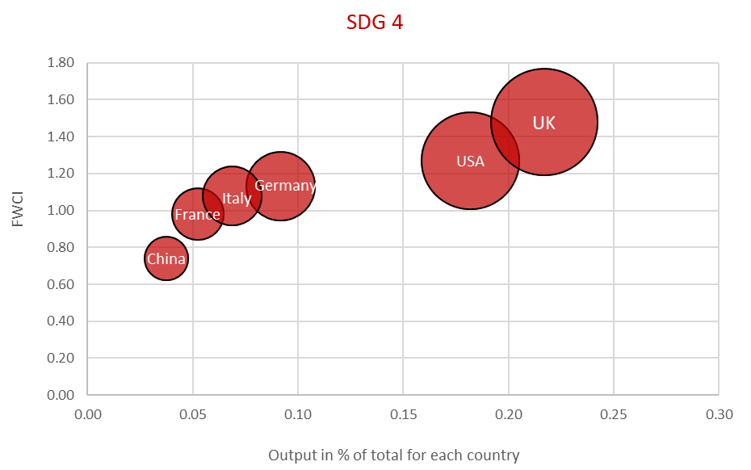

United Nations Sustainable Development Goals -For UK, USA, Germany, France, Italy and China-2015-2019
Other comparator countries are avaliable on request
Notes:
2 slides: 1st with uk, us and china
2nd slide uk, Germany and France. Put a note saying other countries available on request

Slide 28
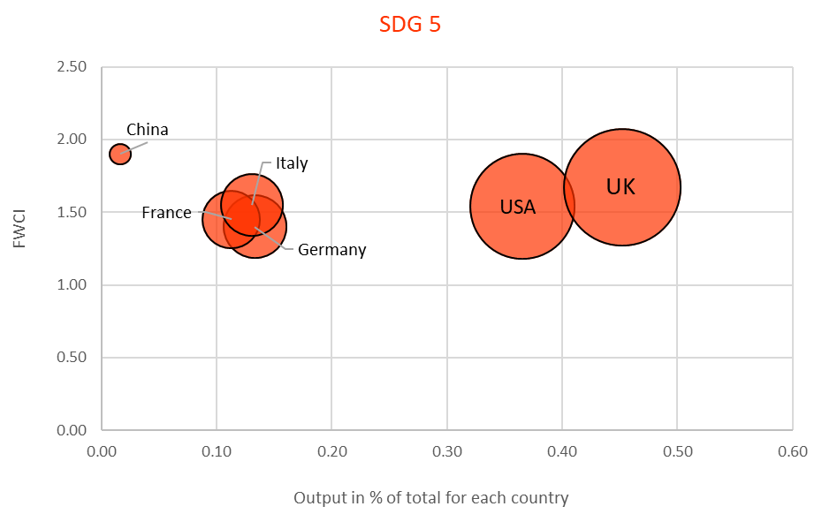

United Nations Sustainable Development Goals -For UK, USA, Germany, France, Italy and China-2015-2019
Other comparator countries are avaliable on request
Notes:
2 slides: 1st with uk, us and china
2nd slide uk, Germany and France. Put a note saying other countries available on request

Slide 29
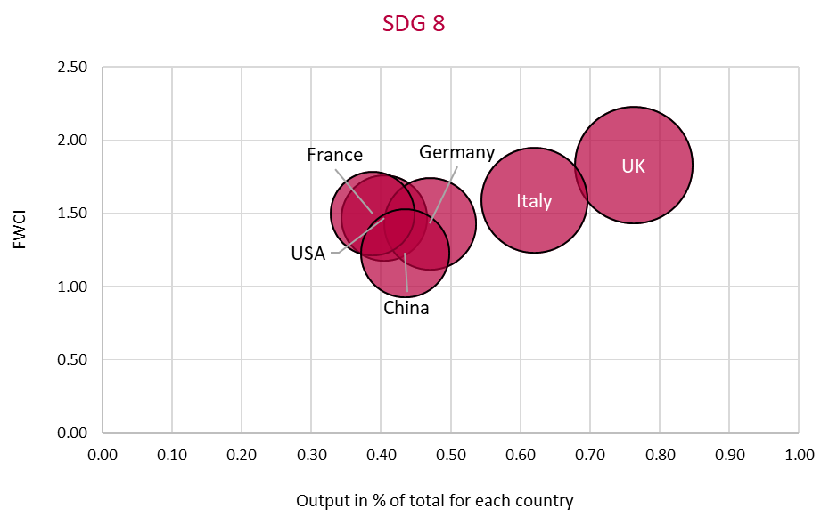

United Nations Sustainable Development Goals -For UK, USA, Germany, France, Italy and China-2015-2019
Other comparator countries are avaliable on request
Notes:
2 slides: 1st with uk, us and china
2nd slide uk, Germany and France. Put a note saying other countries available on request

Slide 30
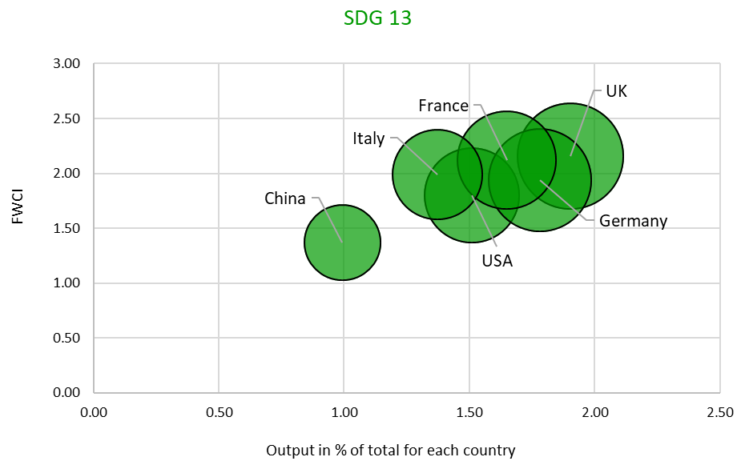

United Nations Sustainable Development Goals -For UK, USA, Germany, France, Italy and China-2015-2019
Other comparator countries are avaliable on request
Notes:
2 slides: 1st with uk, us and china
2nd slide uk, Germany and France. Put a note saying other countries available on request

Slide 31
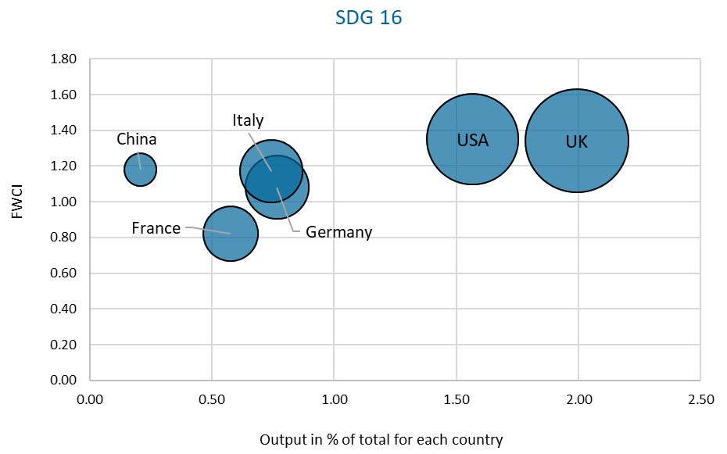

United Nations Sustainable Development Goals -For UK, USA, Germany, France, Italy and China-2015-2019
Other comparator countries are avaliable on request
Notes:
2 slides: 1st with uk, us and china
2nd slide uk, Germany and France. Put a note saying other countries available on request

