Slide 1


Who Pays? Exploring Fairer Funding Models for Higher Education
Making graduate employer contributions work
for everyone
Johnny Rich
Chief Executive, Engineering Professors’ Council | Chief Executive, Push

Slide 2
What if…?
Abolish fees
Adequate and sustainable funding for high-quality HE
A HE sector that meets skills needs for society, for the economy and for employers
Balance employer needs with student ambitions and choice
Progressive repayments for maintenance costs
Reduce repayments from graduates/employer from 9% to 6%
Funding to support fair access for those institutions best at delivering it
De-politicise HE funding
Save taxpayers over £8Bn a year

Slide 3
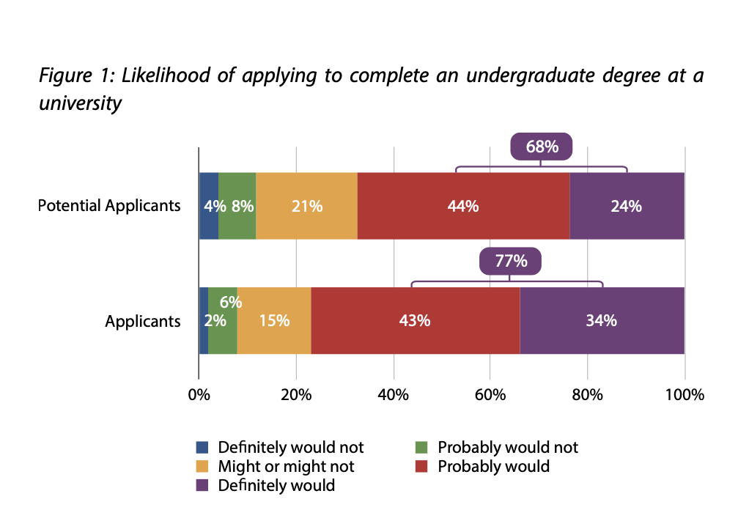
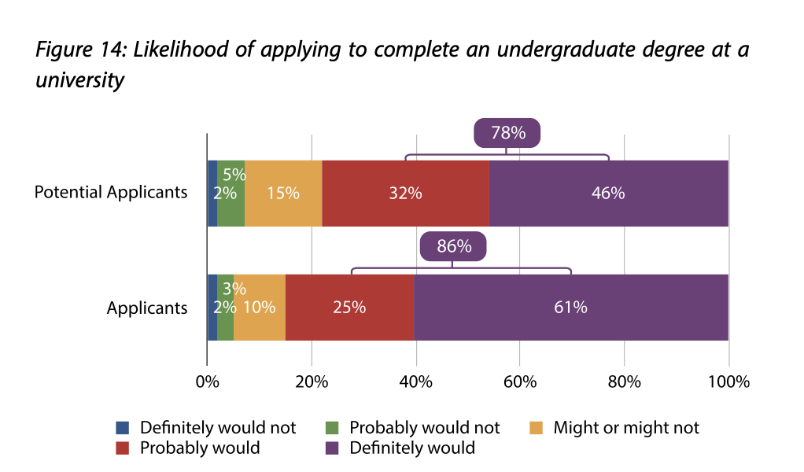
What if this were popular?
Baseline scenario
Graduate Employer Contributions
From: How should undergraduate degrees be funded? A collection of essays, ed R Stephenson, HEPI April 2024

Slide 4
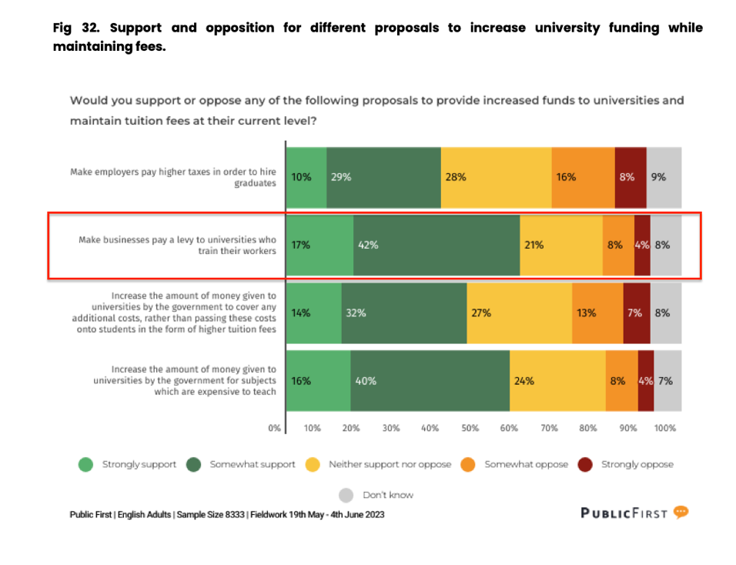
What if this were popular?
59% of the public would support an employer levy – the most popular option polled
Public First survey, 2023

Slide 5
How would it work?
1
Abolish tuition fees
Students can still access maintenance loans

Slide 6
How would it work?
2
Employer contributions
Move tuition payments from the employee side to employer side
3% from graduate for maintenance loan repayment
3% from employer for HE costs
3% saved

Slide 7
Employer contributions
Currently
Graduate earns £30k
Pays 9% over £25k: £450
Graduate gets £29,550*
Employer pays £0
Costs employer £30k*
Employer contributions
Graduate earns £30k
Pays 3% over £25k: £150
Graduate gets £29,850*
Employer pays £150
Costs employer £30,150*
* Before tax & NICs

Slide 8
Employer contributions
Currently
Graduate earns £30k
Pays 9% over £25k: £450
Graduate gets £29,550*
Employer pays £0
Costs employer £30k*
Employer contributions
Graduate earns £30k
Pays 3% over £25k: £150
Graduate gets £29,850*
Employer pays £150
Costs employer £30,150*
Graduate earns £29,800k
Pays 3% over £25k: £147
Graduate gets £29,653*
Employer pays £147
Costs employer £29,947*
* Before tax & NICs

Slide 9
How would it work?
3
Contributions go to
the graduate’s HE institution
Giving universities a stake
in the future employability of their students

Slide 10
How would it work?
4
National Access Fund
HEIs that underperform on access pay in
HEIs that exceed benchmarks draw down
Redistributes and encourages fair access and diversity

Slide 11
How would it work?
5
Government lends to HEIs not students
(on similar terms as current tuition loans)
Manages transition to self-sufficiency
Attractive to government under new PSNFL rules

Slide 12
Economic modelling
Saves Exchequer over £8Bn per cohort*
Comes from employers of rich graduates after 30 years
Minus the cost of lending to HEIs
Allows better maintenance support
Allows us to solve funding crisis
Funding to address skills shortages
More with less
* London Economics modelling for HEPI

Slide 13
Aligning interests
Students
‘The Triangle of Sadness’
‘The Rhombus of Regret’
Universities
Taxpayers
UK universities: from a Triangle of Sadness to a Brighter Future, S. Kapur, King’s Policy Institute, 2023
Employers

Slide 14
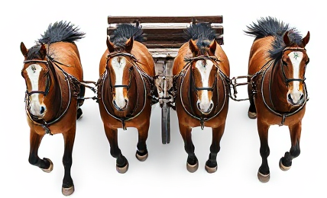
The four horses of happiness

