Slide 1
Education at a Glance 2025
United Kingdom
Andreas Schleicher
9 September 2025

Slide 2
Education pays

Slide 3

Unemployment for tertiary graduates is low
Unemployment rates of tertiary-educated adults, by field of study (2024)

Slide 4
Tertiary qualifications pay higher earnings
Relative earnings of tertiary-educated workers, by level of educational attainment (2023)

Slide 5
Doctorates provide an additional boost to earnings
Relative earnings of doctorates holders (2023)
Ratio of the average gross annual earnings of employed doctorate holders to those of employed master’s degree holders

Slide 6
Tertiary attainment in the UK is high and keeps rising
Trends in the share of 25-34 year-olds with tertiary attainment (2019 and 2024)

Slide 7
The share of young adults with master’s attainment keeps increasing
Trends in the share of 25-34 year-olds with a master's or equivalent degree (2019 and 2024)

Slide 8
Stable earnings advantage of young adults in the U.K.
Relative earnings of young adults (2015 – 2023)
25-34 year-olds; full-time full-year workers; earnings of adults with upper secondary attainment = 100

Slide 9
Fields of study have strong effects on earnings
Relative earnings of tertiary-educated adults, by field of study (2023)

Slide 10
Educational attainment and health are closely correlated
Share of adults who reported being in excellent or very good health in the previous week (2021 or 2023)
Survey of Adult Skills (PIAAC)
National Surveys

Slide 11
12% of young adults do not have an upper secondary qualification
Distribution of educational attainment among 25-34 year-olds (2024)

Slide 12
Adults without upper secondary attainment are at high risk of dropping out of the labour force
Shares of 25-34 year-olds outside the labour force, by educational attainment (2024)
Notes:
% in parentheses is the % of 25-34 year-olds without an upper secondary qualification

Slide 13
Relative earning for young adults with below upper secondary attainment are very low and declining
Relative earnings of young adults, by level of educational attainment (2023)
Earnings of adults with upper secondary attainment = 100; 25-34 year-olds

Slide 14
NEET rates among young men have been increasing
Trends in the share of 18-24 year-old NEET men (2019 and 2024)

Slide 15
Who pays for tertiary education?

Slide 16

Split between public and private funding in tertiary education
Trends in the share of expenditure coming from government sources in bachelor’s, master’s and doctoral or equivalent programmes (2015 and 2022)

Slide 17
High tuition fees for master’s programmes
Annual average tuition fees charged to national students for master's or equivalent programmes, by type of institution (2022/23)

Slide 18
Countries with higher tuition fees often provide more financial support
Annual average tuition fees charged by public institutions to national students enrolled in bachelor's programmes and share of national students benefiting from direct public financial support (2022/23)

Slide 19
Expenditure per student is high in the UK, especially at tertiary level
Total expenditure per full-time equivalent student (including R&D), tertiary level (2022)
USD converted
using PPPs
60,979
Notes:
While the returns are good, the costs are also high
In the US this is particularly true at the college level, where the US ranks second in spending per student after Luxembourg.

Slide 20
Equality of educational opportunity

Slide 21
Access to tertiary education is more equitable in the UK than elsewhere
Share of 25-34 year-olds with tertiary education, by parental educational attainment (2023)
Notes:
The % in parentheses represents the share of tertiary educated parents.

Slide 22
Completion of tertiary programmes

Slide 23
Comparatively good completion rates
Completion rates of new entrants to bachelor's programmes, by timeframe (2023)

Slide 24
International student mobility

Slide 25
International student mobility continues to increase almost everywhere
Trends in the share of international or foreign students in tertiary education (2013, 2018 and 2023)

Slide 26
Strong inflow from Asia
Distribution of international or foreign students studying in OECD countries, by region of origin (2023)

Slide 27
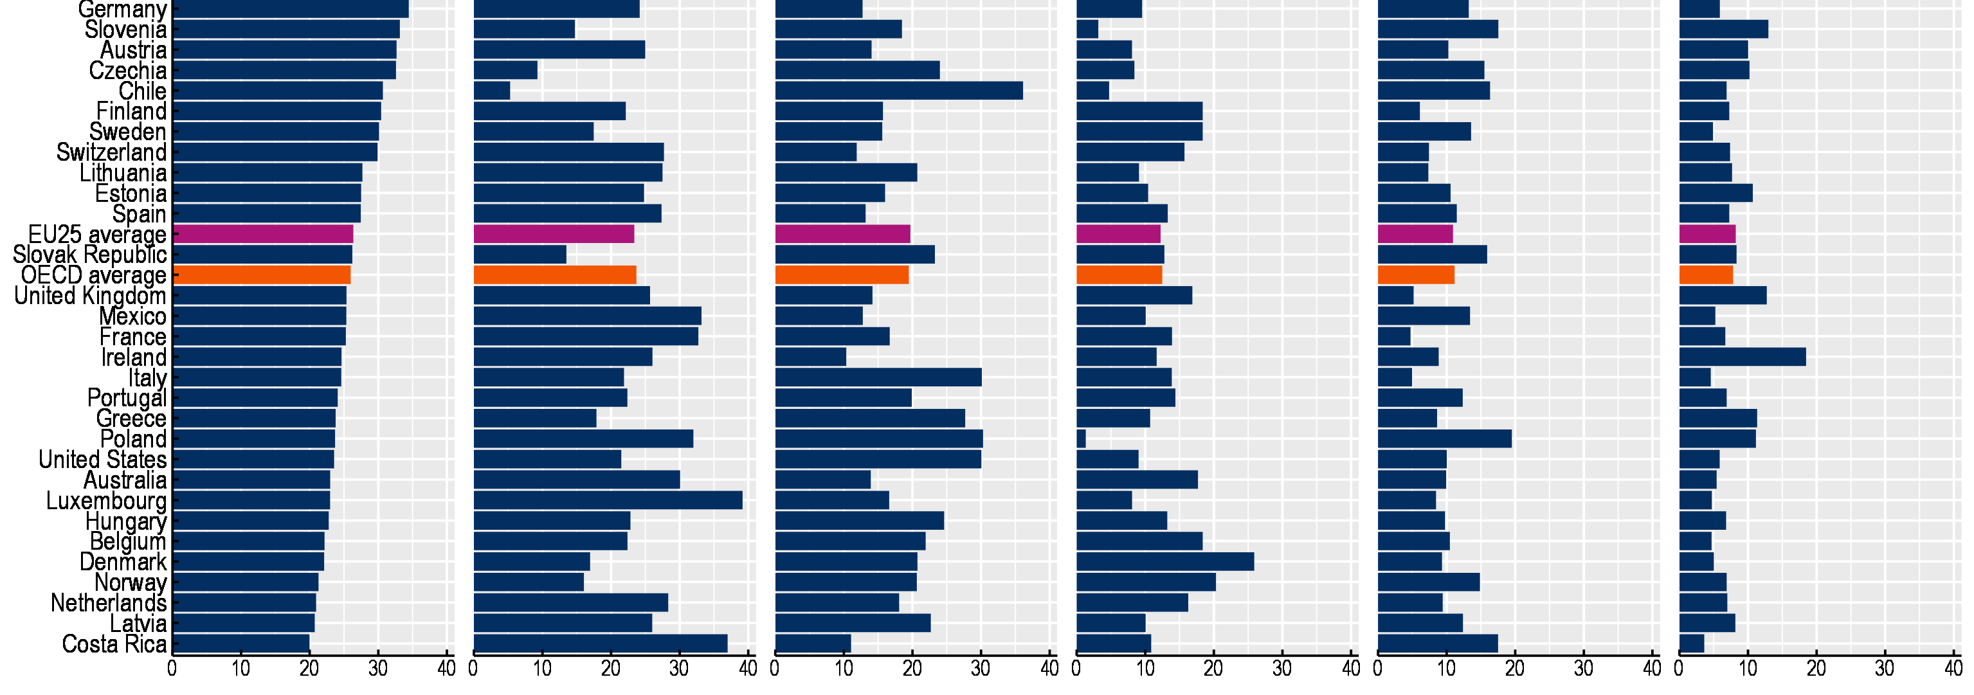
The share of STEM students varies across countries
Field of study among 25-64 year old tertiary-educated adults (2024)
Science, technology, engineering and mathematics (STEM)
Arts and humanities (except languages), social sciences, journalism and information
Business, administration and law
Health and welfare
Education
Other fields

Slide 28
Degrees and skills are not the same

Slide 29
A large share of adults has low literacy skills
Proficiency in literacy among adults (2023)

Slide 30
Skill levels have been declining among adults with low attainment
Trends in adults' mean literacy proficiency, by educational attainment (2012 and 2023)

Slide 31
The skills value of qualifications varies across countries
Adults’ mean literacy proficiency, by educational attainment (2023)

Slide 32
Participation in lifelong learning

Slide 33
Those who need lifelong learning most get the least of it
Participation in education and training, by literacy proficiency level (2023)

Slide 34
Patterns of lifelong learning
Average participation in education and training, by survey, gender, age group, educational attainment and labour force status

Slide 35
Work-based learning

Slide 36
School and work-based VET programmes
Trends in the share of upper secondary vocational students enrolled in combined school- and work-based programmes (2013 and 2023)

Slide 37
Early childhood education and care (ECEC)

Slide 38
Progress in enrolment in the early years
Trends in enrolment rates of 3-5 year-olds in early childhood education (ISCED 0) (2013 and 2023)

Slide 39
Low spending per child in pre-primary education
Government and private expenditure per child in pre-primary education (2022)
USD converted using PPPs

Slide 40
More staff but fewer teachers in the early years
Trends in the ratio of children to staff in pre-primary education (2013 and 2023)

Slide 41
Investment into education

Slide 42
In some countries, education is one of the most important items of government expenditure
Distribution of government expenditure by function (2023)

Slide 43
A high share of GDP invested into education
Expenditure on educational institutions as a percentage of GDP, by level of education (2022)
Notes:
Norway, the UK and Israel invest more than 6% of their GDP in compulsory education, and if you add early childhood expenditure that adds up to over 8% in Norway.

Slide 44
Trends in expenditure per student depend on changes in student numbers and in expenditure
Change in the number of students, expenditure on primary to post-secondary non-tertiary educational institutions and expenditure per student (2015 to 2022)
%

Slide 45
Class size and student/staff ratios

Slide 46
Class sizes in primary education
Trends in average class sizes in primary education (2013 and 2023)

Slide 47

Smaller classes or better teachers in secondary eucation?
More students per teacher
More students per class
Notes:
We can unpack that pattern.
Japan and the US hire a roughly equal number of teachers for every 100 student, as shown on the vertical axis, the student staff ratio is quite similar. But class sizes in the US are small, while they are large in Japan. So why would Japan have large classes when they have as good a teacher supply as the US? The answer is that the Japanese use the time of teachers in very different ways.

Slide 48
Teacher salaries

Slide 49
In most OECD countries, teacher salaries are lower than the average salaries of tertiary-educated workers
Actual salaries of primary teachers relative to earnings of tertiary-educated workers (2024)

Slide 50
Minimum and maximum statutory teacher salaries
Primary teachers’ average actual salaries compared to the statutory minimum and maximum salaries (2024)

Slide 51
Salary progression of teachers
Statutory salaries of teachers and school heads at primary level (2024)

Slide 52
Most senior academic staff earn more than other tertiary-educated workers
Average actual academic staff salaries relative to earnings of tertiary-educated workers, by seniority (2023)

Slide 53
Teacher shortages

Slide 54
Share of non-fully qualified teachers
Share of non-fully qualified teachers, by level of education (2022/23)

Slide 55
The number of unfilled teacher vacancies remains moderate in most countries
Vacancies not filled by fully-qualified teachers at the start of the school year as a percentage of the total number of teaching positions (whether filled by fully qualified teachers or not), 2022/23

Slide 56
Turnover among teachers is high in the UK, with close to 10% of all teachers leaving the profession annually
Share of fully qualified teachers who left the profession by resigning or retiring in pre-primary, primary and secondary education (2022/23)

Slide 57
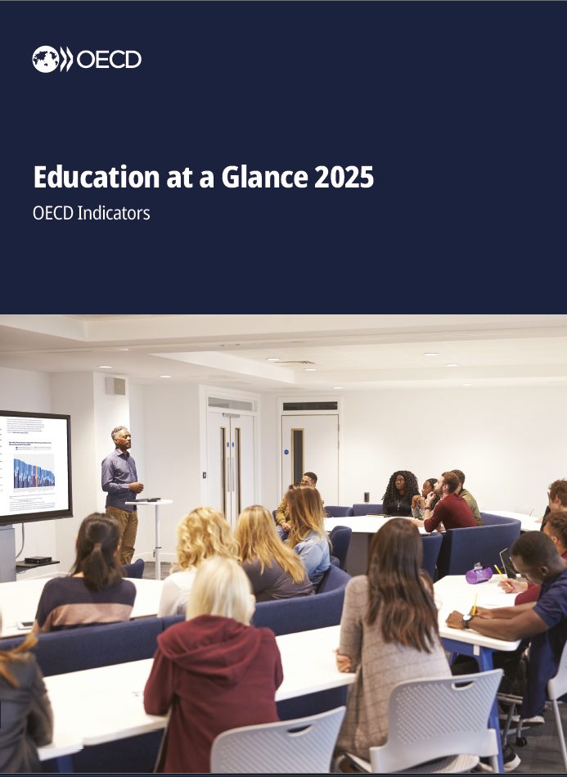
Download Education at a Glance 2025
https://www.oecd.org/en/publications/education-at-a-glance-2025_1c0d9c79-en.html

Slide 58
Thank you

